Slide 1

INSPIRE Harmonized Data set, their impact on Indicators and viable solutions
Davide Artasensi, Marco Minghini, Alexander Kotsev
65th MIG-T meeting – April 15/16, 2021

Slide 2
Issue raised from M&R 2020
The latest M&R 2020 highlighted a critical situation where the approach followed by some Member State generates a negative side-effect on some indicators
Their catalogue is composed of “duplicated” MD definitions for the same data set:
  one dedicated to the “as-is” data set
  if available, one for the INSPIRE harmonized data set
This approach leads to a negative impact on the calculation of the indicators (in particular, the DSi family)
Three viable options are available to tackle this issue
Notes:
Central INSPIRE components are essential for the implementation and evolution of the INSPIRE infrastructure and their long-term sustainability should be ensured, also considering the emerging political priorities (Green Deal data space and GreenData4all in particular)
Scope: do we want to do less than what we are currently doing, or more? Is the tool supposed to have active development (new features) or only maintenance?
Hosting: where do we want the tool to be hosted: JRC servers, Commission cloud, third-party cloud, etc
Governance approach: who will be involved in the governance of the tool?
Helpdesk management: where to host it? Which technology to use?

Slide 3
Solution (1) - key points
One data set => one metadata in the national CSW, aggregating different distribution formats (i.e. in one MD, "as-is" and INSPIRE harmonized)
In the dataset MD (by no means an exhaustive list):
  Abstract and Lineage, as Free Text elements, shall be sufficient to present the rationale on the origin of data together with the process of harmonized transformation
  Conformity declaration (with multiplicity 1..n) shall present the assessment on the INSPIRE specification, based on the effective presence of the harmonized among all the available distribution formats
On the SDS side, all the involved Coupled Resources (i.e. “ogc:metadataURL” elements) will point to the same unique MD definition
From an INSPIRE user PoV, up to the final user to pick the preferred one ("as-is" | harmonized) among the collection of available distribution formats
From the M&R PoV, no changes or issues on the current calculation approach, thanks to the unique definition

Slide 4

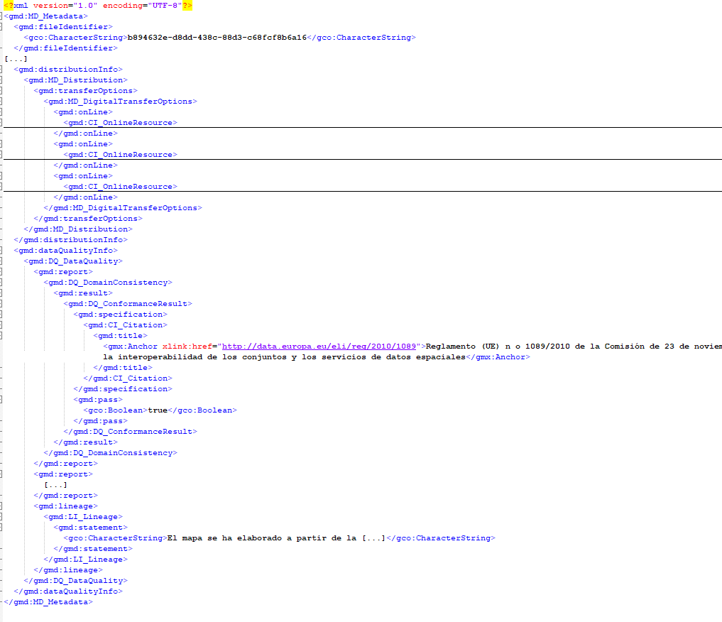


Solution (1) - example
One MD definition, containing "as-is" data as well as "harmonized" data
INSPIRE View Service(s)
MIWP 2.3.2
Resource Locator(s)
gmd:onLine/../gmd:linkage
Generic Download Service(s) with original "as-is" data
Coupled Resources
ogc:metadataURL
INSPIRE Download Service(s) with harmonized data (opt. with "as-is" data)

Slide 5
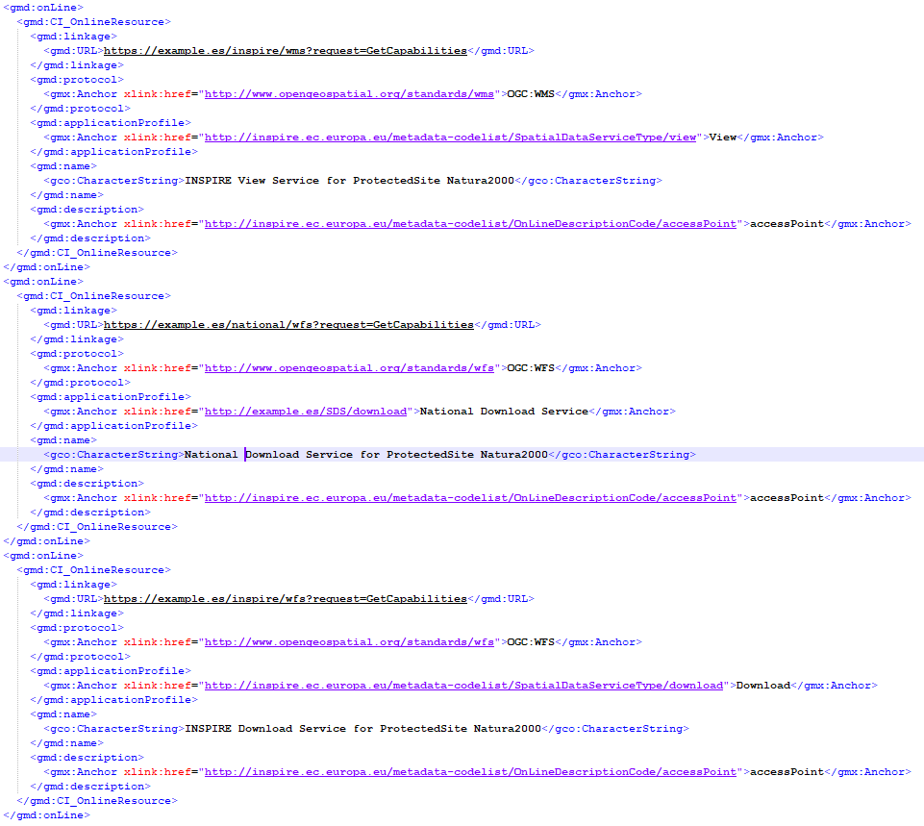
Solution (1) - example
From MIWP 2.3.2 Simplification of INSPIRE implementation (still TBD)
INSPIRE View Service
Generic Download Service (not INSPIRE conformant)
INSPIRE Download Service (with harmonized data set as distribution format)

Slide 6
Solution (2) - key points
One dataset => two metadata in the national CSW, each one dedicated to a specific distribution format of the data (for each, "as-is" or INSPIRE harmonized)
In the “harmonized” MD, the Conformity will clearly state the status of the expressed dataset. In the “as-is” MD, it’s up to the catalogue curator (no explicit requirement, since it could also be entirely no INSPIRE related)
From an INSPIRE user PoV, a clear distinction of the expected distribution format
From the M&R PoV:
  currently unrealistic that, “randomly” picking n MDs, to precisely identify their correlation on a same dataset, in order to aggregate them and count as one
  therefore, an agreement for the distinction (through a specific keyword, or a combination of elements) should be defined, together with reviewing, if needed, the legal definition [1], and of course the calculation workflow and algorithms
[1] https://eur-lex.europa.eu/legal-content/EN/TXT/?uri=uriserv:OJ.L_.2019.220.01.0001.01.ENG

Slide 7
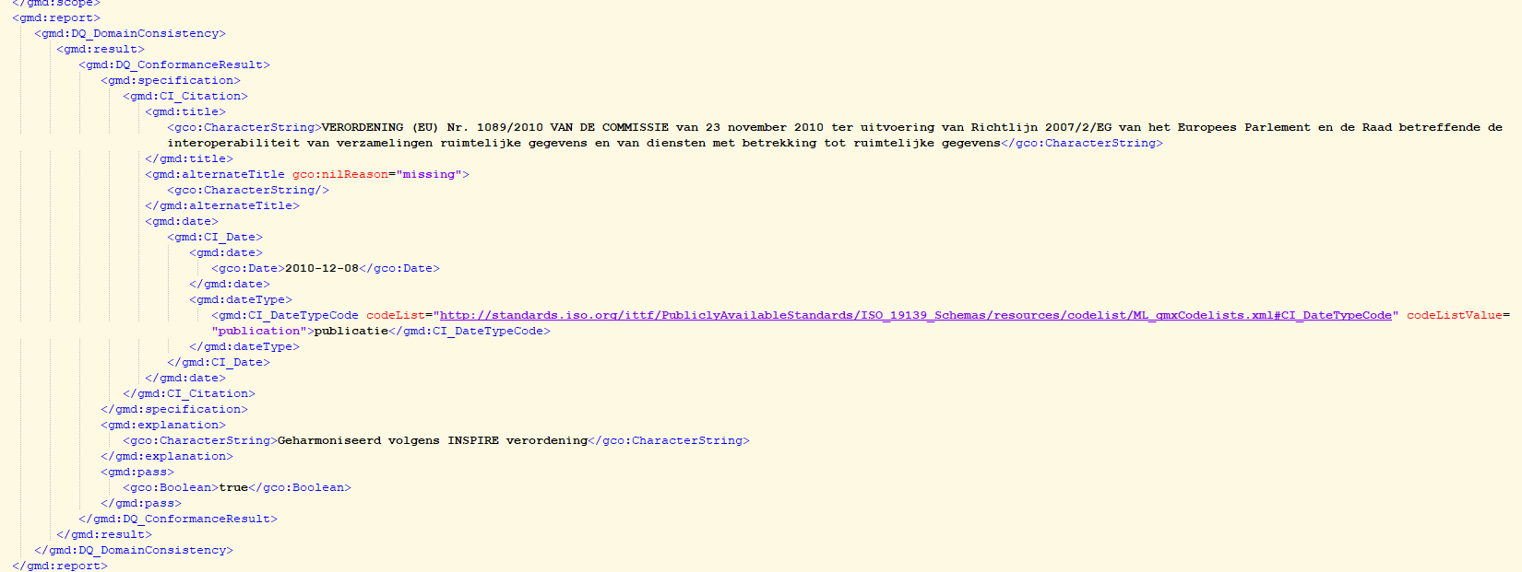
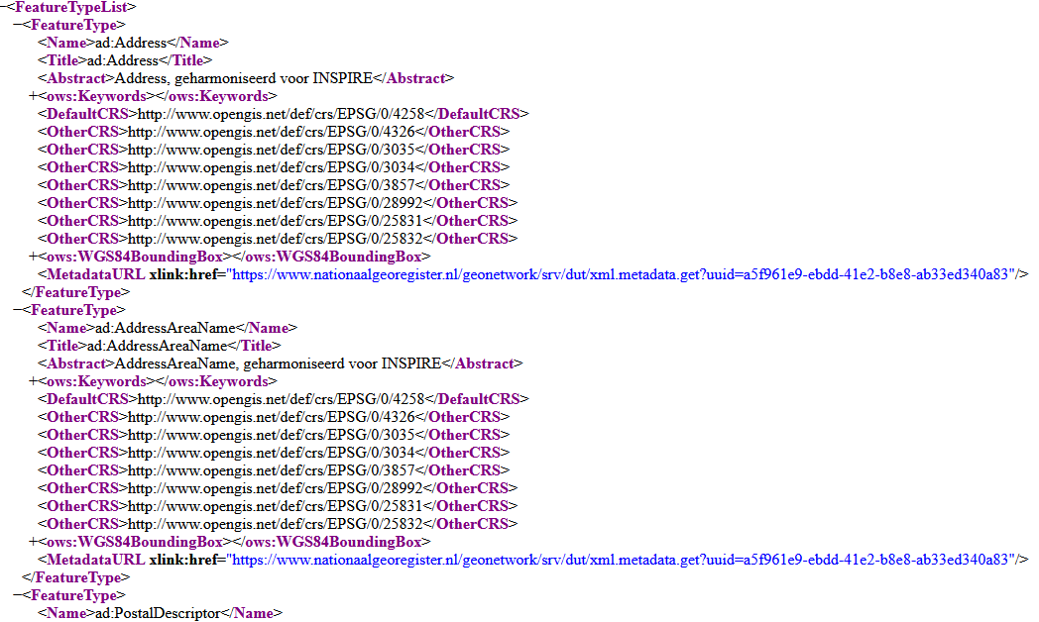
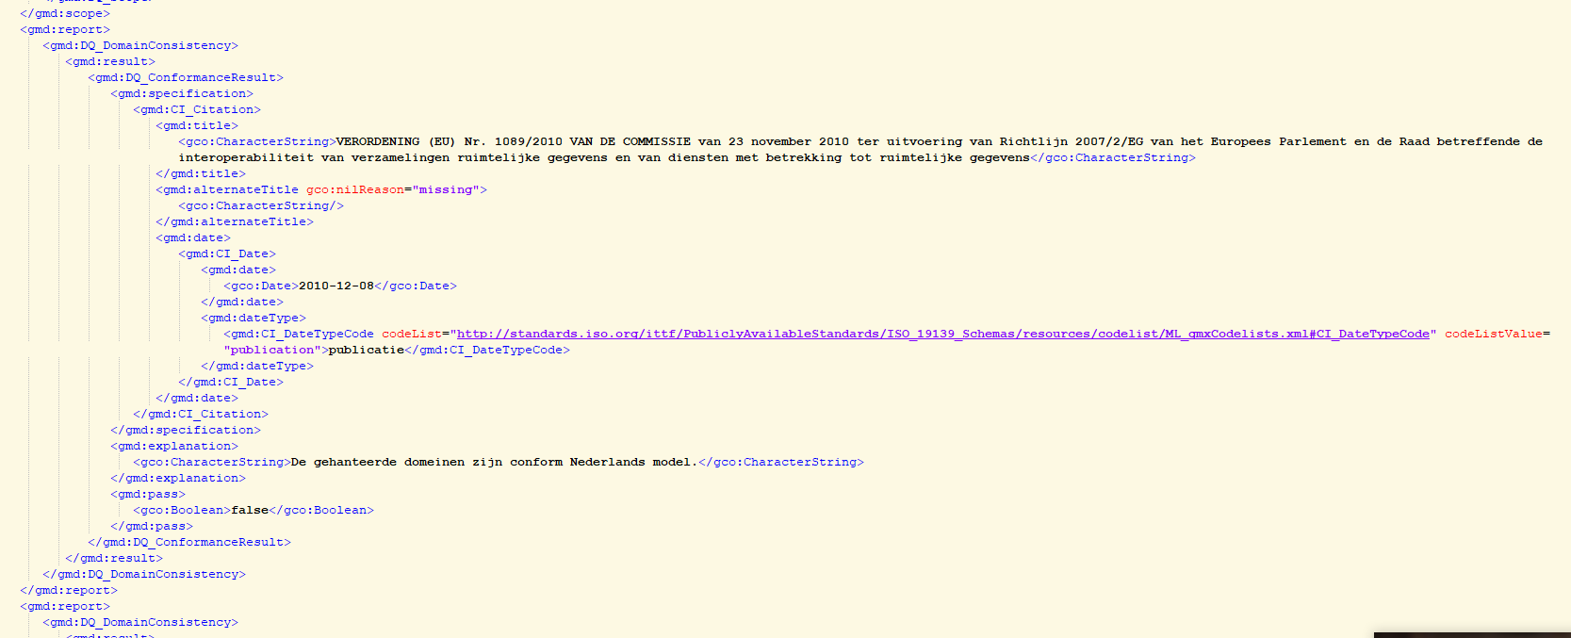
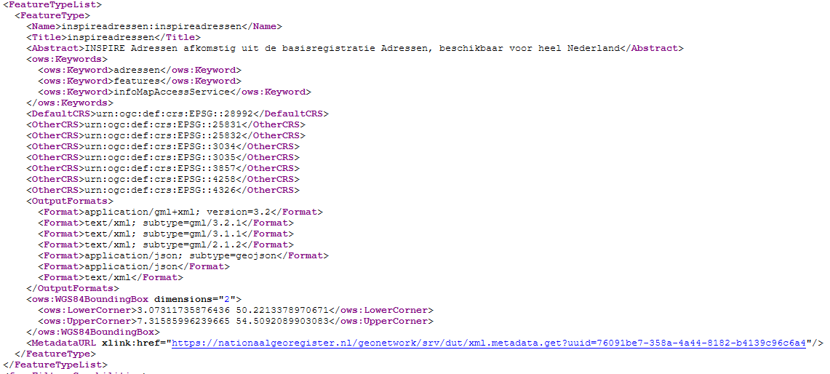
Solution (2) - example
MD FileId: a5f961e9-ebdd-41e2-b8e8-ab33ed340a83 - Resource Title: Adressen (INSPIRE geharmoniseerd)
MD FileId: 76091be7-358a-4a44-8182-b4139c96c6a4 - Resource Title: Adressen

Slide 8






Solution (2) - example
National CSW
Following agreed keyword(s), identify matching data set
Unique data set used for M&R indicator calculations

Slide 9
Solution (3) - key points
One dataset => still two metadata in the national CSW, but collected with a specific OGC filter during the harvest by the INSPIRE Geoportal
On the INSPIRE Geoportal, the harvested data would be composed by only the INSPIRE harmonized collection
From an INSPIRE user PoV, this is a curated but reduced subset, in some cases with penalties/limitations of the INSPIRE data specification (i.e. losing the richness of the original "as-is" data)
From the M&R PoV, it should work as defined in Solution (1), since the collection on our Geoportal will be purely INSPIRE focused
Evaluate a TG Recommendation? To include in the Resource Locator section of the MD harmonized dataset a referral to the original “as-is” description (eg. URL to the external “as-is” dataset MD in the same catalogue)

Slide 10
Preliminary evaluation
Solution (1) should be the preferred way, that unifies the national approach on data (intended as original raw dataset) together with the INSPIRE spec. standards
  (still TBD) MIWP2.3.2 Data simplification subgroup activity: we can include the definition where the Resource Locator shall express this distinction through a codelist, or a combination of conditions
Solution (2), whereas technologically feasible, requires additional work and agreements on both sides (MS and JRC Geoportal)
Solution (3), even if more practical, would hide the accessibility of "as-is" data and it also goes against the data sharing purposes of INSPIRE
Both solution (1) and (3) have a minimal/zero impact on the current Geoportal and M&R workflow

Slide 11
Next steps
Test all three proposed approaches, with current technologies, on various scenarios, towards pilot prototypes
Agreement on one single approach
  Follow-up discussion on the Helpdesk? (GitHub)
  Address this as part of the MIWP 2.3.2 subgroup activity?
Implementation at national level

Slide 12
Thank you!
© European Union 2020
Unless otherwise noted the reuse of this presentation is authorised under the CC BY 4.0 license. For any use or reproduction of elements that are not owned by the EU, permission may need to be sought directly from the respective right holders.

Slide 13





Keep in touch
EU Science Hub: ec.europa.eu/jrc
@EU_ScienceHub
EU Science Hub – Joint Research Centre
EU Science, Research and Innovation
Eu Science Hub
Notes:
Delete/update as appropriate

