Slide 1
INSPIRE Coverage Good Practice
Status update
Where we are now?

Slide 2

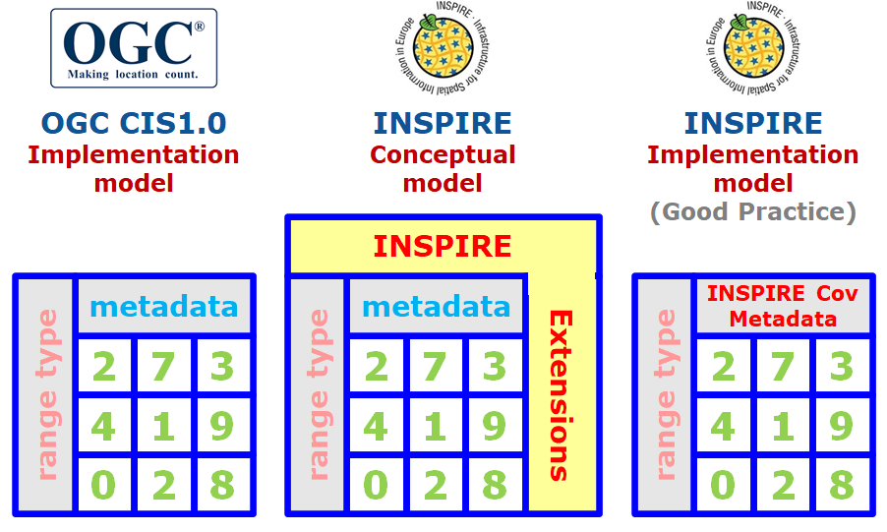
Good Practice - Overview

Slide 3
INSPIRE Good Practice Status - 1 of 5 Steps
✔
Step 1. Initiation
Identification of issues & needs + Discussion
2014 - 2020. INSPIRE Thematic Clusters / INSPIRE Community Forum
  Implementation of INSPIRE Coverages – Webinar, 6th November 2017.
  Practicing INSPIRE coverages - Enhancing your data cube implementation assets! – Workshop, INSPIRE Conference 2018 Antwerp.
  Feel the power of INSPIRE WCS/WCPS in your hands! – Workshop (Summary), INSPIRE Helsinki 2019.
  INSPIRE Coverages demystified – Workshop (Description + Presentations + Video).
  Online INSPIRE Conference 2020 (10th June 2020).
Discussion document
2nd July 2020. Presentation at the 62nd MIG-T Meeting

Slide 4
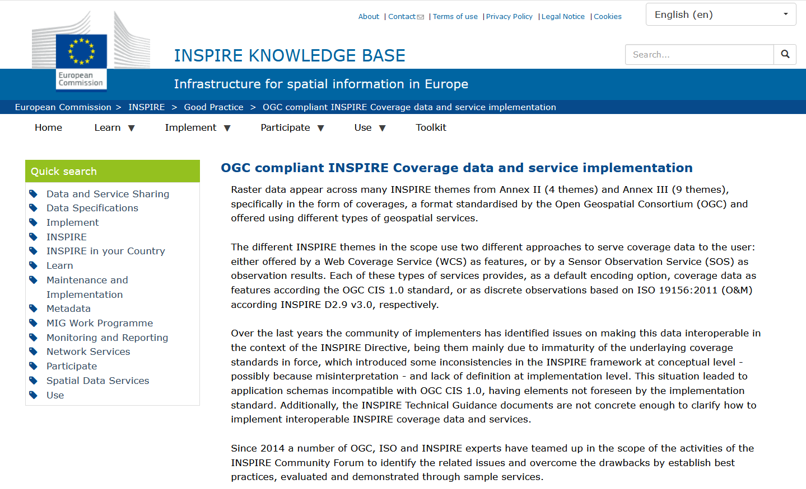
INSPIRE Good Practice Status - 2 of 5 Steps
✔
Step 1. Initiation
Step 2. Submission as good practice candidate
13th October 2020. 63rd MIG-T Meeting
RESULT: Endorsed as candidate!
✔
https://inspire.ec.europa.eu/good-practice/ogc-compliant-inspire-coverage-data-and-service-implementation
Implementations
ICGC (es).
SYKE (fi).
Landesamt für Vermessung und Geoinformation Schleswig-Holstein (de).

Slide 5

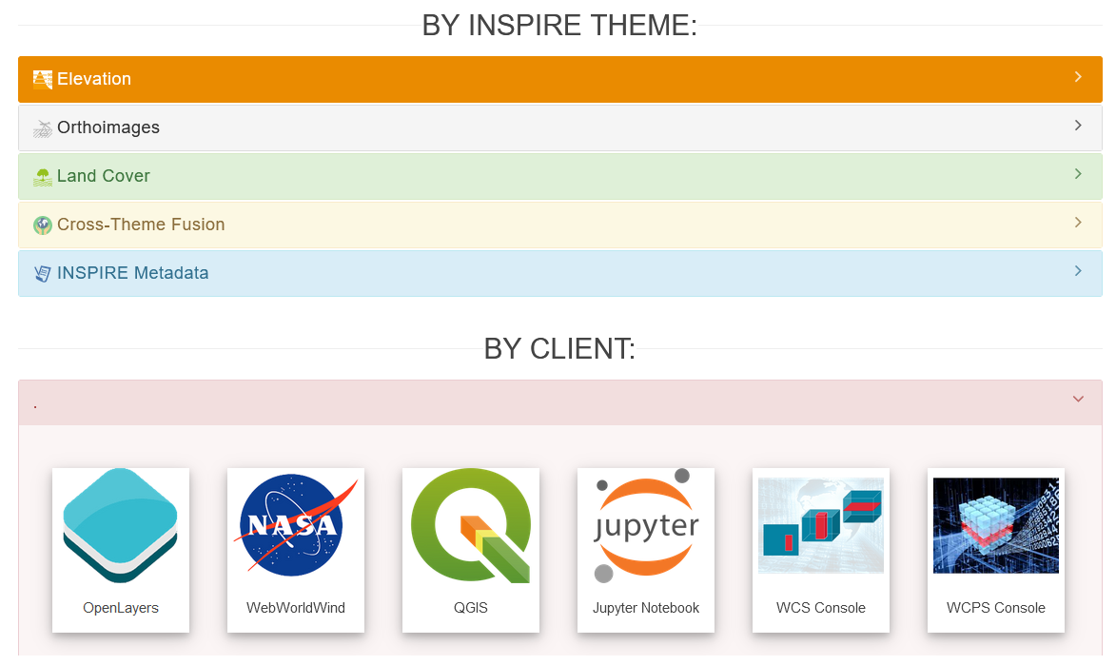
INSPIRE Good Practice Status - 3 of 5 Steps
✔
Step 1. Initiation
Step 2. Submission as good practice candidate
Step 3. Outreach
https://inspire.ec.europa.eu/coverage-good-practice
https://inspire-wcs.eu/
→ Collected Feedback
✔
✔

Slide 6
Post-Outreach
Feedback (https://github.com/INSPIRE-MIF/helpdesk/issues/22)
Herzo van der Wal - Rijkswaterstaat (nl), www.rijkswaterstaat.nl
Christine Hörfarter - Geologische Bundesanstalt / Geological Survey of Austria (at), www.geologie.ac.at
Janos Schaefer - Saarland GDI (de), https://geoportal.saarland.de
Paloma Abad - IGN Spain (es), http://www.ign.es / http://www.idee.es
Geosolutions.

Slide 7
Feedback I - Rijkswaterstaat (nl)
Strong interest in provision of Bathymetry data.
Seeking potential in linking with Sensor Measurements.
Issues:
Viewing tools.
Provision Options.
Herzo van der Wal - www.rijkswaterstaat.nl

Slide 8
Feedback II - Geologische Bundesanstalt (GBA)
Interest in providing Geothermal data.
Issues:
Data available in GBA Vector data with information on temperature (geothermal gradient).
INSPIRE model only supports information on temperature for gridded data (coverage).
INSPIRE vector model only supports information on geothermal potential value.
  MWe for electrical generation capacity.
  MWt for heat generation capacity.
Must the data be transformed to raster, or the INSPIRE models reworked to align with the existing data?
Christine Hörfarter - www.geologie.ac.at

Slide 9
Feedback III - Saarland GDI
Requirements for OI.
Issues:
On getting WCS validated.
Full data requirements served by WCS.
Initiated current WCS Issue on Helpdesk GitHub (#22)
Janos Schaefer - https://geoportal.saarland.de/
E.g. https://geoportal.saarland.de/gdi-sl/inspirewcs?map=/home/lvgl/inspire_oi.map&SERVICE=WCS&VERSION=2.0.0&REQUEST=GetCapabilities

Slide 10
Feedback IV - IGN Spain
Many Coverages appear across a lot of INSPIRE themes in Annex II and III, and for many of them are not possible to provide the data pertaining to these models via WCS.
IGN-CNIG only publishes digital terrain models through a WCS, but not in an INSPIRE compliant way because of the problems that already exist.
We believe that this initiative is a great step towards facilitating the publication of coverage data and all the advantages it will bring.
Paloma Abad - http://www.ign.es / http://www.idee.es

Slide 11
Feedback V - GeoSolutions
Currently investigating extending GeoServer Functionality to support INSPIRE WCS requirements.
Details at:
https://geoserver.geo-solutions.it/educational/en/inspire/inspire_ext.html#extended-wcs-capabilities

Slide 12
INSPIRE Good Practice Status - 4 of 5 Steps
✔
Step 1. Initiation
Step 2. Submission as good practice candidate
Step 3. Outreach
Step 4. Submission
Step 5. Legal scrutiny
Step 6. Feedback
✔
✔
...?

Slide 13
Conclusion & outlook
What the GP will bring if endorsed:
  Efficient and interoperable provision of (raster) coverage data, reusable by the relevant INSPIRE thematic domains referred.
  Compliance assurance of INSPIRE coverage models to OGC CIS 1.0 modelling paradigms without major modifications to data models.
  Data can be provided using any WCS service publication engine conforming to OGC CIS 1.0.
  Interoperability through agreement on a generalized solution towards encoding, avoiding diverse options defined by MS or thematic community, and enabling consistent provision via WCS/WCPS.
  Will boost the availability of coverage data, underpinning the huge potential of WCS/WCPS in raster data analytics.
What should be done if the GP is not endorsed:
  Propose an alternative (clear & interoperable) solution to provide data for INSPIRE raster themes.
Dedicated GitHub repository: https://github.com/INSPIRE-MIF/gp-coverage-encoding

