Slide 1


Delivery status of Priority Datasets for eReporting
INSPIRE MIG April 2023
© Dominika Hrašková, REDISCOVER Nature/EEA
Stefan Jensen - April 27th 2023
Notes:
OPENING SLIDE – dark background and white logo

Slide 2
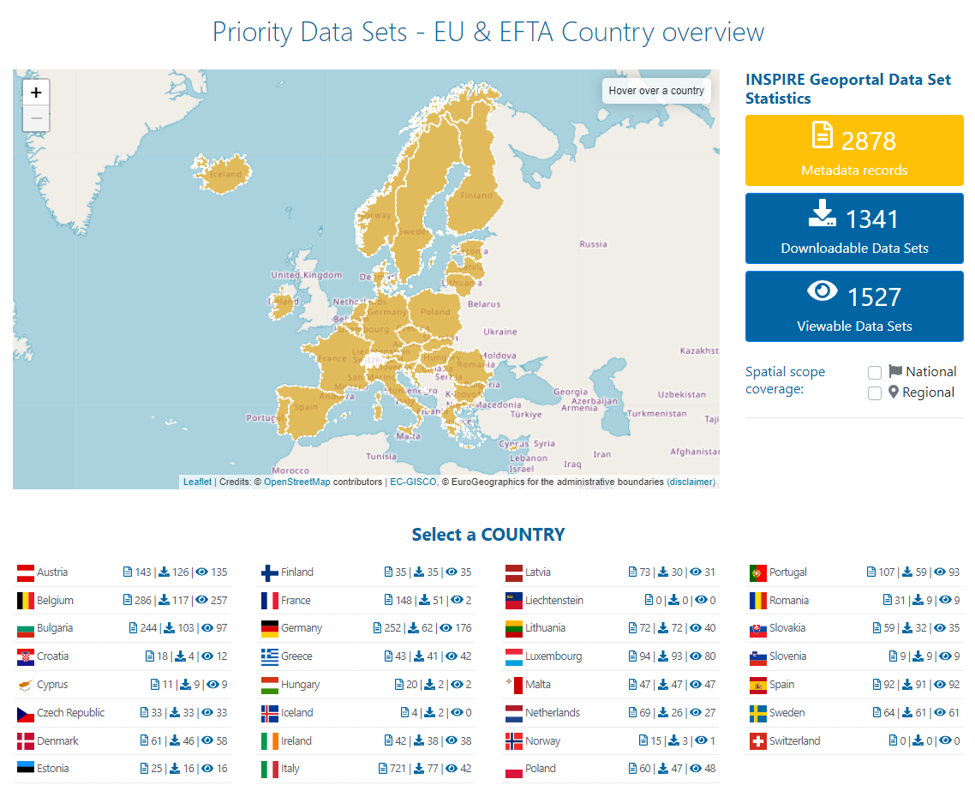
INSPIRE priority list of datasets for e-Reporting - status 26.4.2023

Slide 3
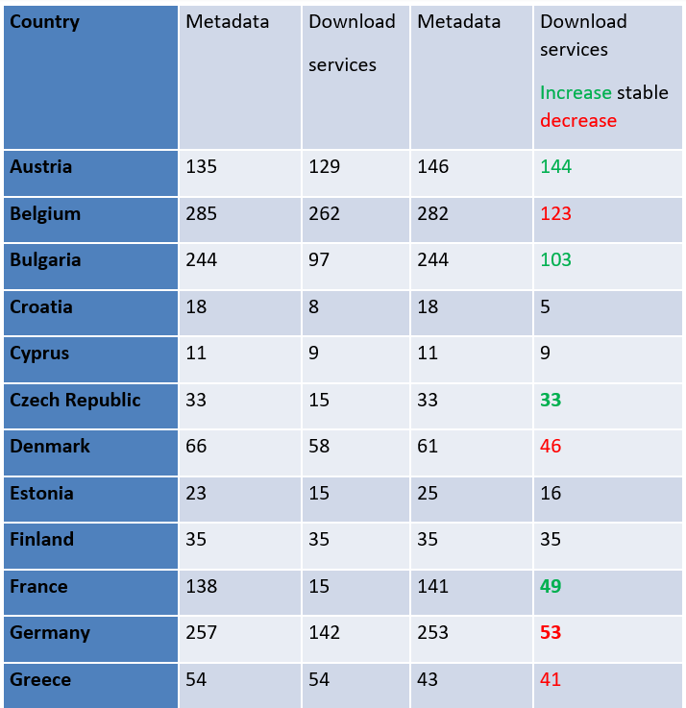
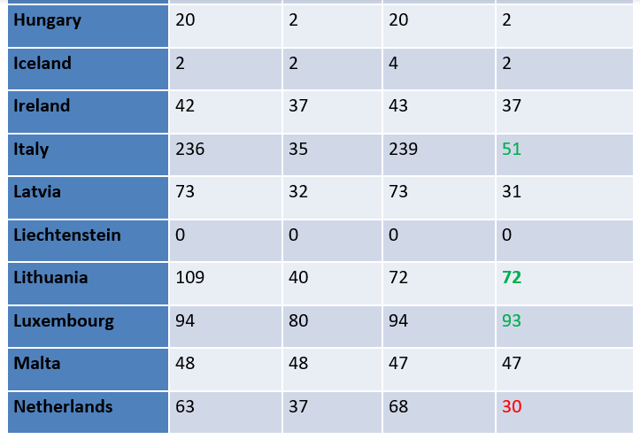
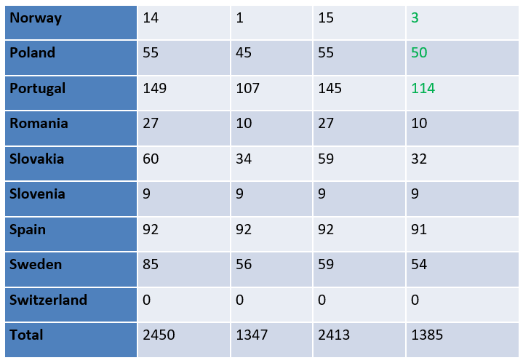
INSPIRE priority list of datasets for e-Reporting – progress since 3/2022
March 2022 November 2022
March 2022 November 2022
March 2022 November 2022
Member States with
decreasing access:
Belgium
Denmark
Finland
Germany
Greece
Netherlands
Member States with
continuing low access:
Croatia
Cyprus
Hungary
Romania
Slovenia
Status 17.11.2022

Slide 4
INSPIRE priority list of datasets for e-Reporting – progress since 11/2022
Country | Metadata records | Downloadable Data Sets | Viewable Data Sets
at | 143 | 126 | 135
be | 286 | 117 | 257
bg | 244 | 103 | 97
ch | 0 | 0 | 0
cy | 11 | 9 | 9
cz | 33 | 33 | 33
de | 252 | 62 | 176
dk | 61 | 46 | 58
ee | 25 | 16 | 16
el | 43 | 41 | 42
es | 92 | 91 | 92
fi | 35 | 35 | 35
fr | 148 | 51 | 2
hr | 18 | 4 | 12
hu | 20 | 2 | 2
ie | 42 | 38 | 38
is | 4 | 2 | 0
it | 721 | 77 | 42
li | 0 | 0 | 0
lt | 72 | 72 | 40
lu | 94 | 93 | 80
lv | 73 | 30 | 31
mt | 47 | 47 | 47
nl | 69 | 26 | 27
no | 15 | 3 | 1
pl | 60 | 47 | 48
pt | 107 | 59 | 93
ro | 31 | 9 | 9
se | 64 | 61 | 61
si | 9 | 9 | 9
sk | 59 | 32 | 35
Member States with
decreasing access:
None
Member States with
continuing low access:
Croatia
Cyprus
Hungary
Romania
Slovenia
Number of downloadable
datasets
11/2022 - 1385
4/2023 – 1342
Status 26.4.2023
Member States with
Increasing access:
Italy

