Slide 1
GeoPackage
Danish INSPIRE Addresses

Slide 2






Danmarks Adresser
INSPIRE Addresses (AD)
ShapeChange
DDL+FC
ShapeChange
Geopackage Template
Predefined file in
XML
Complete+
DeltaDaily
DK Adr.
Atom feed
download
Initial load and daily delta
DK Adr.
DAR INSPIRE no historic
FME
Adm.unit
VIEW
DAR Simpel no historic
Geopackage
Data Reciever
Data source
WMS AD
Postgres
Mapserver
Data Warehouse
Distribution

Slide 3
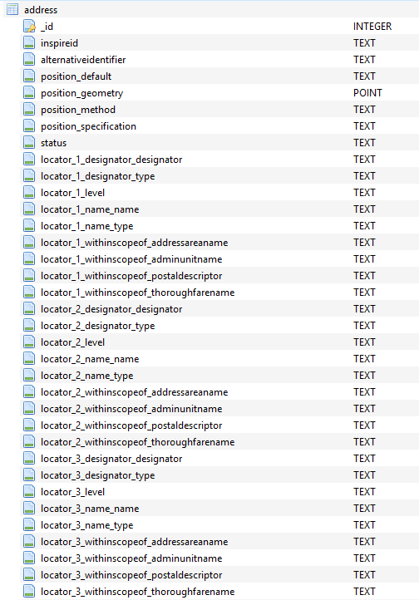
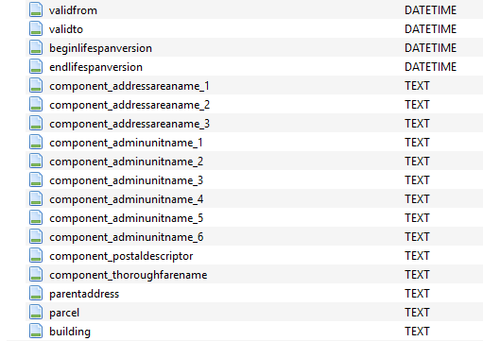
Model transformations
ShapeChange:
Flattener
AttributeCreator (geometry)
upper multiplicity: * → 6, * → 3, …
…

Slide 4
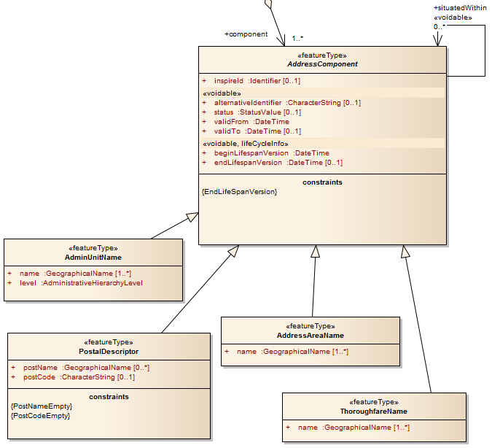
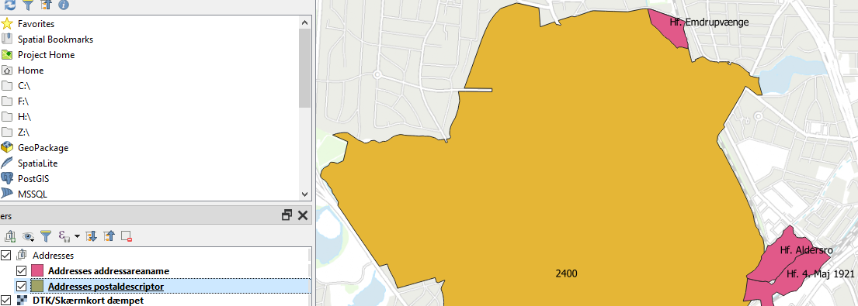
Extra geometries
+ geometry
+ geometry

Slide 5
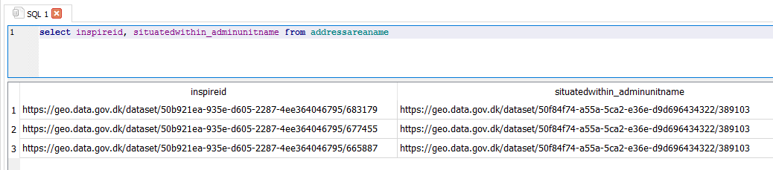
INSPIRE ID
inspire.namespace + ‘/’ + inspireid.localId

Slide 6
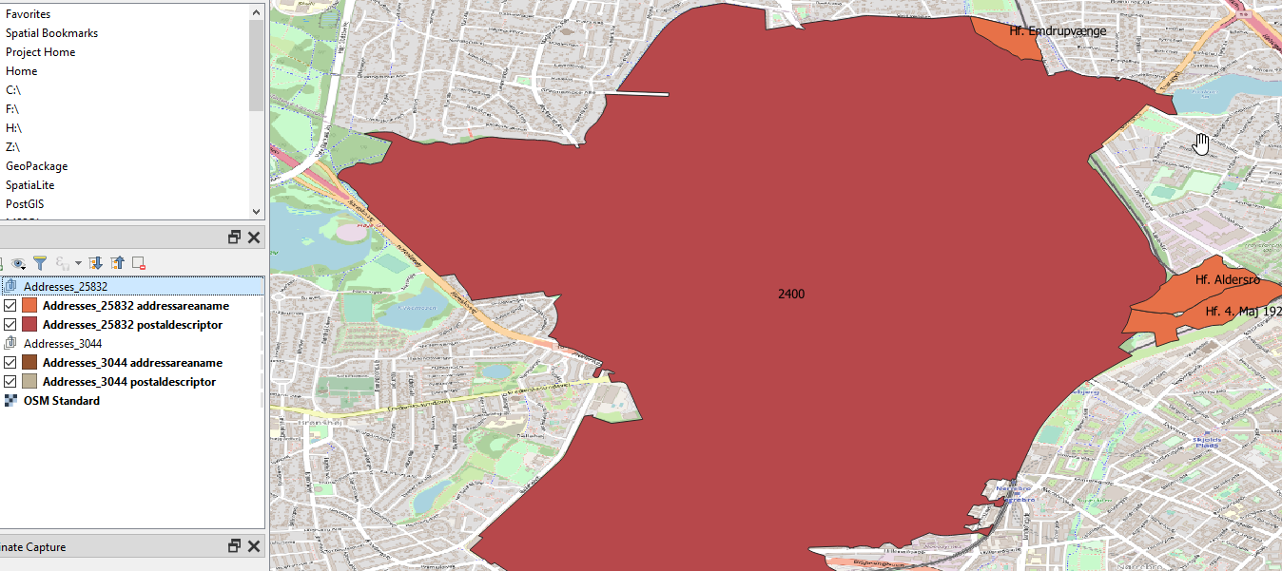
QGIS - EPSG:25832 (ETRS89 / UTM zone 32N)
✓

Slide 7
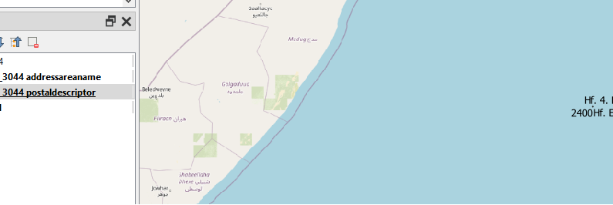
QGIS - EPSG:3044 (ETRS89 / UTM zone 32N (N-E))
✗
Somalia

Slide 8
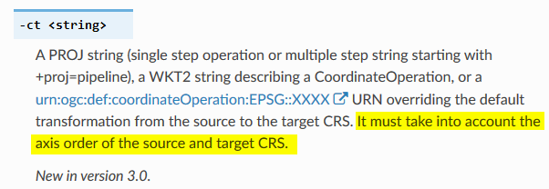
GDAL/OGR
ogr2ogr -s_srs EPSG:3044 -t_srs EPSG:25832 -f GPKG target_25832.gpkg source_3044.gpkg
projinfo -s EPSG:3044 -t EPSG:25832
[…]
PROJ string:
+proj=axisswap +order=2,1
[…]
ogr2ogr -ct "+proj=axisswap +order=2,1" –f GPKG tmp.gpkg source_3044.gpkg
ogr2ogr -a_srs EPSG:25832 target_25832.gpkg tmp.gpkg

Slide 9
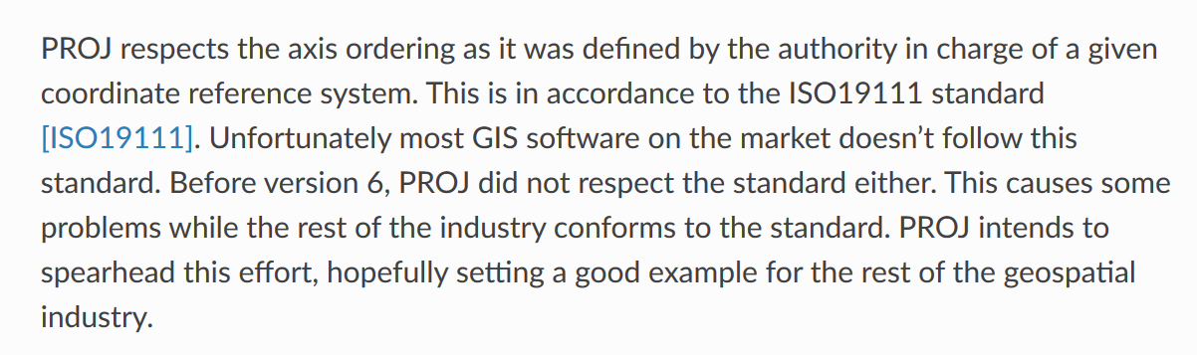
PROJ
https://proj.org/faq.html#why-is-the-axis-ordering-in-proj-not-consistent

