Slide 1
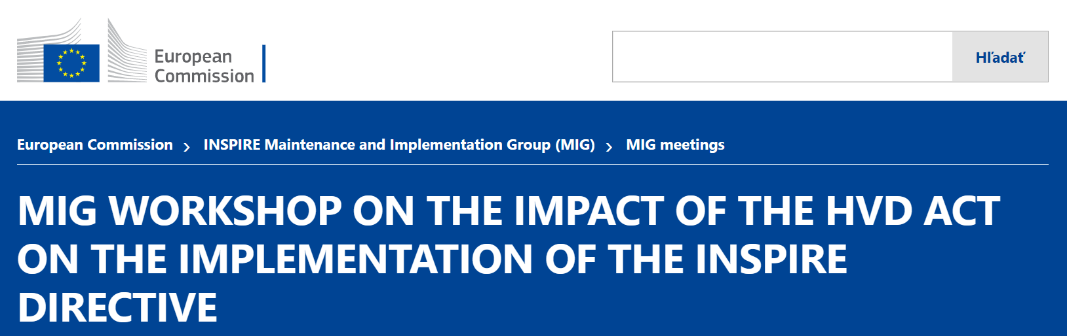


INSPIRE vs. OpenData&HVD
SK perspective
inspire@enviro.gov.sk

Slide 2
Context
‹#›
Legislation
Governance
Metadata
Data
Services/API
Sharing/Licencing
Monitoring/reporting

Slide 3
Legislation
‹#›
INSPIRE
Observations/Comparisons
Directive INSPIRE (2007/2)
Metadata regulation (1205/2008)
Interoperability regulations (1089/2010, 102/2011, 1253/2014)
Network services regulation (976/2009), Download and transformation amendment (1088/2010)
Spatial data services regulation (1311,1312/2014)
Data sharing regulation (268/2010)
Monitoring and reporting decision (2019/1372), regulation (2019/1010)
OD&HVD
Observations/Comparisons
Directive Open Data (2019/1024)
  Regulation HVD (2023/138)

Slide 4
Legislation II
‹#›
INSPIRE
Observations/Comparisons
SK transposition
1 SDI Law (3/2010 with changes)
1 Decree (352/2017 with changes)
Questions
Will HVD require changes in INSPIRE legislation?
OD&HVD
Observations/Comparisons
SK transposition
1 Law on freedom of information (211/2000 with changes)
1 Decree (78/2020)
Questions
What are the exact dates of force/deadlines?
  Directive entry force: 16.07.2019?
  Regulation entry force: 09.06.2023?
  First reporting: 09.02.2025?
Are there foreseen another legislation acts, or technical guidelines under OD&HVD?

Slide 5
Governance
‹#›
INSPIRE
Observations/Comparisons
INSPIRE Committe
INSPIRE MIG & MIT-T
SK responsible authority: Ministry of environment of the Slovak republic
Questions
Where and how the governance synergy between INSPIRE and OD&HVD will/shall take place on EU and national level?
OD&HVD
Observations/Comparisons
Committee on open data and the re-use of public sector information
SK responsible authority: Ministry of Investments, Regional Development and Informatization of the Slovak Republic
Questions
Is it possible to get an overview of governance and contacts on OD&HVD structures across the MS as already available under INSPIRE in your country?

Slide 6
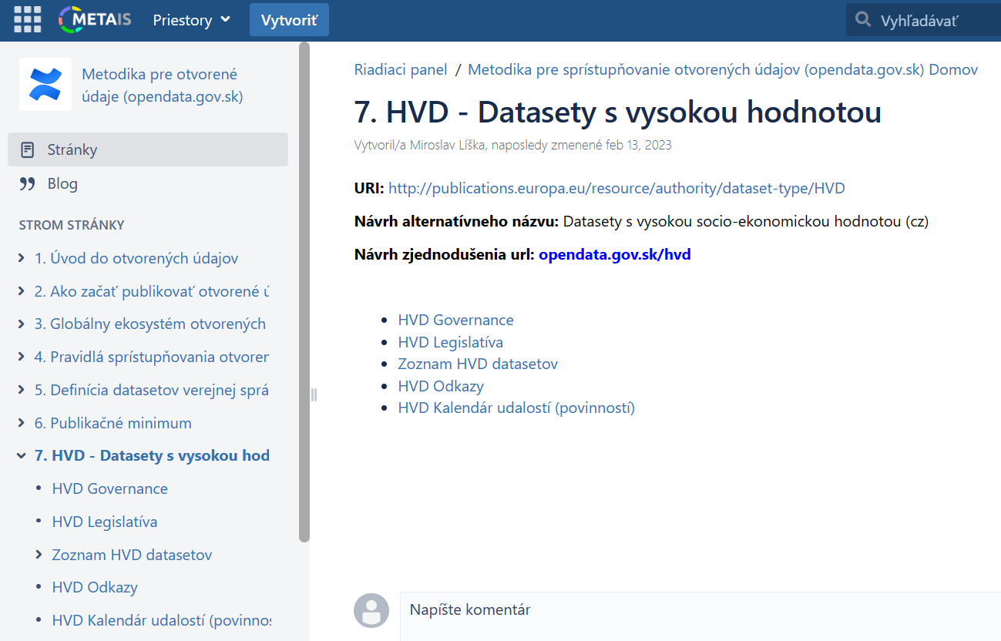
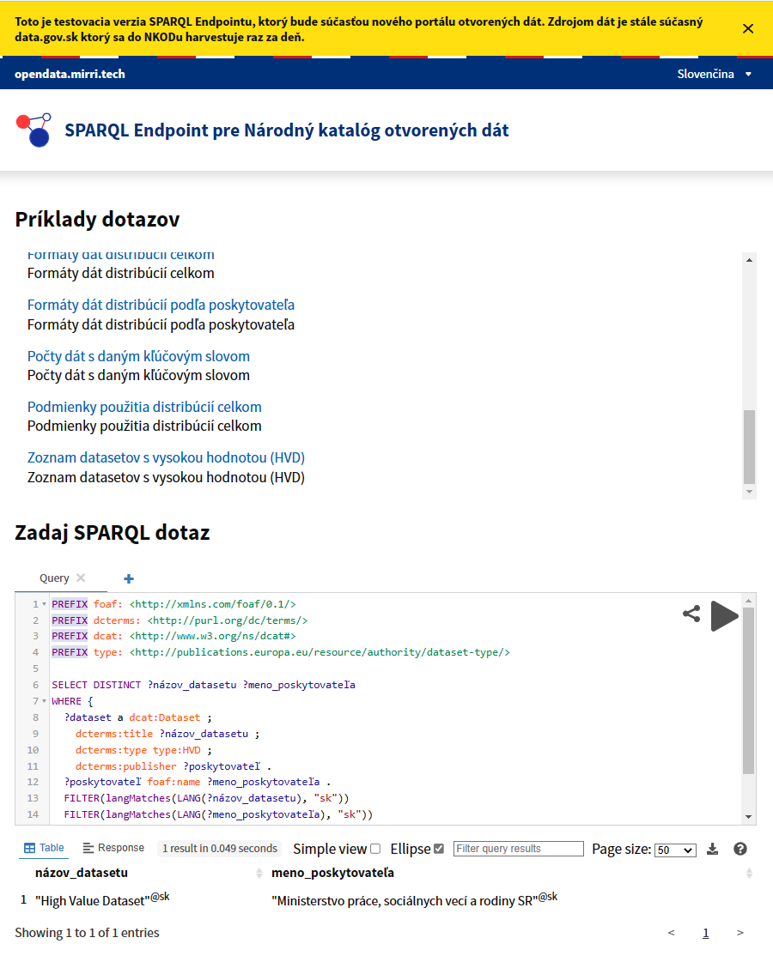
Governance
‹#›
SK situation
Initial coordination of responsible authorities
Plans to invite other relevant stakeholders
Plans to establish integration between SDI and OpenData metadata registers
Support for HVD harvesting via developed new OpenData portal

Slide 7
Metadata
‹#›
INSPIRE
Observations/Comparisons
ISO MD profile + national extensions
National profile extensions
Harvesting national catalogues to EC Geoportal
Questions
Will HVD impact INSPIRE metadata?
What will be the MD elements and criteria to assign INSPIRE MD under HVD?
Is it foreseen to establish common coordination, where and how “INSPIRE & HVD MD integration” shall take place?
Is it foreseen to consider HVD requirements in INSPIRE validator?
Is it foreseen also integrate under HVD also MD for series and MD for services?
OD&HVD
Observations/Comparisons
DCAT profile
Requirements for mapping
Unclear metadata aggregation at Union level
Questions
Is it foreseen to provide common INSPIRE & HVD metadata mapping?
How and where will HVD metadata be aggregated on Union level?
What are the HVD requirements for metadata update?
Are there some expectations to validate HVD metadata?
Only metadata for datasets are expected from HVD, or also for applications?
How to cope with concept of Distributions, supported by OD&HVD metadata?

Slide 8
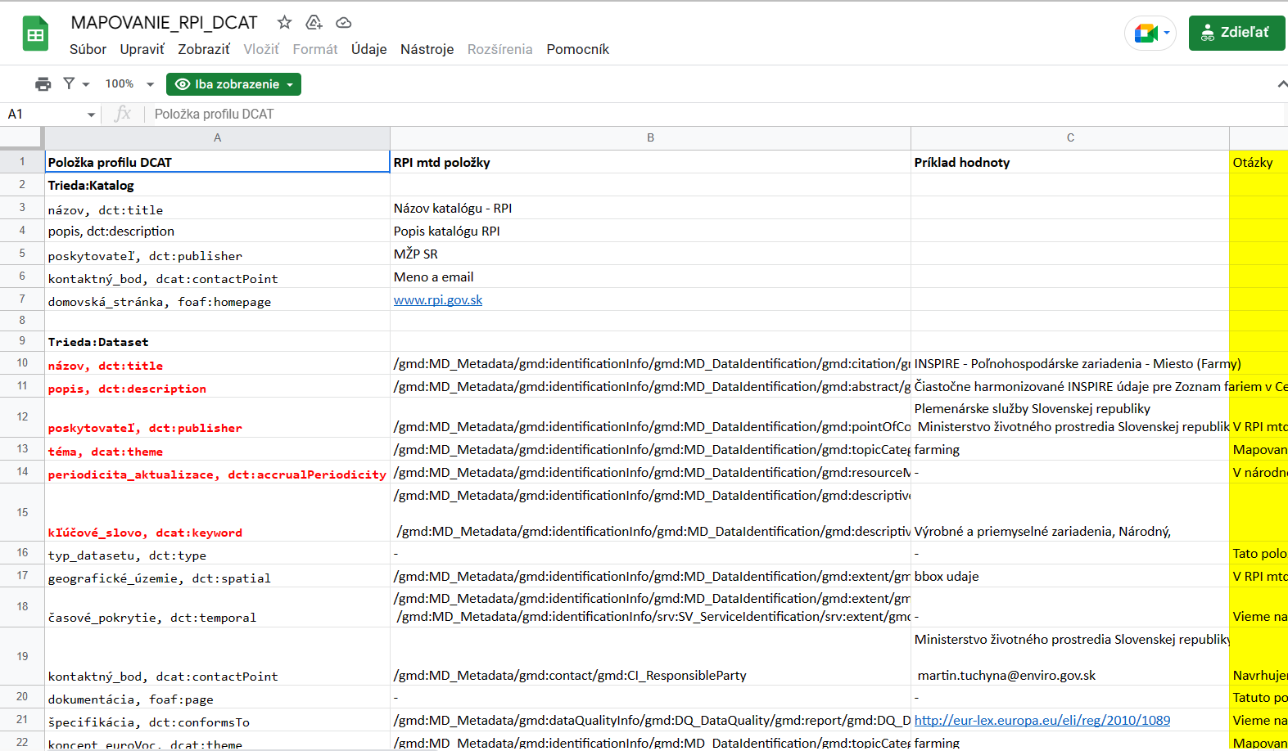
Metadata
‹#›
Initial mapping from ISO/INSPIRE SK national MD profile to DCAT

Slide 9
Data
‹#›
INSPIRE
Observations/Comparisons
Narrower scope (34 themes)
Higher model complexity
UML & narrative data model description
Unified model structure
Direct and indirect spatial representation
Availability data validation rules and tools
Only latest available versions
Encodings: GML, GeoJSON, GeoPackage
Questions
Does yet unharmonised (AsIs) data falls under the HVD?
Which encoding for Orthoimagery and Elevation data (TIFF, GPKG)?
Are INSPIRE GPKG vector datasets acceptable also under OD&HVD?
OD&HVD
Observations/Comparisons
Wider scope (6 categories, ~ 68 datasets)
Lighter data structure
Tabular/narrative data model notation
Heterogenous model structure
It’s unclear, if some HVD datasets comes with spatial representation
Unclear situation about data validation
Heterogenous update frequency and timeliness
Questions
Encodings: Unclear, what exactly means Union or internationally recognised open, machine-readable format
For environmental domain, is INSPIRE priority datasets mapping going to be applied?
What about Copernicus data?

Slide 10
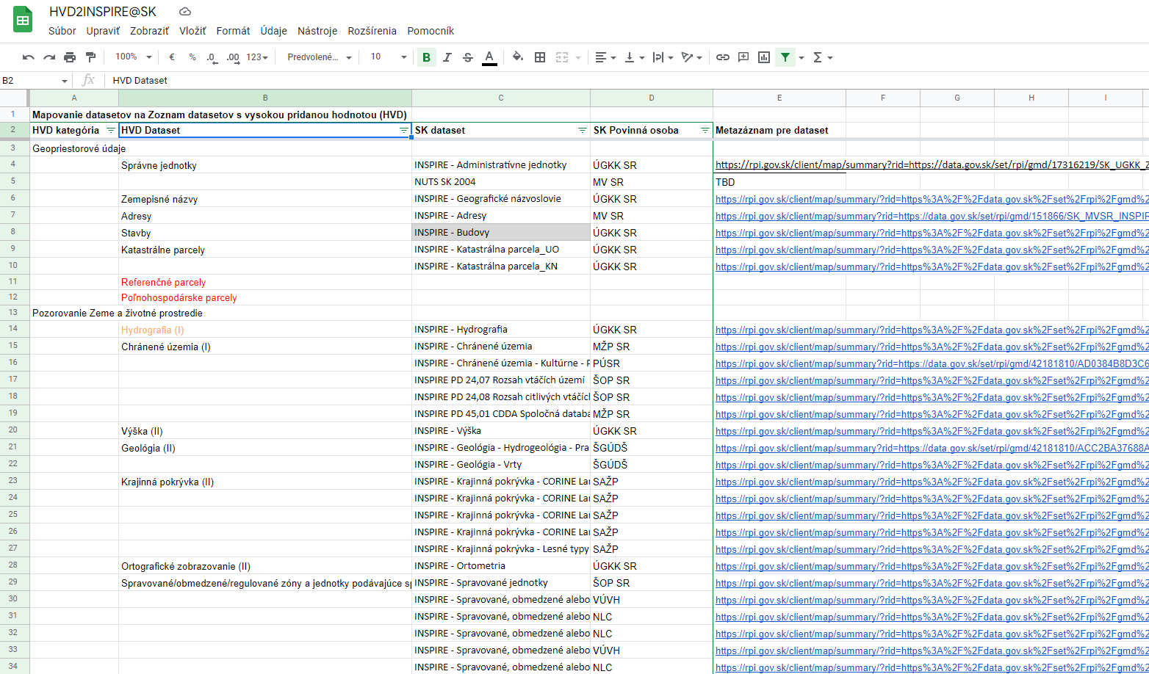
Data II
‹#›
SK situation
Initial mapping has been started, on dataset metadata level
More challenging will be the level of geometry and attributes

Slide 11
Services/APIs
‹#›
INSPIRE
Observations/Comparisons
Spatial data / network services, mainly:
View (WMS, WMTS, )
Download (WFS, WCS, ATOM)
Upcoming OGC APIs (Tiles, Features, Coverages..)
QoS requirements
Validation support
Questions
What types of queries shall be supported by APIs?
What are minimal requirements for API implementations and documentation?
What will be the impact on INSPIRE MD simplification and linkages to Network services?
OD&HVD
Observations/Comparisons
APIs
Bulk download
Unclear QoS requirements
Unclear requirements for validation
Questions
What will be the EC actions, aiming support consumptions of APIs on desktop, web client applications?
What will be the requirements for APIs quality (e.g. type, performance…)
What will be the requirements for management of the APIs and structure of the data provided?

Slide 12
Sharing/Licensing
‹#›
INSPIRE
Observations/Comparisons
Free and restricted sharing allowed
CC-0, CC-BY supported licenses
Only MD and View services are under free licence requirements
Questions
If provider will restrict access to download because INSPIRE allows it, provides OD&HVD has higher legal “power” to enforce provision of the data?
Is EC planning/willing to provide legal support with data provision enforcement?
OD&HVD
Observations/Comparisons
Only free sharing allowed
CC-0, CC-BY supported licenses
Except public sector bodies exempted
Questions
What will be the criteria and process to establish and maintain list of public sector bodies exempted in accordance with Article 14(5) of Directive (EU) 2019/1024?

Slide 13
Monitoring/Reporting
‹#›
INSPIRE
Observations/Comparisons
Annual period
15.12. Harvest - Data
01.03. Country Fiche - Report
Automatic process
Indicators for technical components
Text info about Costs/Benefits
Questions
Why metadata / data validation / processing is also executed after 15.12 period (e.g. SK last validations an indicator calculations in January 2023)?
Why there is limited uptake of Costs/Benefits information from MS?
Will HVD impact change of INSPIRE monitoring?
OD&HVD
Observations/Comparisons
2 years period (From 2025)
Report
MS will provide report upon request of the Commission
Questions
There will be no data under the OD&HVD monitoring/reporting? Just report?
What is meant with “data protection impact assessment” ?
Any plans to monitor and evaluate the benefits, use and impact of HVD?

