Slide 1

News from standardization bodies
11th MIG meeting –18 June 2020

Slide 2
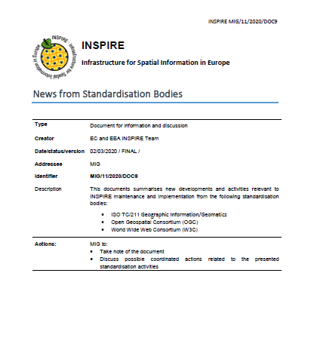
News from standardisation bodies
Information provided by
  OGC
  ISO TC/211
  W3C

Slide 3
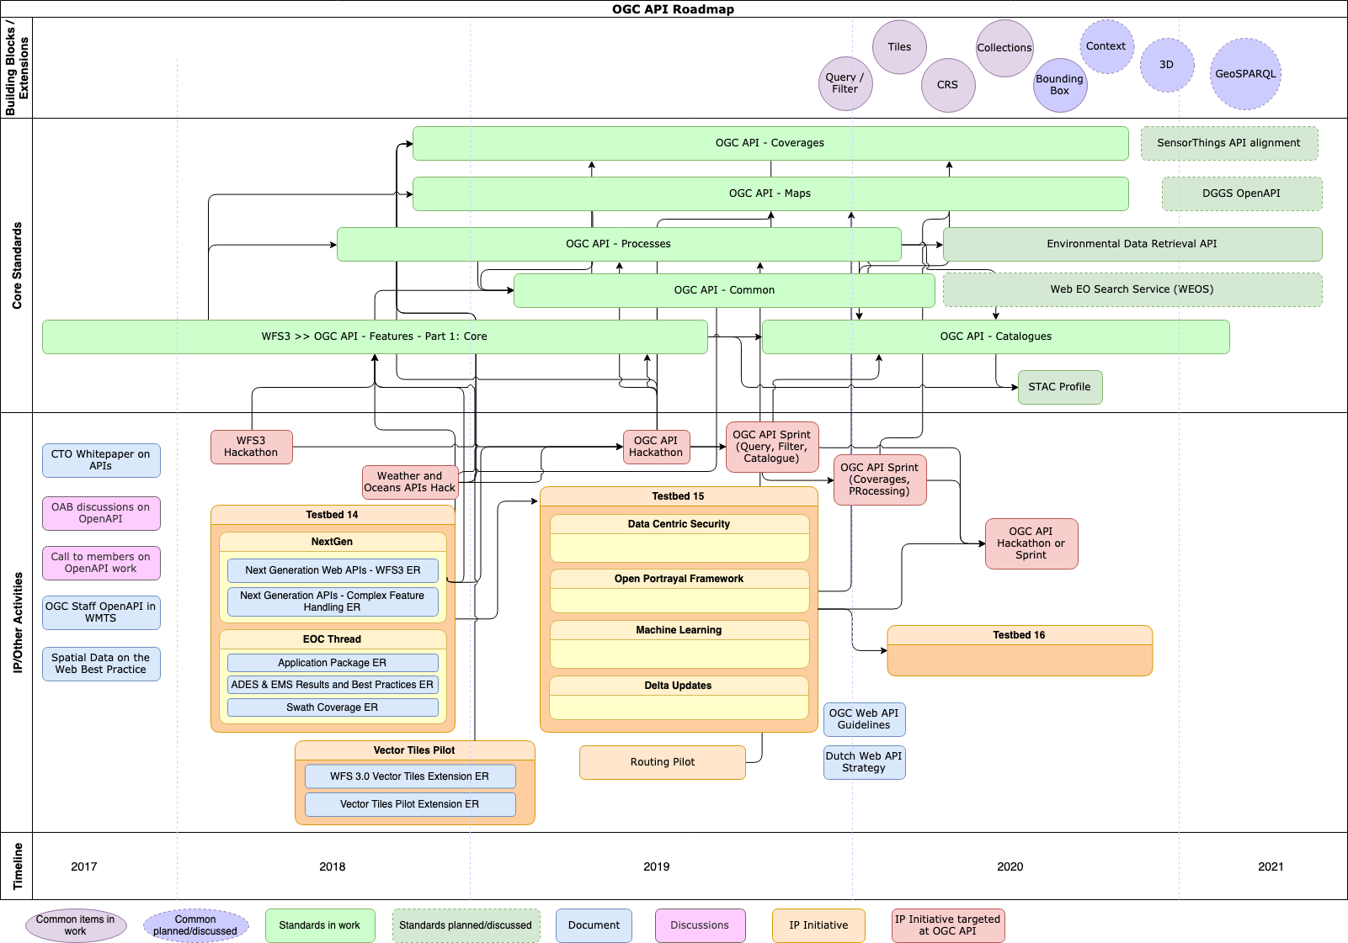

Slide 4
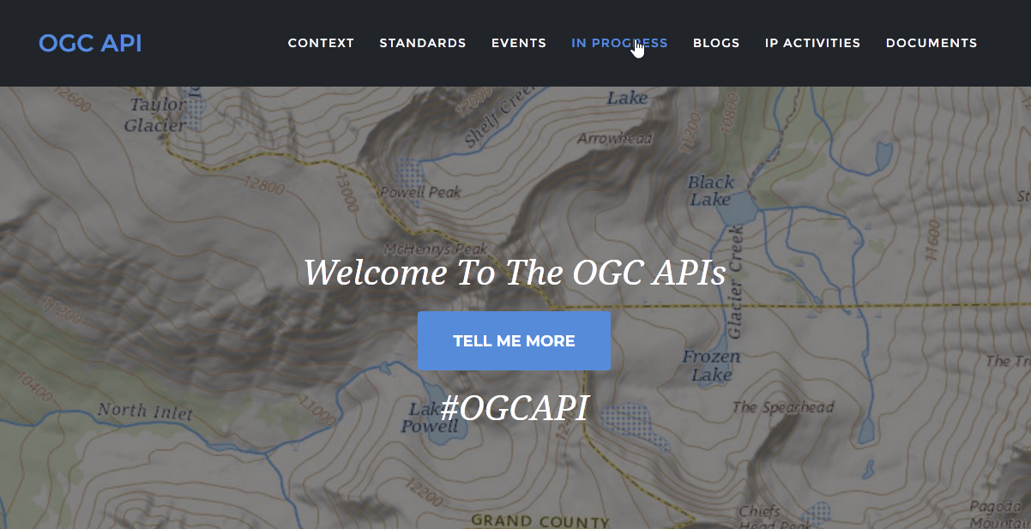
OGC Selected recent developments relevant to INSPIRE
OGC API – Features
  Part 2: CRS
    Draft available on GitHub
    Foreseen inclusion in the MIWP Action 2020.1
  ETS available for OGC API-Features – Part 1: Core
OGC SensorThings API, Part 1 – Sensing (1.1)
  JSON properties extension
  Comment due by the 6th of July, 2020
  OGC API Records
    SWG established in January 2020
    Drafting of OGC API - Records - Part 1: Core ongoing
https://ogcapi.ogc.org

Slide 5
OGC – JRC collaboration
Bi-monthly meetings JRC-OGC
  Explore synergies and ensure good uptake of OGC standards + feedback on the technical level
  Next meeting scheduled for 24th June
    Please approach us if you have comments/suggestions/feedback

Slide 6
W3C – Web of Things
W3C’s Web of Things Interest Group and Working Group have both been recently rechartered
Developed standards for digital twins that decouple client applications from the physical location, and the communications technologies for connecting to sensors and actuators.
Recommendations have been prepared for Thing Descriptions and Architecture. Related work has focused on security and a proposed scripting API.
On a related note, W3C is hosting work on extensions to schema.org to support IoT devices

Slide 7
W3C Dataset exchange working group
The Dataset Exchange Working Group has released a second version of the data catalogue vocabulary (DCAT2).
  W3C Recommendation 04 February 2020
  What is new
    Extensibility (e.g. domain specific)
    Properties and guidance to address identifiers, dataset quality information, and data citation issues.
https://www.w3.org/TR/vocab-dcat-2/

Slide 8
ISO TC/211 Geographic information/Geomatics
Yearly report prepared jointly by ISO/TC 211, OGC and IHO for the United Nations Committee of Experts on Global Geospatial Information Management
Contribution to UNGGIM-Europe IGIF Pathway on standards
New version of the ISO/TC 211 Strategic Business Plan published (Dec. 2019)
Ontology is increasingly getting a wider focus, and a new standardization work is initiated on TC 211 ontologies and the application to these in different communities/domains.
Initiatives on Land Administration and on Land Cover/Land Use are both in preparatory stages, however very well developed already.

Slide 9





Keep in touch
EU Science Hub: ec.europa.eu/jrc
@EU_ScienceHub
EU Science Hub – Joint Research Centre
EU Science, Research and Innovation
Eu Science Hub
Notes:
Delete/update as appropriate

