Slide 1

MIWP Action 2020.1
INSPIRE Download Services based on the OGC API – Features standard
11th MIG meeting –18 June 2020

Slide 2
Status
New MIWP Action (2020.1) endorsed through written procedure
  Short term action (proposed Date of Completion: end of 2020)
Objective
  Prepare and submit for approval by the MIG an INSPIRE good practice dedicated to the use of the OGC API - Features as an INSPIRE Download service
Out of scope
  ETS covered separately (foreseen within the evolution of the INSPIRE Reference Validator

Slide 3
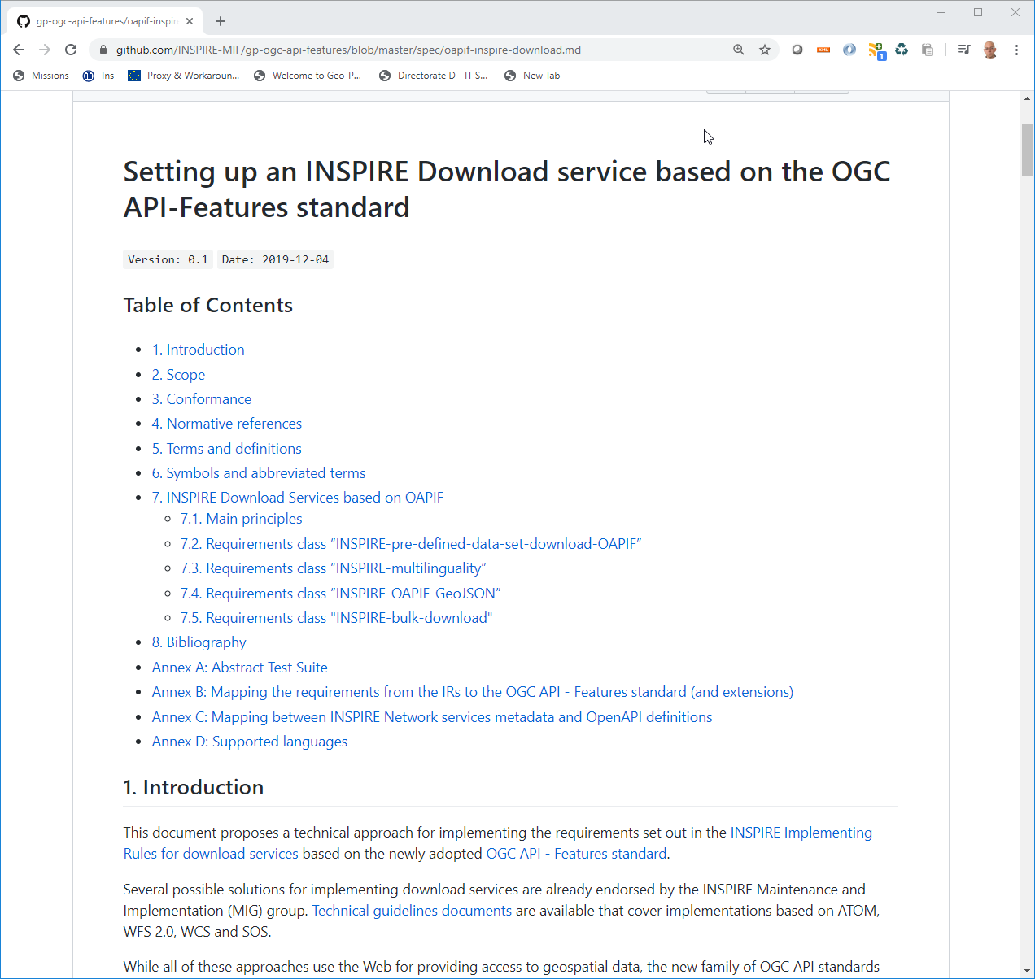
A community approach to specification development
https://github.com/INSPIRE-MIF/gp-ogc-api-features
Specification is drafted entirely on GitHub
  Requirements classes
    INSPIRE-pre-defined-data-set-download-OAPIF
    INSPIRE-multilinguality
    INSPIRE-OAPIF-GeoJSON
    INSPIRE-bulk-download
  ATS
First round of comments is completed
  Solution providers and open source projects
  Representatives of the OGC
  Early adopters
Special thanks to
  Heidi Vanparys (Danish Agency for Data Supply and Efficiency) & Jari Reini (NLS Finland) for the outstanding work on the specification

Slide 4
Tasks
Review the existing guideline
Test the proposed approach through deployment of OGC API – Features instances with volunteer MS data providers.
  Different open source and proprietary implementations of the OGC API – Features should ideally be covered.
Summarise the lessons learnt on GitHub, and propose revisions of the draft guideline.
Organise a webinar/meeting for discussing the lessons learnt and potential issues or improvement proposal.
Draft and submit for endorsement an INSPIRE good practice fiche.
Identify and document issues for (i) a possible update of the INSPIRE NS Regulation, and (ii) the technological evolution of INSPIRE in general.

Slide 5
Nominations are welcome
  Formal nominations received from ES, AT, BE, SE (thanks)
  Draft guideline authors: DK, FI, JRC
  Other contributors: OGC, software vendors and open source projects
  Please provide expert names and contact details to Alexander Kotsev
    alexander.kotsev@ec.europa.eu

Slide 6





Keep in touch
EU Science Hub: ec.europa.eu/jrc
@EU_ScienceHub
EU Science Hub – Joint Research Centre
EU Science, Research and Innovation
Eu Science Hub
Notes:
Delete/update as appropriate

