Slide 1

INSPIRE Schemas -
Versioning and schema repository
Jordi Escriu, Fabio Vinci, Marco Minghini, Alexander Kotsev
Governance of INSPIRE artefacts
67 MIG-T Meeting – October 7th, 2021

Slide 2
Objectives
Establish practical rules for managing changes to the schemas endorsed by MIG, after going through the governance process.
Come up with an agreed functional solution for restructuring the official repository of INSPIRE XML app. schemas:
https://inspire.ec.europa.eu/schemas
Update the criteria used for versioning schema releases:
https://inspire.ec.europa.eu/XML-Schemas/Data-Specifications/2892
Keep trace of historic / old versions of schemas in the repository, if possible maintaining them operative.
Encourage MS to update existing implementations using the latest endorsed versions of schemas, while minimising the impact on them.

Slide 3
Versioning of schema releases
Proposal to maintain existing criteria (*)
Follow the X.Y.Z pattern, where:
X (major version number):
To be updated (e.g. v3.X --> v4.0) when changes to the applicable legal framework (e.g. Implementing Rules) are applied. These are always breaking changes.
Y (minor version number):
To be updated (e.g. v3.0.X --> v3.1) when non-breaking changes to the schemas are applied.
Z (bug-fix version number):
To be updated (e.g. v3.0 --> v3.0.1) when errors or bugs are fixed in the XML schemas. These can be breaking or non-breaking changes.
Breaking changes = Non-backwards compatible
Non-breaking changes = Backwards compatible
* Already endorsed by MIG and used in the previous years.

Slide 4
Restructuring the schema repository
1a. Initial proposal - Description
For each (INSPIRE general or thematic-related) schema folder in the repository:
Keep inside this folder all version folders (‘X.Y’) of the corresponding schemas, including the last-endorsed and the historic ones.
Include a ‘deprecated’ subfolder to keep trace of historic bug-fixes of each version of the schema.
In case of a new bug-fix endorsed:
  Copy the (old) incorrect schema into the corresponding subfolder (named with the major, minor and bug-fix version numbers) within the ‘deprecated’ subfolder.
  Inside its corresponding (‘X.Y’) version folder, replace the incorrect schema by the corrected one (bug-fix).
Maintain updated a ‘latest’ shortcut, always pointing to the last endorsed version of the schema.

Slide 5
Restructuring the schema repository
1a. Initial proposal - Structure
Folders = In maroon bold text
Files = In blue plain text
am (https://inspire.ec.europa.eu/schemas/am/)
latest ← Shortcut pointing to the latest version of the schema endorsed by MIG
deprecated
3.0.0
AreaManagementRestrictionRegulationZone.xsd ← version 3.0.0
3.0.1
AreaManagementRestrictionRegulationZone.xsd ← version 3.0.1
4.0.0
AreaManagementRestrictionRegulationZone.xsd ← version 4.0.0
3.0
AreaManagementRestrictionRegulationZone.xsd ← version 3.0.2
4.0
AreaManagementRestrictionRegulationZone.xsd ← version 4.0.1 (Last endorsed schema)

Slide 6
Restructuring the schema repository
1a. Initial proposal - Example
  Release 2021.2
  4.0.1 → breaking changes
  https://inspire.ec.europa.eu/schemas/am/4.0/AreaManagementRestrictionRegulationZone.xsd (version 4.0.1)
  https://inspire.ec.europa.eu/schemas/am/deprecated/4.0.0/AreaManagementRestrictionRegulationZone.xsd (version 4.0.0)
  Release 2022.1
  4.0.2 → breaking changes
  https://inspire.ec.europa.eu/schemas/am/4.0/AreaManagementRestrictionRegulationZone.xsd (version 4.0.2)
  https://inspire.ec.europa.eu/schemas/am/deprecated/4.0.1/AreaManagementRestrictionRegulationZone.xsd (version 4.0.1)
  https://inspire.ec.europa.eu/schemas/am/deprecated/4.0.0/AreaManagementRestrictionRegulationZone.xsd (version 4.0.0)

Slide 7
Restructuring the schema repository
1a. Initial proposal – Pros vs. Cons
Advantages
Structure based on OGC current practice.
Existing implementations would not be impacted when breaking changes, non‑breaking changes, or non-breaking bug-fixes are applied to the schemas.
Disadvantages
Breaking bug-fixes may impact existing implementations – However:
  They are corrections to the schemas, previously endorsed by MIG (i.e. accepted by MS).
  MS may be properly warned through different mechanisms:
    INSPIRE Reference Validator (when using deprecated versions of schemas).
    Notifications sent time in advance to applying changes to the repository (e.g. 1 month before).
It does not allow storing different bug-fix versions of schemas in the same folder – This forces to use the ‘deprecated’ folder and change the namespace for the deprecated schemas.
Hard to maintain dependencies between deprecated schemas (schema imports), and keep them operative.

Slide 8
Restructuring the schema repository
1b. Variant of initial proposal - Example
Namespace for the deprecated schemas is maintained.
Only keeping operative the immediately previous version for bug-fixed schemas.
  Release 2021.2
  4.0.1 → breaking changes
  https://inspire.ec.europa.eu/schemas/am/4.0/AreaManagementRestrictionRegulationZone.xsd (version 4.0.1)
  https://inspire.ec.europa.eu/schemas/am/deprecated/4.0/AreaManagementRestrictionRegulationZone.xsd (version 4.0.0)
  Release 2022.1
  4.0.2 → breaking changes
  https://inspire.ec.europa.eu/schemas/am/4.0/AreaManagementRestrictionRegulationZone.xsd (version 4.0.2)
  https://inspire.ec.europa.eu/schemas/am/deprecated/4.0/AreaManagementRestrictionRegulationZone.xsd (version 4.0.1)
  https://inspire.ec.europa.eu/schemas/am/deprecated/4.0/AreaManagementRestrictionRegulationZone_4.0.0.zip (version 4.0.0)

Slide 9
Restructuring the schema repository
2. Evolved proposal - Description
Similar structure than the initial proposal but:
  Avoiding usage of a ‘deprecated’ folder.
  Instead: Using a new separated repository – with the full set of XML schemas (*) - to store each historic schema release.
  Each of this repositories represented by an specific release folder at https://inspire.ec.europa.eu/schemas (e.g. 2021.1, 2021.2, etc.).
  The last release will be always available at https://inspire.ec.europa.eu/schemas (without a specific folder).
  Dependencies between schemas will be maintained and kept running within the context for each separated release repository (**).
* Including ALL INSPIRE general or thematic-related schema folders in the repository.
** NOTE: Needed to create deprecated and new versions of any schema for which there are no changes in the new release, but that imports a schema in which there are breaking changes in that release.

Slide 10
Restructuring the schema repository
2. Evolved proposal - Structure
am (https://inspire.ec.europa.eu/schemas/am/) ← Last schema release: 2022.1
latest ← Shortcut pointing to the latest version of the schema endorsed by MIG
3.0
AreaManagementRestrictionRegulationZone.xsd ← version 3.0.2
4.0
AreaManagementRestrictionRegulationZone.xsd ← version 4.0.2 (Last endorsed schema)
2021.2/am (https://inspire.ec.europa.eu/schemas/2021.2/am/) ← Release: 2021.2
3.0
AreaManagementRestrictionRegulationZone.xsd ← version 3.0.2
4.0
AreaManagementRestrictionRegulationZone.xsd ← version 4.0.1
2021.1/am (https://inspire.ec.europa.eu/schemas/2021.1/am/) ← Release: 2021.1
3.0
AreaManagementRestrictionRegulationZone.xsd ← version 3.0.2
4.0
AreaManagementRestrictionRegulationZone.xsd ← version 4.0.0

Slide 11
Restructuring the schema repository
2. Evolved proposal - Example
  Release 2021.2
  4.0.1 → breaking changes
  https://inspire.ec.europa.eu/schemas/am/4.0/AreaManagementRestrictionRegulationZone.xsd (version 4.0.1)
  https://inspire.ec.europa.eu/schemas/2021.1/am/4.0/AreaManagementRestrictionRegulationZone.xsd (version 4.0.0)
  Release 2022.1
  4.0.2 → breaking changes
  https://inspire.ec.europa.eu/schemas/am/4.0/AreaManagementRestrictionRegulationZone.xsd (version 4.0.2)
  https://inspire.ec.europa.eu/schemas/2021.2/am/4.0/AreaManagementRestrictionRegulationZone.xsd (version 4.0.1)
  https://inspire.ec.europa.eu/schemas/2021.1/am/4.0/AreaManagementRestrictionRegulationZone.xsd (version 4.0.0)

Slide 12
Restructuring the schema repository
2. Evolved proposal – Pros vs. Cons
Advantages
Same advantages than the ‘Initial’ proposal + …
It allows storing all bug-fix versions of schemas, one in each historic schema release folder - Namespace for deprecated schemas remain the same.
Easier to maintain dependencies between schemas (schema imports), and keep them operative - Automatic replaces possible when managing a new release.
Disadvantages
As in the ‘Initial’ proposal, breaking bug-fixes may impact existing implementations. Same ‘buts’ as well.
More storage is needed at the official repository (full set of XML schemas per each release).

Slide 13
Technical Guidelines - Conversion from Docx to AsciiDoc
Lukasz Ziemba, Jordi Escriu, Fabio Vinci, Marco Minghini, Alexander Kotsev
Governance of INSPIRE artefacts
67 MIG-T Meeting – October 7th, 2021

Slide 14
TGs. Conversion Docx-AsciiDoc
Draft procedure
Objective
Conversion: Docx to AsciiDoc
Facilitate access and maintenance of TGs in a GitHub repository.
Technical details
AsciiDoc format:
  Supports more advanced features than Markdown; Same benefits in GitHub.
Tools used:
  Pandoc v2.14 + Python v3.8 script + Beautiful Soup Python library v4.9
Scope & Limitations
Technical Guidance for the implementation of INSPIRE dataset and service metadata based on ISO/TS 19139:2007 v2.0.1
Conversion procedure has not been tested with other TGs yet.

Slide 15
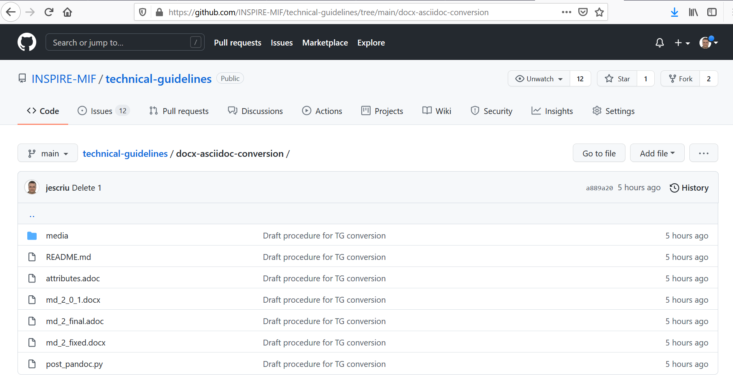
TGs. Conversion Docx-AsciiDoc
GitHub Repository
https://github.com/INSPIRE-MIF/technical-guidelines/tree/main/docx-asciidoc-conversion

Slide 16
TGs. Conversion Docx-AsciiDoc
Future evolution
Evolution
Improve the process to correct small defects identified.
Test it to make it effective for all TGs.
Further evolve it taking into account the test results.
Study how to proceed with complex elements (e.g. UML models).
Planning
Start conversions in 2022.
Priority of conversions: Based on number of change proposals in the GitHub stack and TGs importance/popularity.

Slide 17

Thank you!
Jordi.ESCRIU@ec.europa.eu
© European Union 2020
Unless otherwise noted the reuse of this presentation is authorised under the CC BY 4.0 license. For any use or reproduction of elements that are not owned by the EU, permission may need to be sought directly from the respective right holders.

