Slide 1
What would happen if the Spanish SDI disappeared?

Slide 2
What would happen if we had other data policy?

Slide 3
The study
Background:
  Lack of recent economical studies about SDI.
  We have written two documents about costs (metadata & services) but not about economical value.
  Our data and services are open and free but that doesn’t mean they don’t have an economical (monetary) value.
The issue is very complex:
  I don’t want to raise false expectations, we haven’t resolved the problem.

Slide 4
The study
Our partners:
  KU Leuven (Danny Vandenbroucke and Glen Vancauwenberghe)
  CNIG (Paloma Abad, Antonio Rodríguez and Emilio López)
  Netherlands, Sweden, Switzerland, Slovenia, Croatia, Finland, France (THANK YOU VERY MUCH!!!!)
    They participated in interviews and facilitated statistics and valuable information.
Input data:
  We have only considered the central node of Spanish SDI (local, regional, ministries SDI nodes are out of the scope of the study).
    The IGN is the coordinator of the Spanish SDI and is providing web services operating on datasets which are captured and funded by several administrations (orthophotos, LiDAR, transport network, …).
  We have statistics of data downloads and number of requests to our WMS and WMTS.
    Benefits from other resources (documents, tools, WFS, WCS,…) are considered negligible.

Slide 5
2 approaches
Comparing with Google Maps costs.
Comparing with other countries charging for the use of their data and services.
Many assumptions had to be made because of complexity of the comparison.
  An Excel file with parameters has been developed so every one could adapt the study to their circumstances.

Slide 6
Google Maps comparison
Three key parameters and one assumption:
  Assumption: A Google map load (the base of Google fee system) equals to a user session in a SDI web mapping application.
  Parameters:
    Number of tiles / WMS request: 16, 24, 30, 36.
    Number of tiles / user session: 326, 450, 500.
    Fee-levels: 7$.
  Several methods to estimate the parameter values:
    Literature and expert opinions.
    Simple experiments.
    Calculations where relevant and feasible.

Slide 7
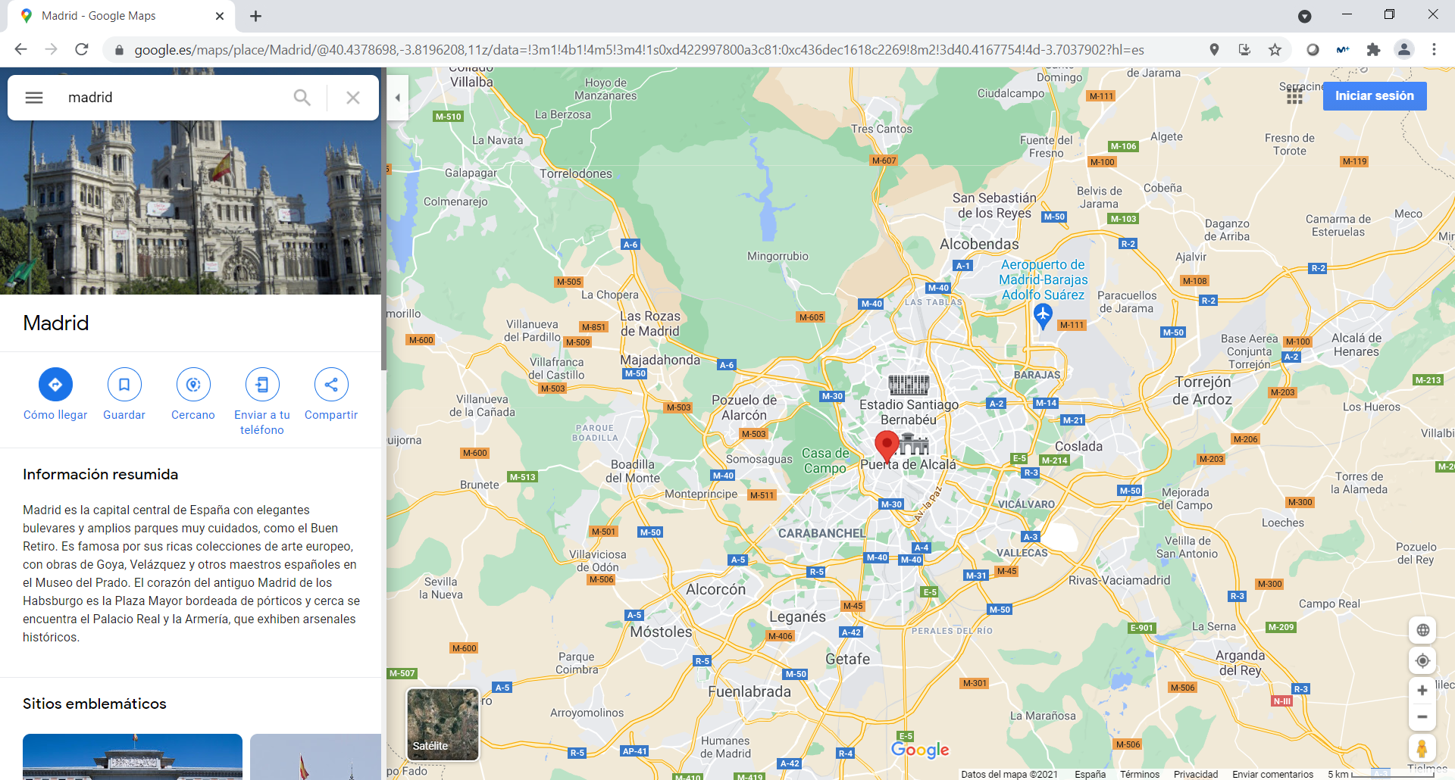
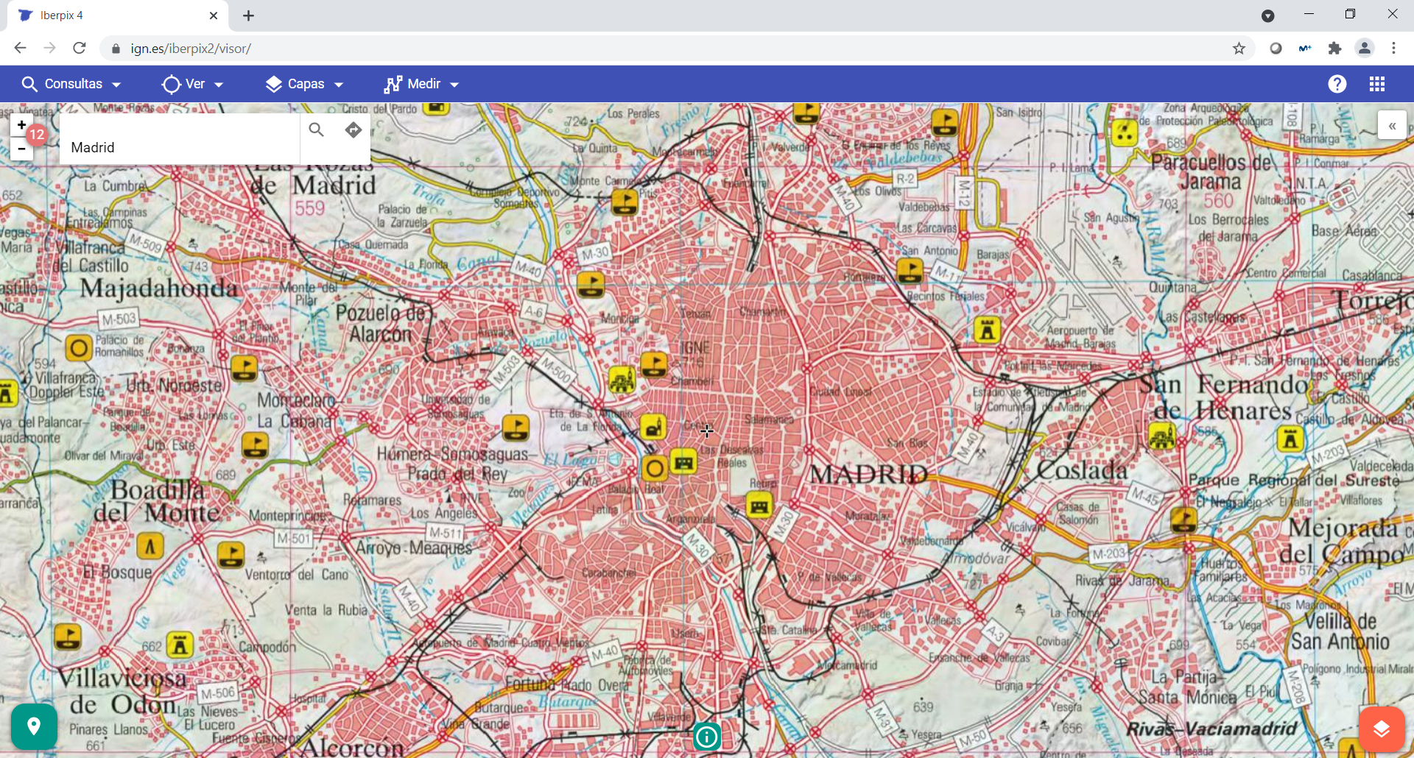
Google Maps session
1 Google maps session =
326, 450, 500 tiles
WMS (image)
WMTS (tiles)
1 WMS image = 16, 24, 30, 36 tiles

Slide 8
SUMMARY | 2020 | 2019 | 2018 | 2017 | 2016
Number of requests per year, WMTS | 17.898.719.075 | 14.027.335.376 | 8.031.710.102 | 4.324.051.938 | 3.591.318.000
Number of requests per year, WMS | 1.086.603.543 | 901.520.866 | 779.033.600 | 920.644.250 | 959.754.108
Parameter 1 (tiles/WMS) - to be entered | 24 | 24 | 24 | 24 | 24
Number of requests per year, WMS, weighted | 26.078.485.032 | 21.636.500.784 | 18.696.806.400 | 22.095.462.000 | 23.034.098.592
Total number of requests per year, WMTS+WMS, weighted | 43.977.204.107 | 35.663.836.160 | 26.728.516.502 | 26.419.513.938 | 26.625.416.592
Parameter 2 (tiles/user session) - to be entered | 450 | 450 | 450 | 450 | 450
Number of user sessions per year | 97.727.120 | 79.252.969 | 59.396.703 | 58.710.031 | 59.167.592
Number of user sessions per month | 8.143.927 | 6.604.414 | 4.949.725 | 4.892.503 | 4.930.633
Parameter 3 (price/1000 sessions/month) - to be entered | 5,82 | 6,25 | 5,93 | 5,82 | 5,82
Value per month | 47.398 € | 41.278 € | 29.352 € | 28.474 € | 28.696 €
Value per year | 568.772 € | 495.331 € | 352.222 € | 341.692 € | 344.355 €

Slide 9
Other European countries comparison
First, again, thank you for being transparent and helpful.
All studied countries have statistics of use and downloads.
Three parameters are taken into consideration:
  Different percentage of each type of users that need to pay a fee.
  Fee per request based on the applicable fees for different use levels.
  Different calculations for WMS, WMTS and dataset.
And we applied the price level index:
  https://ec.europa.eu/eurostat/statistics-explained/index.php?title=Comparative_price_levels_of_consumer_goods_and_services#Overall_price_levels

Slide 10
Other European countries comparison
For calculating the value of WMS and WMTS of the Spanish SDI, we applied the fee models of Finland, France and Sweden.
For each country we worked with two fees per request (minimum and average fee).
We also work with different percentages of request that require a fee (100%, 50%, 10%).
Conclusion: different scenarios implies very different estimations.

Slide 11
Other European countries comparison
For calculating the fee model for the download of data, we focused on orthophotos, topographic maps and LiDAR data.
We took into consideration two countries.
And we work with different percentages of request that require a fee (100%, 50%, 10%) as well.

Slide 12
SUMMARY for the 10% CHARGES scenarios
SUMMARY - WMS | 2020 | 2019 | 2018 | 2017 | 2016
Number of requests per year, WMS | 1.086.603.543 | 901.520.866 | 779.033.600 | 920.644.250 | 959.754.108
Finland
Minimum fee - 10% of services - adjusted | 13.330 € | 11.059 € | 9.557 € | 11.294 € | 11.774 €
Average fee - 10% of services - adjusted | 114.971 € | 95.388 € | 82.427 € | 97.411 € | 101.549 €
France
Minimum fee - 10% of services - adjusted | 101.503 € | 84.213 € | 72.772 € | 86.000 € | 89.653 €
Average fee - 10% of services - adjusted | 1.250.327 € | 1.037.357 € | 896.414 € | 896.414 € | 1.104.365 €
Sweden
Minimum fee - 10% of services - adjusted | 272.234 € | 225.864 € | 195.176 € | 230.655 € | 240.454 €
Average fee - 10% of services - adjusted | 6.040.191 € | 5.011.357 € | 4.330.477 € | 5.117.659 € | 5.335.062 €
SUMMARY - WMTS | 2020 | 2019 | 2018 | 2017 | 2016
Number of requests per year, WMTS | 17.898.719.075 | 14.027.335.376 | 8.031.710.102 | 4.324.051.938 | 3.591.318.000
Finland
Minimum fee - 10% of services - adjusted | 13.723 € | 10.755 € | 6.158 € | 3.315 € | 2.754 €
Average fee - 10% of services - adjusted | 452.869 € | 354.916 € | 203.216 € | 109.406 € | 90.867 €
France
Minimum fee - 10% of services - adjusted | 91.198 € | 71.473 € | 40.923 € | 22.032 € | 18.299 €
Average fee - 10% of services - adjusted | 1.276.775 € | 1.000.617 € | 572.929 | 308.449 € | 256.181 €
Sweden
Minimum fee - 10% of services - adjusted | 4.484.284 € | 3.514.361 € | 2.012.237 € | 1.083.333 € | 899.757 €
Average fee - 10% of services - adjusted | 98.093.712 € | 76.876.640 € | 44.017.689 € | 23.697.914 € | 19.682.175 €

Slide 13
 |  |  | LiDAR | Raster | Orthophoto
 |  | DOWNLOADS (2019) | 3.173.372 | 1.714.520 | 564.803
Country 1 - adjusted | Adjusted fee/download |  | 12,06 € | 12,06 € | 12,06 €
Number of downloads | %charges | 100% | 38.272.458 | 20.677.971 | 6.811.807
 |  | 50% | 19.136.229 | 10.338.986 | 3.405.904
 |  | 10% | 3.827.246 | 2.067.797 | 681.181
Country 2 - adjusted | Adjusted fee/download |  | 3,10 | 17,95 | 26,92
 | %charges | 100% | 9.838.692 € | 30.772.287 € | 15.201.847 €
 |  | 50% | 4.919.346 € | 15.386.143 € | 7.600.924 €
 |  | 10% | 983.869 € | 3.077.229 € | 1.520.185 €
Adjustment factors | Finland (country 1) | 0,766719745
 | Croatia (country 2 for orthophoto & raster) | 1,35252809
 | Sweden (country 2 for LIDAR) | 0,782926829

Slide 14
Future works
Extending the analysis to other SDI nodes.
Getting better insights in Google mechanism and business model.
More advanced and extended experiments.
More information on charging mechanism and fees.

Slide 15
This is only the first step. Are you interested in continuing with the project?
Thanks for your attention.

