Slide 1

INSPIRE Geoportal
Robert Tomas
INSPIRE MIG-T Meeting
Paris, 24-25 October
Joint Research Centre
The European Commission’s science and knowledge service

Slide 2

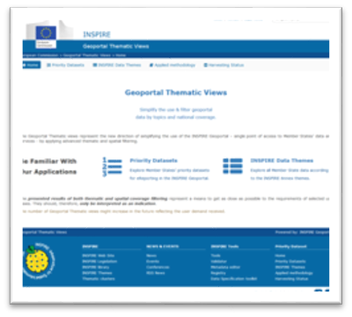

    New INSPIRE GEOPORTAL
Officially launched 18.9. 2018 during the INSPIRE Conference 2018
Based on the concept of “THEMATIC VIEWS”:
  User-centric = easy to use – set of predefined thematic views.
  Data sets-centric = main goal is to get the data!!
  Provide clear & reliable overviews of INSPIRE data sets availability.
Optimalisation of the back-end processes
Improved performance = complete re-coding of the front-end applications
Integration with other INSPIRE tools (IKB, Registry, Reference Validator, Thematic Clusters)
Notes:
DG JRC within the Commission

Slide 3
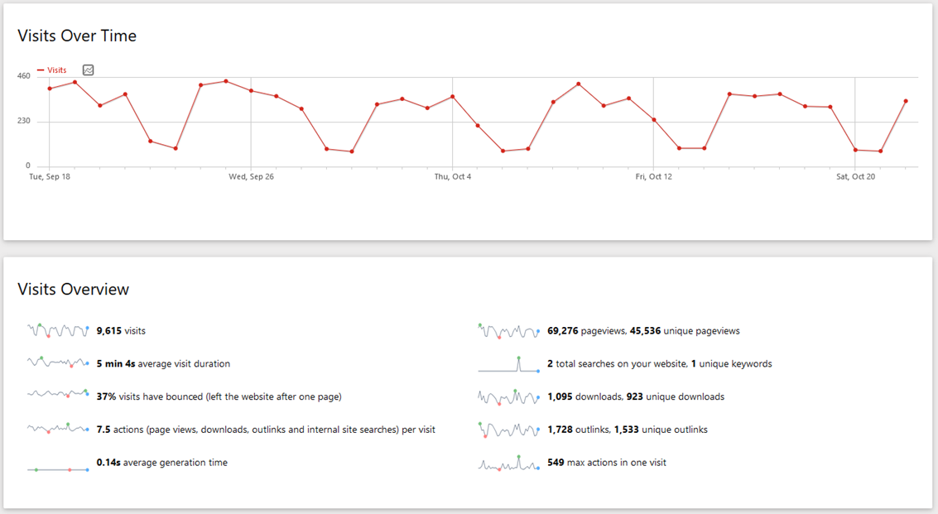

2018-09-18 -> 2018-10-22
    New INSPIRE GEOPORTAL – Web Analytics
Notes:
DG JRC within the Commission

Slide 4
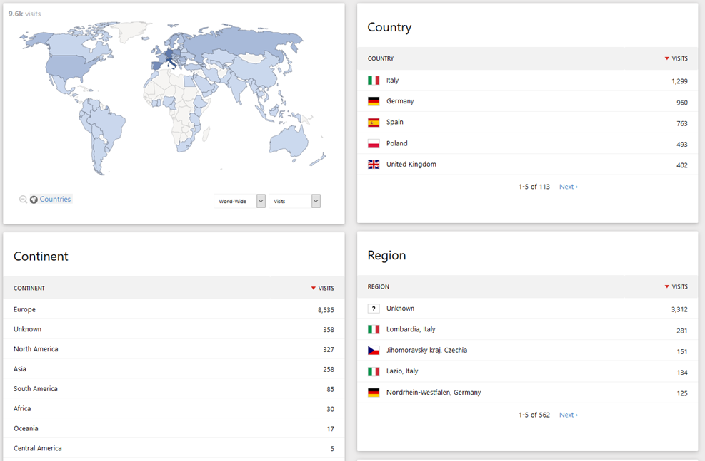
2018-09-18 -> 2018-10-22
    New INSPIRE GEOPORTAL – Web Analytics
Notes:
DG JRC within the Commission

Slide 5
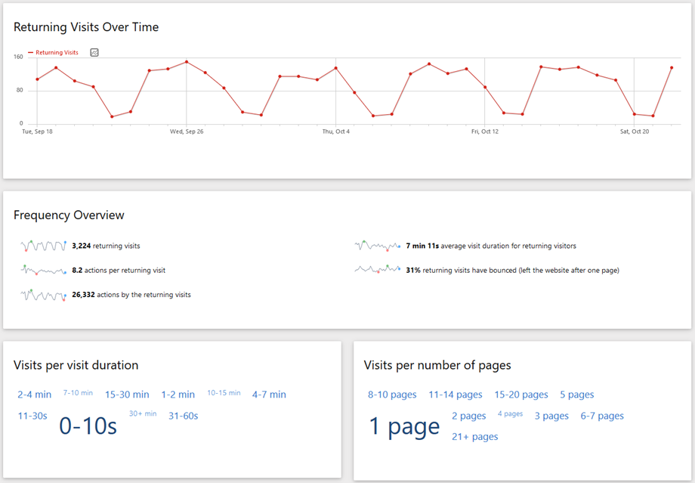
2018-09-18 -> 2018-10-22
    New INSPIRE GEOPORTAL – Web Analytics
Notes:
DG JRC within the Commission

Slide 6
    INSPIRE GEOPORTAL – Annex I Data sets
Notes:
DG JRC within the Commission

Slide 7
    INSPIRE GEOPORTAL – Priority data sets
Notes:
DG JRC within the Commission

Slide 8
    INSPIRE Geoportal - Future plans
The New INSPIRE GEOPORTAL
Demo
MIG-T Meeting
Paris, 23-24.10.2018
Notes:
DG JRC within the Commission

Slide 9

    INSPIRE Geoportal – V1.1 Planning – January 2019
The two major Tasks were defined:
Upgrade of the Harvesting process
  HW reinforcing back-end solution = better load balancing
  New Harvesting management platform = for registered MS catalogues responsible; self-updating functionality; MS official confirmation of the Harvesting reports.
INSPIRE Analytics – new “Viewer” based on the Resource browser / Apache SOLr search engine to enable users & innovative service providers (via open API) exploit INSPIRE Metadata, data & services.
+ small additions e.g. English translations, highlighting selected keywords
Notes:
DG JRC within the Commission

Slide 10
    INSPIRE Geoportal - possible future directions
Geoportal Organisation & Governance
Geoportal Advisory Board (EC services, EEA, MS representatives)
  To discuss collected proposals and give advice on the future Geo-portal development directions.
Proposal for a new temporary MIG sub-group JRC Geoportal team + MS technical experts-National catalogues administrators
  To meet 2x a year to discuss strictly technical matters related to the provision of country INSPIRE data via Geoportal;
  Possible improvements of the INSPIRE infrastructure (distributed).
Notes:
DG JRC within the Commission

Slide 11
    INSPIRE Geoportal expert Workshop 23-24.1.2019
    Together improving availability of MS data sets
Main objectives of the workshop are:
1) Assessing and resolving together concrete technical issues with providing MS data resources via INSPIRE Geoportal (Helpdesk)
2) Collecting and discussing proposed changes and improvements of the Geoportal (functional, organisational)
3) Setting up a network of technical experts and agreeing on the operational aspects/follow up (Harvesting, Helpdesk, ...)
Where: the workshop will take place at JRC (Ispra, Italy) from 23-24.1.2019.
Who: WS is targeted at MS technical experts who:
- are directly administrating national catalogues harvested by the INSPIRE Geoportal or
- are coordinating the national activity, but have a strong technical background.
Please, nominate max. 2 experts per country by 26.10.2018 by replying to this e-mail and providing the following information: Name, organisation, current role in the National INSPIRE/SDI infrastructure, contact e-mail.
Notes:
DG JRC within the Commission

Slide 12


Thank you
Questions?
robert.tomas@ec.europa.eu
Make it work together

