Slide 1
Action 1.1 Towards a Digital
Ecosystem for the
Environment and Sustainability

Slide 2
Content
Ex-ante policy development pathways for the EGDDS legal instrument(s) - a technical perspective
JRC study of interoperability provisions for environmental data sharing
JRC Knowledge base on Common European Data Spaces
Guidelines on the validation and use of GPKG for END e-reporting

Slide 3
Ex-ante policy development pathways for the EGDDS legal instrument(s)
A perspective from the JRC
Jordi Escriu, Marco Minghini, Alexander Kotsev

Slide 4
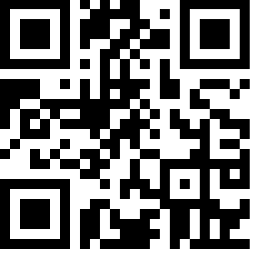
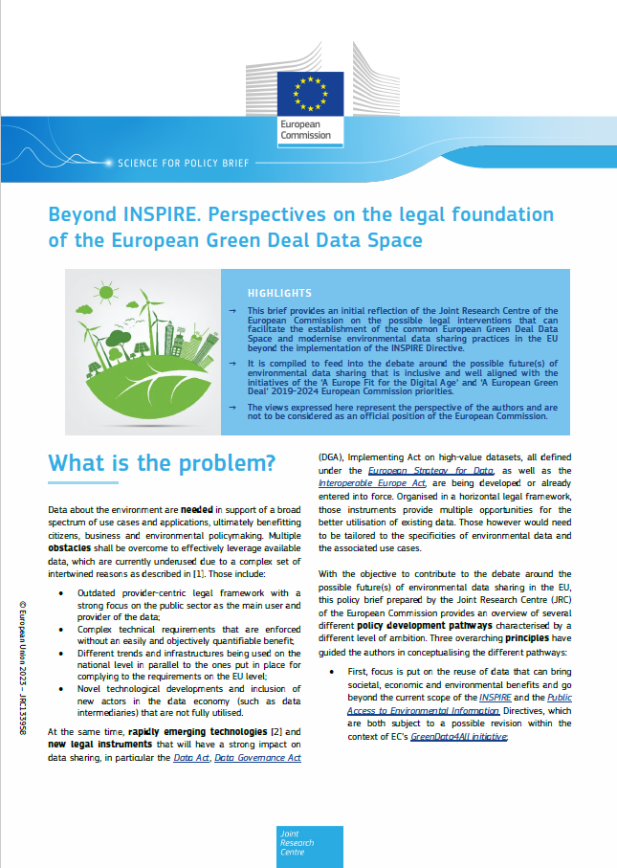
Context & Disclaimers
JRC prepared an ex ante perspective on the possible future(s) of the legal framework
Overall objective: contribute to the debate around the different policy options led by ENV
Focus is put on the technical and governance aspects
This represents the opinion of the authors and is not an official position of the European Commission
https://europa.eu/!Hyf3mf

Slide 5
What is the problem
Multiple obstacles shall be overcome to effectively leverage available data
  Legal framework that needs to be modernised
  Complex technical requirements
  Parallel implementations on the national level
  Rapidly evolving technological landscape
  Many opportunities created by the horizontal legislation defined by the European Strategy for data
    Data Act, Data Governance Act, HVD implementing provisions

Slide 6
Policy development pathways (ex-ante)
Different level of ambition and integration between INSPIRE and the horizontal legal instruments
Each pathway has its specific advantages and disadvantages
Guiding Principles
focus is put on the reuse of data that can bring societal, economic and environmental benefits and go beyond the current scope of INSPIRE
the EU legal framework should effectively contribute to establishing and sustaining an ecosystem of actors around data-driven innovation
Legal framework should align existing and new (digital and green) legal frameworks in a future-proof manner.

Slide 7



Business data
IoT data
Public Sector Geospatial
Open Data
Citizen-Generated Data
Research Data
Copernicus
Data types
INSPIRE
Open Data
Directive
Data Governance
Act
Horizon Europe
programme
Space
programme
Legal instrument
Data Act
Public Access to Environmental
Information Directive
Policy measures
B2G data
sharing
Non-personal
data reuse
SDI
Open Data + HVD
Data trust
FAIR data
Open reusable EO
MIG
Open Data Committee
Registered
Data Altruism Organisations
Horizon Europe WP
Governance
MIG-T
Data intermediaries
Green Data Board
European Data Innovation Board
Pathway 1 a, b
Environment
Businesses
Citizens
Benefits
Pathway 2
Pathway 3 b
Pathway 3 a

Slide 8
Study of interoperability provisions for environmental data sharing

Slide 9

Expert contract
Title:
Evaluation of prospective interoperability provisions for environmental data sharing and reuse within the common European Green Deal data space
Timeline:
Started in June 2023 – Duration: 8 Months (~ end by January 2024)
Expert awarded:
Thorsten Reitz (wetransform - https://wetransform.to)

Slide 10

Objective
Identify approaches, challenges, and opportunities for setting the most-targeted and appropriate interoperability provisions for environmental data sharing and reuse.
Applicable to the European Green Deal Data Space.
To be considered as input for the GreenData4All initiative.
Update of the existing legal framework for environmental data sharing in EU, with a potential revision of the INSPIRE (Directive 2007/2/EC) and Public Access to Environmental Information (Directive 2003/4/EC) Directives.
Scope: Discovery, access and reuse of data in the environmental sector.
Context: EU Strategy for Data.

Slide 11

Tasks - Deliverables and schedule
Timing | Reference | Deliverable
M1 Jun 2023 | KO | Kick-off meeting with JRC
M3 Aug 2023 | D1 | Identification and analysis of current interoperability provisions on environmental data sharing
M6 Nov 2023 | D2 | Recommended interoperability provisions for the Green Deal data space
M7 Dec 2023 | D3 | Validation workshop
M8 Jan 2024 | D4 | Prospective interoperability provisions for the Green Deal data space and outreach
Task 1. Identification and analysis of current interoperability provisions on environmental data sharing
Task 2. Recommended interoperability provisions for the Green Deal data space
Task 3. Validation workshop
Task 4. Prospective interoperability provisions for the Green Deal data space and outreach

Slide 12

Expected outcomes
Critical analysis of the interoperability rules governing the sharing of environmental data based on the legal framework currently in force in the EU.
  State-of-the-art (emerging trends, modern standards and technology).
  Existing practices and previous experience (MS implementations).
Identification of main barriers, bottlenecks, challenges and opportunities for improving and further achieving the interoperability objectives in the future societal and policy context.
Summary of lessons learned and, where necessary, pragmatic suggestions for setting prospective approaches for achieving the interoperability in the Green Deal data space (scenarios with different level of ambition).

Slide 13
JRC Knowledge base on Common
European Data Spaces

Slide 14

JRC knowledge base on data sharing and use
Objectives
  Identify, map and expose JRC resources relevant to common European data spaces
  Complement other data space resources and activities
Components
  Science for Policy report
  Interactive dashboard
  Wiki page
Intended audience
  Policy DGs
  Data space stakeholders
    Data providers, standardisation bodies, early adopters of technology, user communities

Slide 15

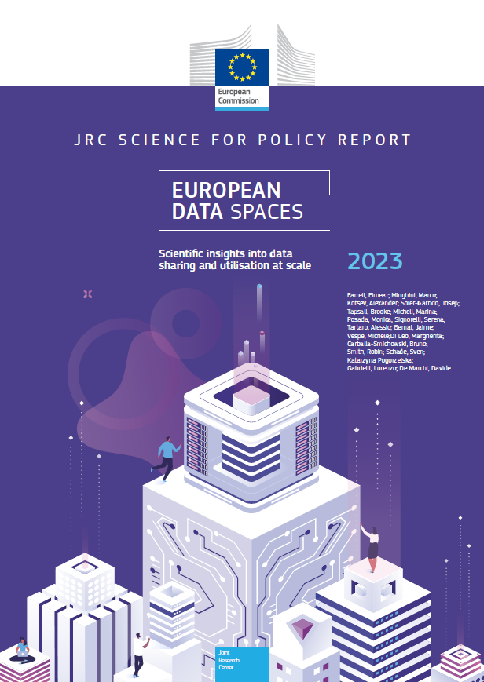
JRC Science for Policy report
  What?
  Scientific techno-socio-economic perspective
  Non-binding recommendations/good practices
  Complementary to other resources on data spaces
  How?
  Input by 18 co-authors
  Co-creation and validation
    Within JRC
    With policy DGs
    Other stakeholders

Slide 16
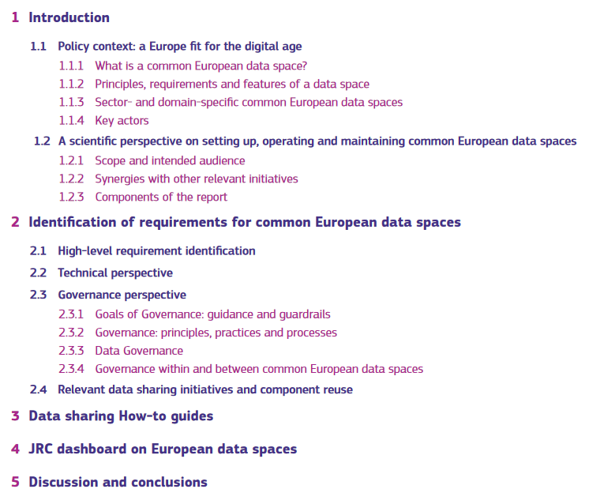

Contents

Slide 17
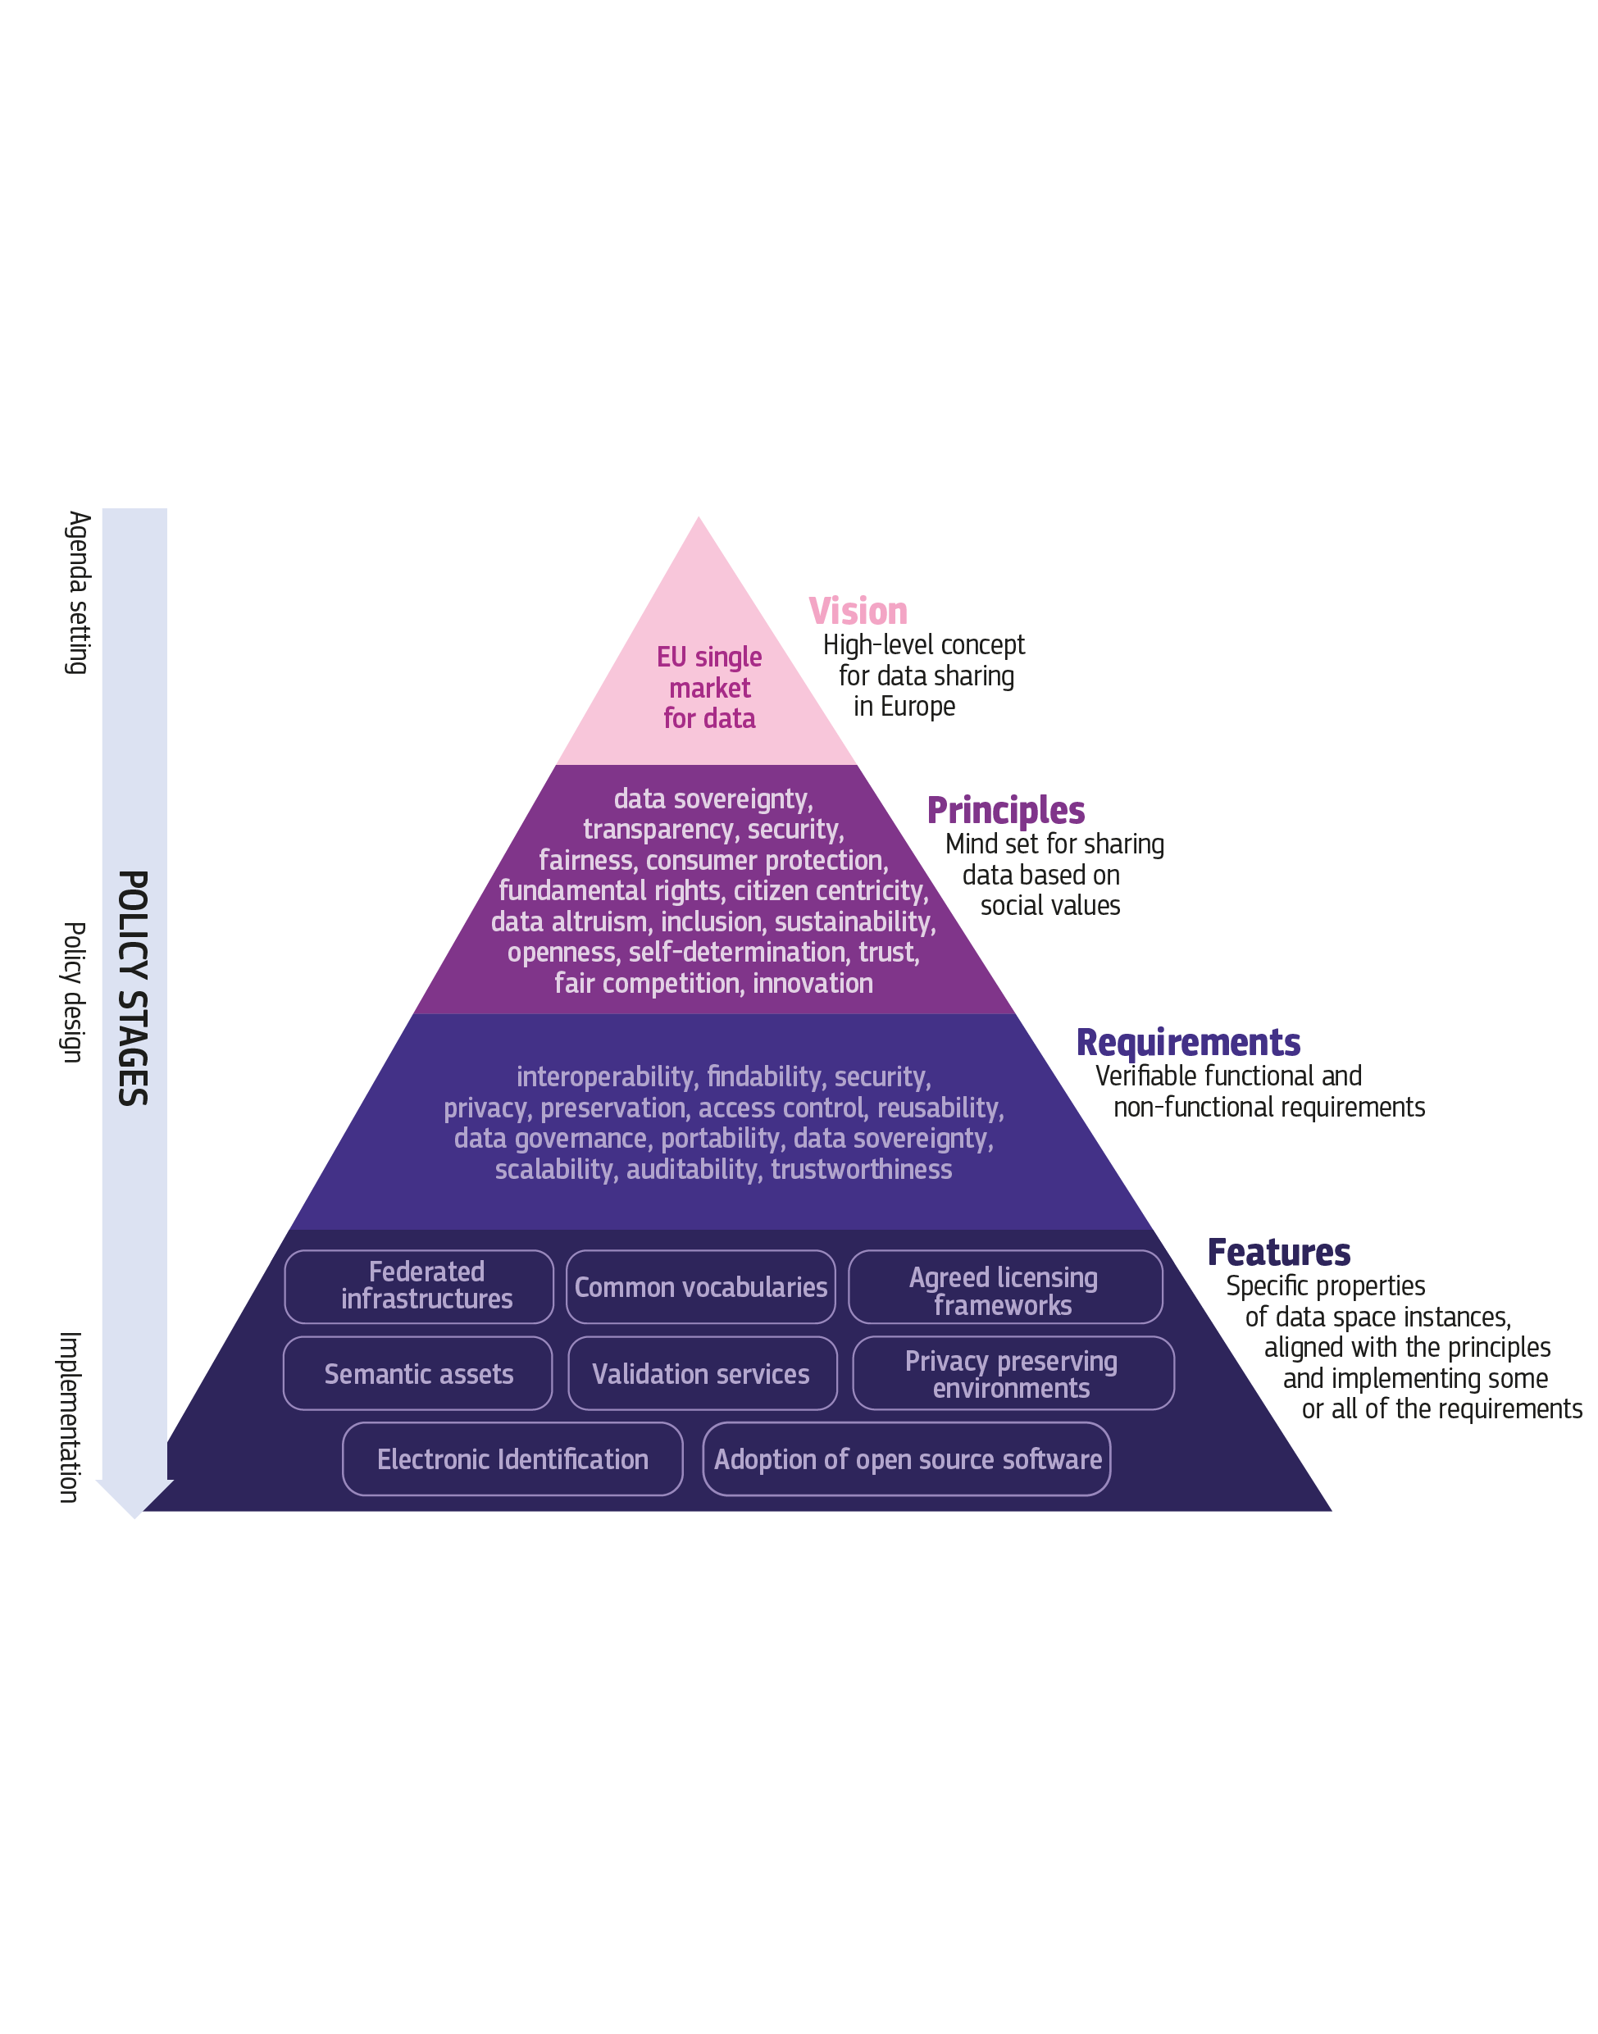
Our analytical lens

Slide 18
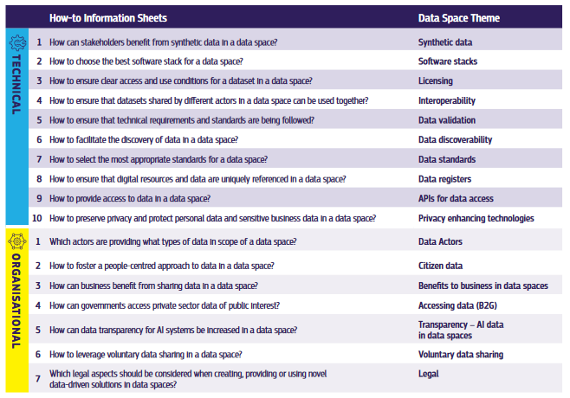
How-to’s on technical and organisational aspects of data sharing

Slide 19
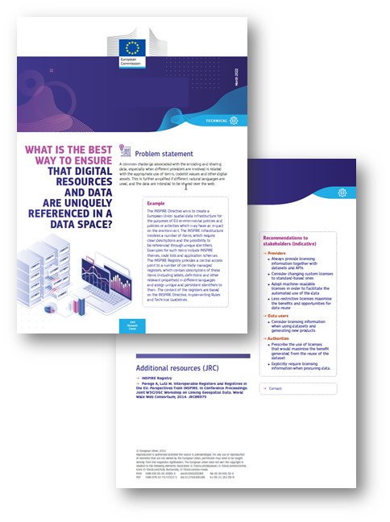
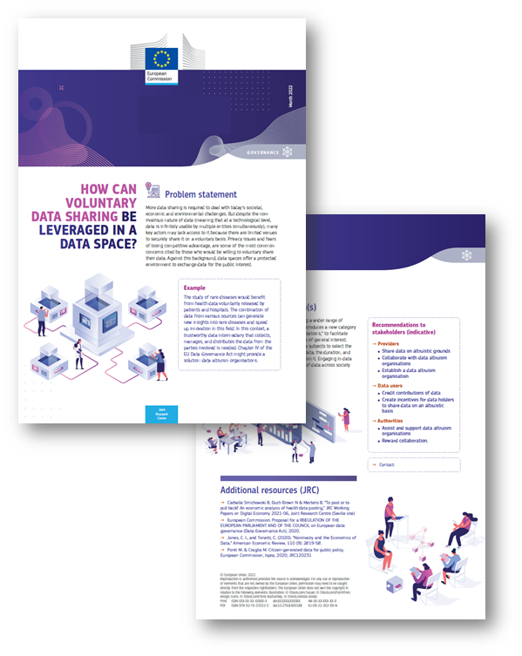

Sample How-to's on Data Sharing

Slide 20
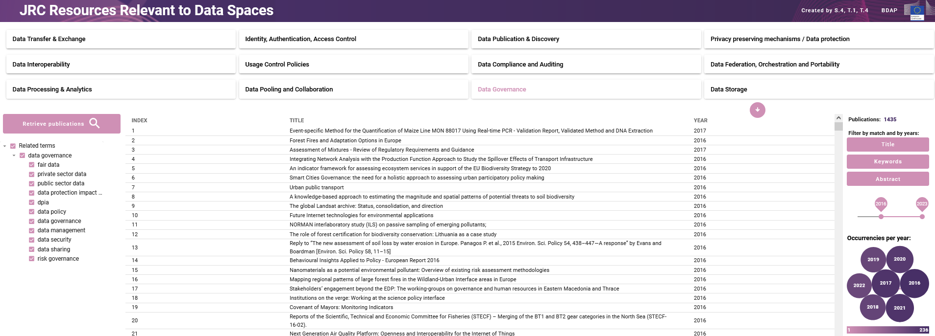
Dashboard: JRC resources mapped to requirements for European data spaces
https://jeodpp.jrc.ec.europa.eu/eu/dashboard/voila/render/DataSpaces/JRCResourcesData.ipynb

Slide 21
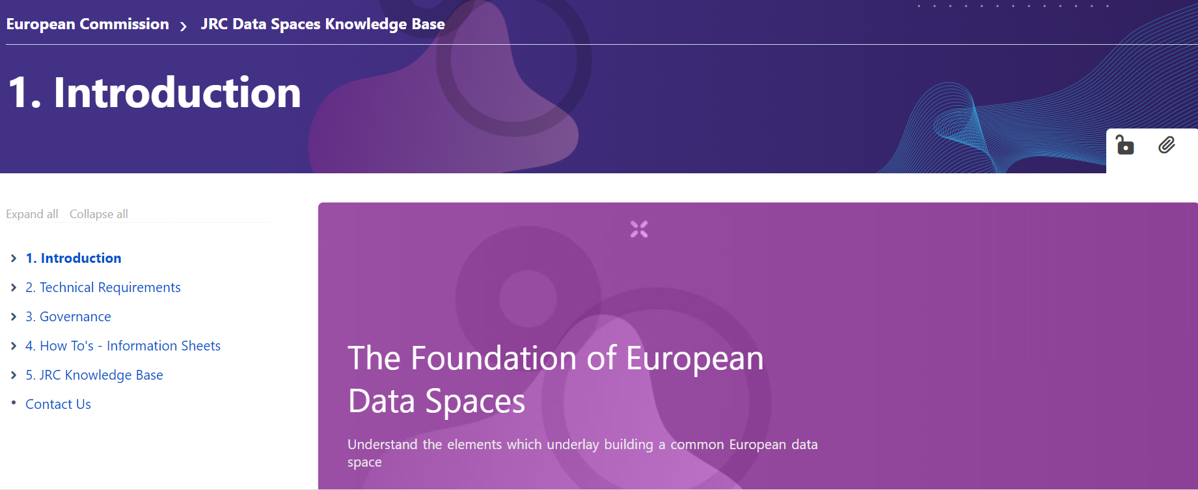
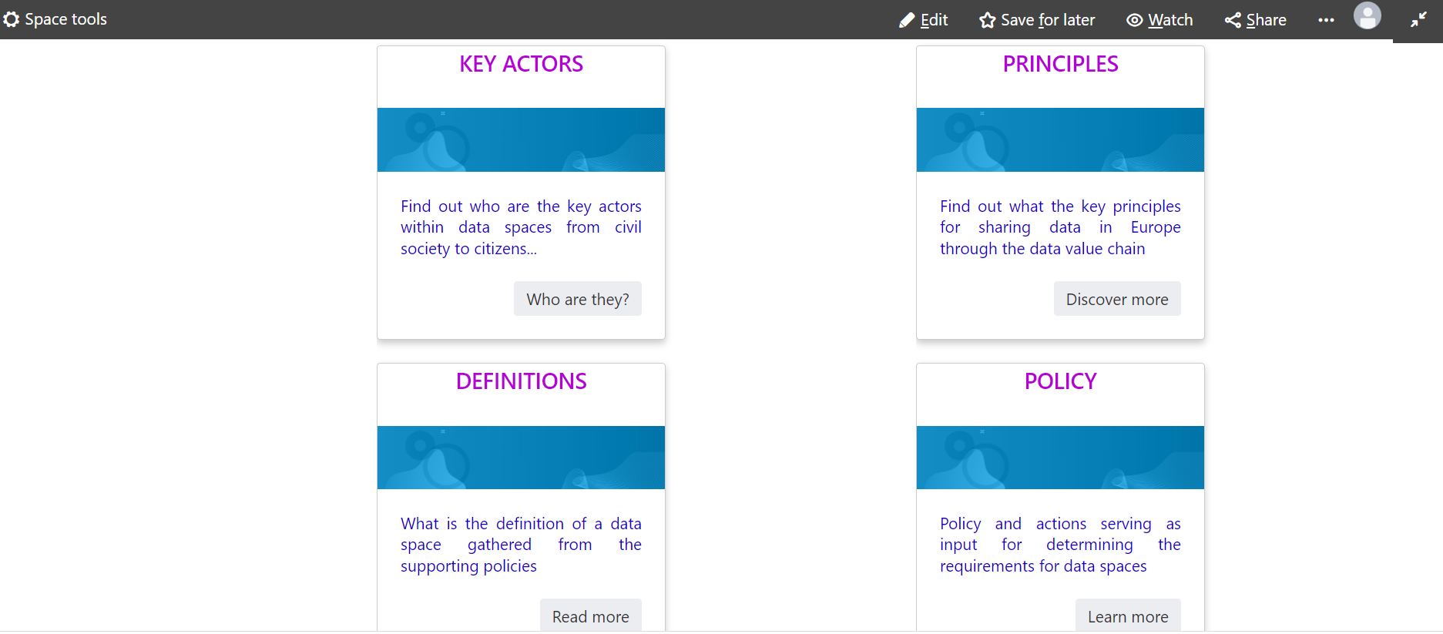

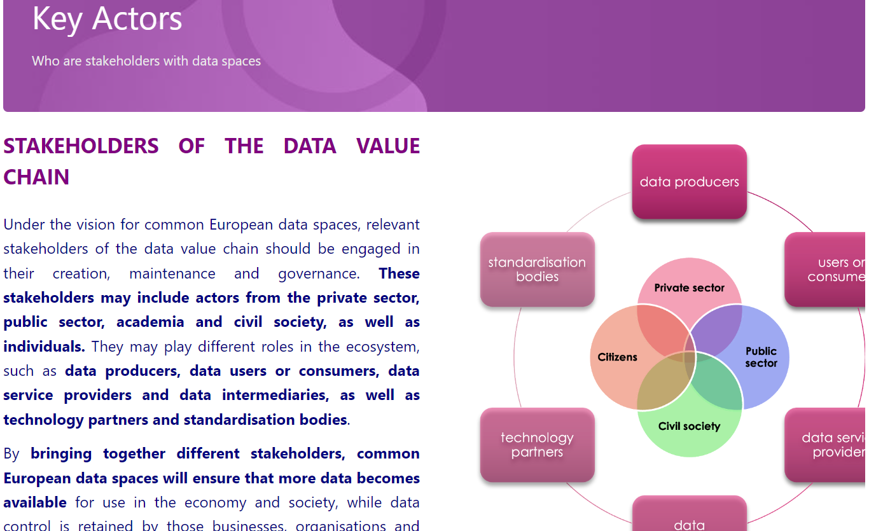
Wiki
https://wikis.ec.europa.eu/display/jrcdataspaceswiki/JRC+Data+Spaces+Knowledge+Base

Slide 22
Guidelines on the validation and use of GPKG for END e-reporting

Slide 23








Keep in touch
ec.europa.eu/
europeancommission
europa.eu/
@EuropeanCommission
@EU_Commission
EUTube
@EuropeanCommission
EU Spotify
European Commission
Notes:
Delete/update as appropriate

Slide 24

Thank you
© European Union 2023
Unless otherwise noted the reuse of this presentation is authorised under the CC BY 4.0 license. For any use or reproduction of elements that are not owned by the EU, permission may need to be sought directly from the respective right holders.
Slide xx: element concerned, source: e.g. Fotolia.com; Slide xx: element concerned, source: e.g. iStock.com
Notes:
Update/add/delete parts of the copy right notice where appropriate.
More information: https://myintracomm.ec.europa.eu/corp/intellectual-property/Documents/2019_Reuse-guidelines%28CC-BY%29.pdf

