Slide 1

INSPIRE Registry & Re3gistry software
JRC INSPIRE Team
75th MIG-T meeting – July 7, 2023

Slide 2
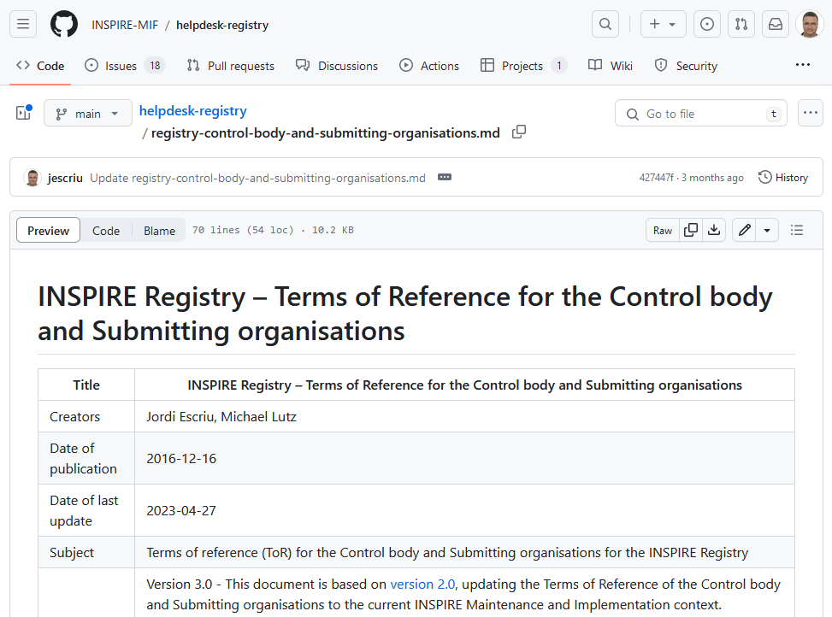
INSPIRE Registry
74 MIG-T
‘Terms of Reference for the Control body and Submitting organisations’
    ENDORSED!
https://github.com/INSPIRE-MIF/helpdesk-registry/pull/53

Slide 3
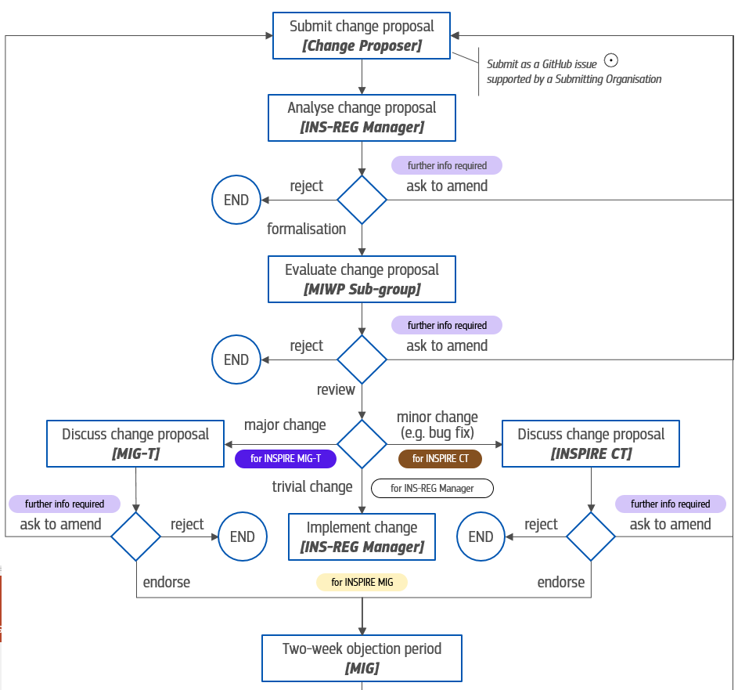
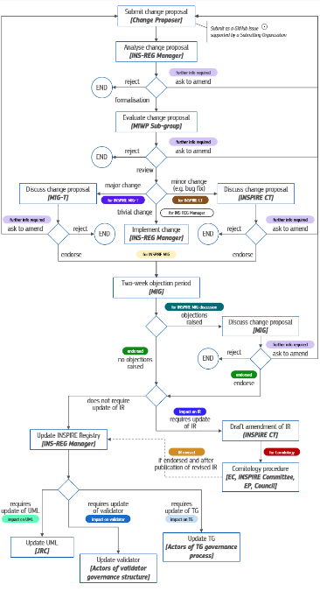
INSPIRE Registry
74 MIG-T
‘Governance workflow’
    ENDORSED!

Slide 4
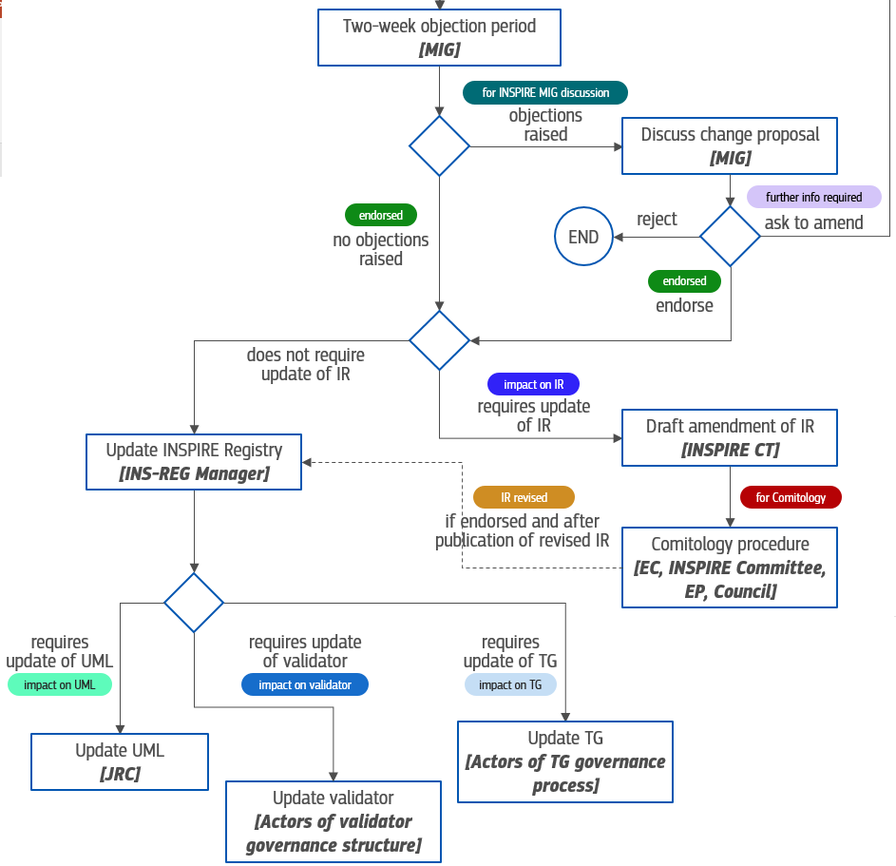
INSPIRE Registry
74 MIG-T
‘Governance workflow’
    ENDORSED!

Slide 5
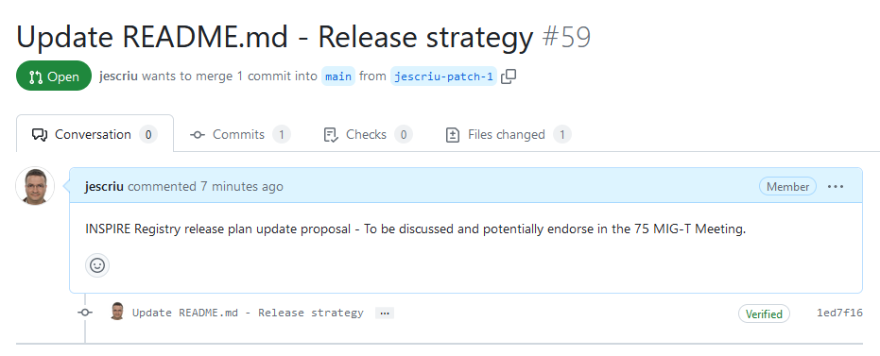
INSPIRE Registry
Release strategy
Proposal 75 MIG-T
Update and streamlined INSPIRE Registry release plan:
  Two releases a year: 31 January & 31 July.
  Aligned with the releases of the rest of INSPIRE artefacts.
Proposed for Endorsement
https://github.com/INSPIRE-MIF/helpdesk-registry/pull/59

Slide 6
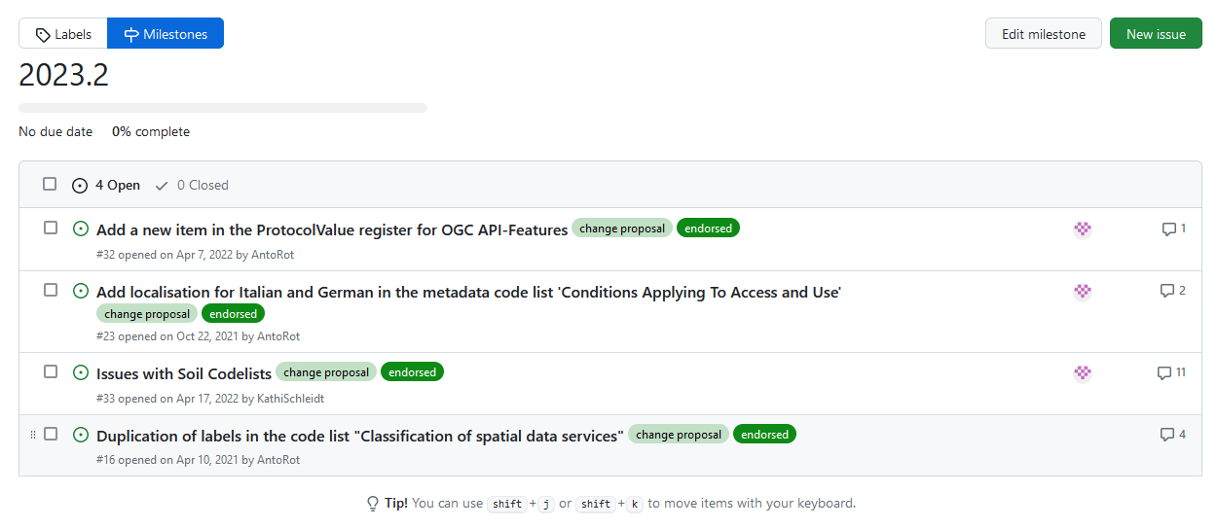
Release of INSPIRE Registry - 2023.02
Change proposals agreed in the 74 MIG-T
https://github.com/INSPIRE-MIF/helpdesk-registry/milestone/1
Expected on 31 July

Slide 7



Re3gistry & INSPIRE Registry
Community feedback
New surveys are now available in EU-Survey
Promotion:
  Re3gistry software:
  https://ec.europa.eu/eusurvey/runner/Re3gistry_Survey
  INSPIRE Registry
  XXX

Slide 8
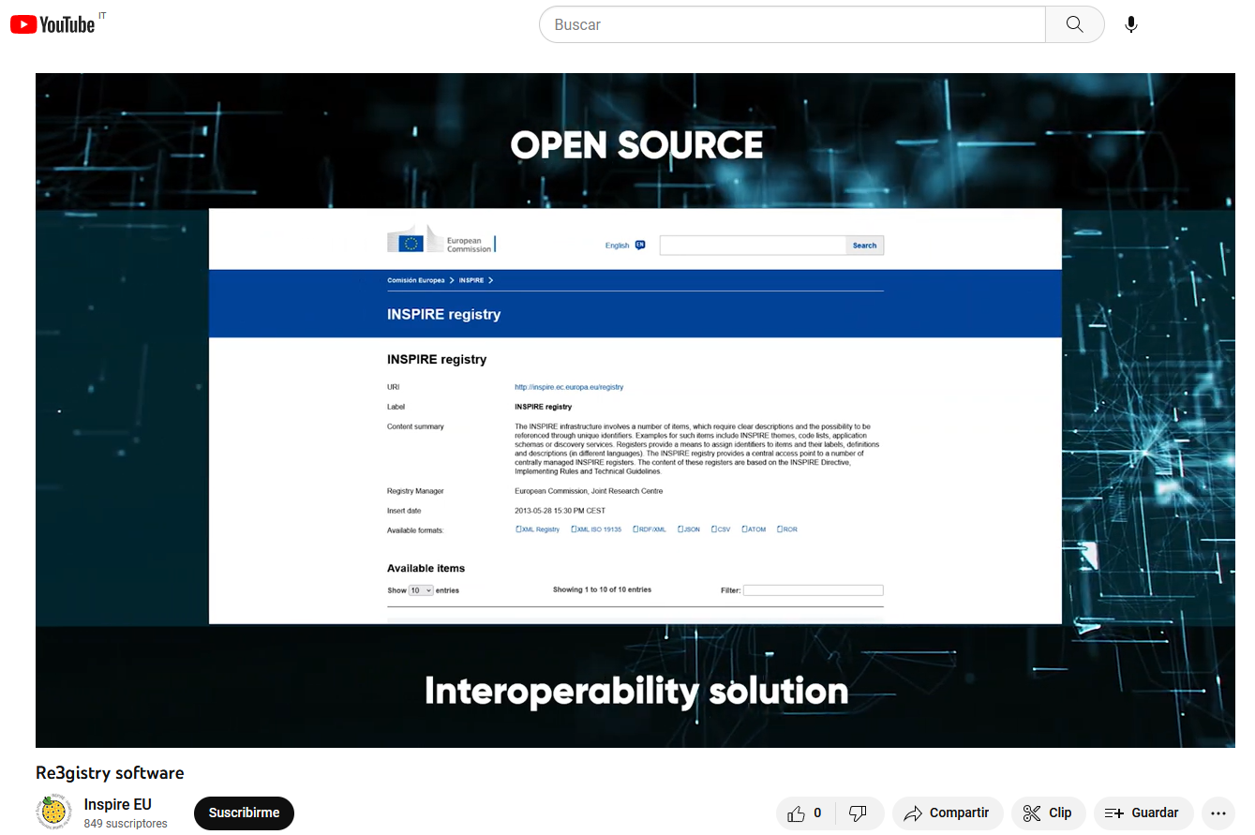
Re3gistry promotional video
INSPIRE YouTube channel
https://youtu.be/6Y_KAhibGas

Slide 9


Thank you!
© European Union 2023
Unless otherwise noted the reuse of this presentation is authorised under the CC BY 4.0 license. For any use or reproduction of elements that are not owned by the EU, permission may need to be sought directly from the respective right holders.
jordi.escriu@ec.europa.eu
Notes:
Update/add/delete parts of the copy right notice where appropriate.
More information: https://myintracomm.ec.europa.eu/corp/intellectual-property/Documents/2019_Reuse-guidelines%28CC-BY%29.pdf

Slide 10





Keep in touch
EU Science Hub: ec.europa.eu/jrc
@EU_ScienceHub
EU Science Hub – Joint Research Centre
EU Science, Research and Innovation
Eu Science Hub
Notes:
Delete/update as appropriate

