Slide 1

MIWP Action 2.3.2
'Data-service linking simplification'
MIG-T Sub-group 2.3.2
Antonio Rotundo, Ine de Visser, Marie Lambois, Heidi Vanparys
JRC INSPIRE Team
Jordi Escriu, Davide Artasensi, Marco Minghini, Alexander Kotsev
69th MIG-T meeting – April 1st, 2022

Slide 2

MIWP Action 2.3.2
Data Service Linking Simplification - Overview
Data set metadata
Service metadata
Part A. Data - service linking simplification
Good practice guidelines
OperatesOn
Service URL
ID DATASET
Get
Capabilities
Service metadata URL
Part B. Data - service linking simplification
Remapping of Extended Capabilities
INSPIRE extended capabilities
Data set metadata URL
Layers
Notes:
The main message is that ...

Slide 3
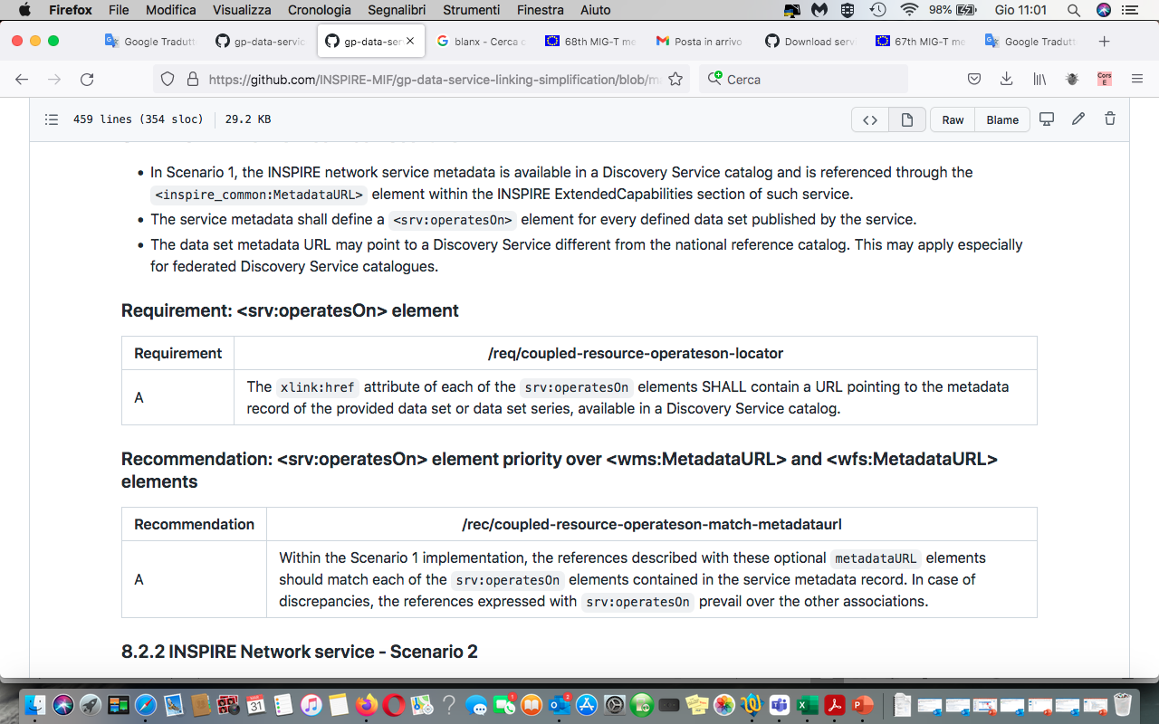
Pending issue from Part A.
Data Service Linking Simplification guidelines
Coupled resource implementation is not compliant Issue #38
Agreed approach
Relax TG Requirement 3.6 by keeping the linkage to the #MD_DataIdentification section of the metadata as optional
Add an explanatory note on this aspect in the Part A final consolidated proposal
Notes:
The main message is that ...

Slide 4
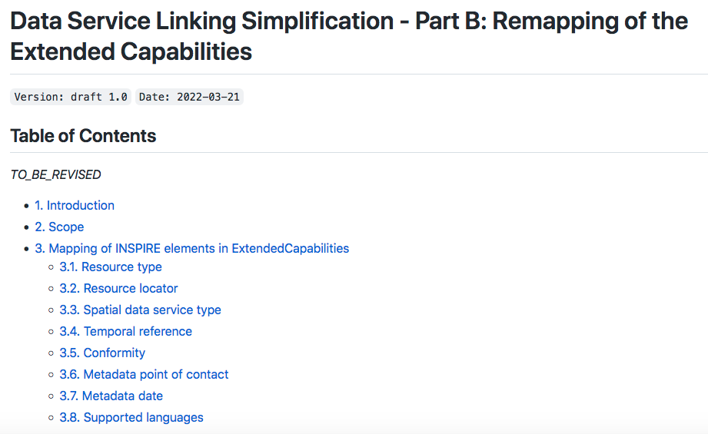
MIWP Sub-group 2.3.2
Part B. Remapping of Extended Capabilities
4 volunteer experts from 4 Member States: DK, FR, IT, NL
Kick-off meeting: 2021-12-03
Starting point: Part A Consolidated proposal – Annex B
2nd meeting: 2022-02-25
Good discussion in the dedicated GitHub repository
Consolidated proposal ready and agreed by Part B – team
Few aspects to be further polished / completed.
https://github.com/INSPIRE-MIF/gp-data-service-linking-simplification/blob/main/proposals/Part-B-team/Consolidated-proposal-Part-B.md
Notes:
The main message is that ...

Slide 5
Part B. Remapping of Extended Capabilities
Aim of the work
Define an alternative mapping of INSPIRE service metadata elements to elements available in the Capabilities document of OGC OWS standard services (WMS, WFS) and Atom feeds.
Avoid (as an option) the need for the INSPIRE Extended Capabilities section.
Remove remaining obstacles in the implementation of INSPIRE requirements for network services due to the extensions required to software tools available in the market.
Notes:
The main message is that ...

Slide 6
Part B. Remapping of Extended Capabilities
Resource Type and Resource Locator
Current mapping (in INSPIRE NS - View/Download Service TGs)
INSPIRE metadata elements | Elements of INSPIRE Extended Capabilities/Atom feed | Applicable on Service type
Resource Type | inspire_common:ResourceType | WMS - WFS
Resource Type | not mapped | Atom
Resource Locator | inspire_common:ResourceLocator | WMS - WFS
Resource Locator | Feed level link in the top Atom feed /feed/link[@rel="self"] | Atom
Agreed new mapping
INSPIRE metadata elements | New allocation | Applicable on Service type
Resource Type | No element mapped | WMS - WFS - Atom
Resource Locator | No element mapped | WMS - WFS - Atom
Notes:
The main message is that ...

Slide 7
Part B. Remapping of Extended Capabilities
Spatial data service type
Current mapping (in INSPIRE NS - View/Download Service TGs)
INSPIRE metadata elements | Elements of INSPIRE Extended Capabilities/Atom feed | Applicable on Service type
Spatial Data Service Type | inspire_common:SpatialDataServiceType | WMS - WFS
Spatial Data Service Type | not mapped | Atom
Agreed new mapping
INSPIRE metadata elements | New allocation | Applicable on Service type
Spatial Data Service Type | gmd:applicationProfile element (in data set metadata record) | WMS - WFS - Atom
Notes:
The main message is that ...

Slide 8
Part B. Remapping of Extended Capabilities
Temporal reference
Current mapping (in INSPIRE NS - View/Download Service TGs)
INSPIRE metadata elements | Elements of INSPIRE Extended Capabilities/Atom feed | Applicable on Service type
Temporal Reference | inspire_common:TemporalReference | WMS - WFS
Temporal Reference | not mapped | Atom
Agreed new mapping
INSPIRE metadata elements | New allocation | Applicable on Service type
Temporal Reference | updateSequence attribute in the WMS_Capabilities/WFS_Capabilities root element. | WMS - WFS
Temporal Reference | feed/updated element in the Atom feed | Atom
Temporal Reference | Otherwise, gmd:citation/gmd:CI_Citation/gmd:date/gmd:CI_Date/gmd:date element in the data set metadata record, with one of the following prioritised date types:- publication, - revision or - creation | WMS – WFS - Atom
Notes:
The main message is that ...

Slide 9
Part B. Remapping of Extended Capabilities
Conformity
Current mapping (in INSPIRE NS - View/Download Service TGs)
INSPIRE metadata elements | Elements of INSPIRE Extended Capabilities/Atom feed | Applicable on Service type
Conformity | inspire_common:Conformity | WMS - WFS
Conformity | not mapped | Atom
Agreed new mapping
INSPIRE metadata elements | New allocation | Applicable on Service type
Conformity | wms:Keyword element for each specification against the service is conformant, included within an specific wms:KeywordList group. | WMS
Conformity | ows:Keyword element for each specification against the service is conformant, included within an specific ows:Keywords group including an ows:Type element of type URI. | WFS
Conformity | atom:category element for each specification against which the service is conformant. | Atom
Notes:
The main message is that ...

Slide 10
Part B. Remapping of Extended Capabilities
Metadata point of contact
Current mapping (in INSPIRE NS - View/Download Service TGs)
INSPIRE metadata elements | Elements of INSPIRE Extended Capabilities/Atom feed | Applicable on Service type
Metadata Point of Contact | inspire_common:MetadataPointOfContact | WMS - WFS
Metadata Point of Contact | not mapped | Atom
Agreed new mapping
INSPIRE metadata elements | New allocation | Applicable on Service type
Metadata Point of Contact | WMS_Capabilities/Service/ContactInformation/ContactPersonPrimary/ContactOrganization and WMS_Capabilities/Service/ContactInformation/ContactElectronicMailAddress | WMS
Metadata Point of Contact | WFS_Capabilities/ows:ServiceProvider/ows:ProviderName and WFS_Capabilities/ows:ServiceProvider/ows:ServiceContact/ows:ContactInfo/ows:Address/ows:ElectronicMailAddress | WFS
Metadata Point of Contact | <feed><author><name> and <feed><author><email> | Atom
Notes:
The main message is that ...

Slide 11
Part B. Remapping of Extended Capabilities
Metadata date
Current mapping (in INSPIRE NS - View/Download Service TGs)
INSPIRE metadata elements | Elements of INSPIRE Extended Capabilities/Atom feed | Applicable on Service type
Metadata Date | inspire_common:MetadataDate | WMS - WFS
Metadata Date | Feed level link in the top Atom feed /feed/updated | Atom
Agreed new mapping
INSPIRE metadata elements | New allocation | Applicable on Service type
Metadata Date | updateSequence parameter in the WMS_Capabilities/WFS_Capabilitiesroot element. | WMS - WFS
Metadata Date | <updated> element in the Atom feed. | Atom
Metadata Date | Otherwise, gmd:citation/gmd:CI_Citation/gmd:date/gmd:CI_Date/gmd:date element in the data set metadata record, with one of the following prioritised date types: - publication, - revision or - creation | WMS – WFS - Atom
Notes:
The main message is that ...

Slide 12
Part B. Remapping of Extended Capabilities
Supported languages
Current mapping (in INSPIRE NS - View/Download Service TGs)
INSPIRE metadata elements | Elements of INSPIRE Extended Capabilities/Atom feed | Applicable on Service type
Metadata Language | inspire_common:SupportedLanguages | WMS - WFS
Metadata Language | Feed level link in the top Atom feed /feed/link[@rel="self"]/@hreflang | Atom
Agreed new mapping
INSPIRE metadata elements | New allocation | Applicable on Service type
Metadata Language | gmd:MD_Metadata/gmd:language/gmd:LanguageCode element in the data set metadata record for default language. xml:lang attribute for supported languages | WFS - Atom
This doesn’t work for WMS, it is not based on the (newer) OWS specification.
In this case keep the possibility to include the (optional) ExtendedCapabilities section, including the SupportedLanguages elements
<ows:ServiceIdentification>
<ows:Title xml:lang="en">My WFS</ows:Title>
<ows:Title xml:lang="da">Min WFS</ows:Title>
<ows:Abstract xml:lang="en">My abstract</ows:Abstract> <ows:Abstract xml:lang="da">Min abstrakt</ows:Abstract>
…
Notes:
The main message is that ...

Slide 13
Part B. Remapping of Extended Capabilities
Unique Resource Identifier (referring to data set)
Current mapping (in INSPIRE NS - View/Download Service TGs)
INSPIRE metadata elements | Elements of INSPIRE Extended Capabilities/Atom feed | Applicable on Service type
Unique Resource Identifier | inspire_dls:SpatialDataSetIdentifier/inspire_common:Code inspire_dls:SpatialDataSetIdentifier/inspire_common:Namespace | WFS
Unique Resource Identifier | spatial_dataset_identifier_code and spatial_dataset_identifier_namespace | Atom
Mapping proposed
INSPIRE metadata elements | New allocation | Applicable on Service type
Unique Resource Identifier | not mapped as Unique resource identifier is not relevant for services | WMS - WFS - Atom
TO BE FURTHER DISCUSSED AND AGREED
Notes:
The main message is that ...

Slide 14
Action 2.3.2 - Next steps
Next meeting
Complete / Finish consolidated proposal for Part B:
  Agree on the few remaining discussions (e.g. on the remapping of Unique Resource Identifier).
  Discuss the best approach to re-structure the affected TGs (e.g. adding a third scenario in NS TGs?).
  Accordingly, propose the specific changes to TGs deemed necessary to accommodate the simplification approach into the INSPIRE framework.
Quality checking for Action 2.3.2 consolidated proposals (Part A & Part B): Several issues to be revised, agreed and closed in GitHub.
  Find typos.
  Make refinements.
  Revise consistency of changes proposed to TGs.
Notes:
The main message is that ...

Slide 15
Action 2.3.2 - Next steps
Candidate INSPIRE Good Practice
Merging Part A + Part B as a single consolidated proposal (through a dedicated pull request).
Submission of the final (integrated) consolidated proposal as INSPIRE Good Practice (GP) candidate – To MIG-T: Voting Today?
If endorsed as candidate, start the actions to ensure future support of the GP in the revamped INSPIRE Geoportal backend (in progress).
Follow-up activities related to the INSPIRE GP process (Outreach, Submission for MIG endorsement, Feedback):
https://inspire.ec.europa.eu/portfolio/good-practice-library
Notes:
The main message is that ...

Slide 16

Thank you!
© European Union 2020
Unless otherwise noted the reuse of this presentation is authorised under the CC BY 4.0 license. For any use or reproduction of elements that are not owned by the EU, permission may need to be sought directly from the respective right holders.
JRC-INSPIRE-SUPPORT@ec.europa.eu

