Slide 1
OGC SensorThings API
INSPIRE Good Practice

Slide 2
OGC SensorThings API
OGC Standard since 2015, V1.1 update 2019
Based on O&M Data model (ISO 19156)
RESTful API following Oasis Odata V4.0
  Utilizes a slightly different URL pattern than Open API
  but
  Allows for far more powerful queries
Adheres to recommendations of W3C Data on the Web Best Practices
Far easier to deploy and use than SOS
Explicit queries allow access to required data
Extended response formats allow for GeoJSON and CSV responses

Slide 3
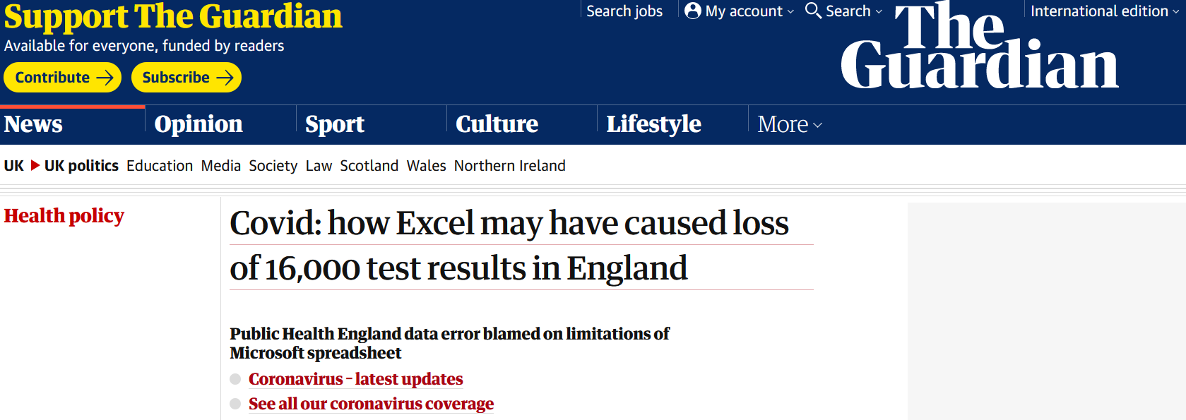
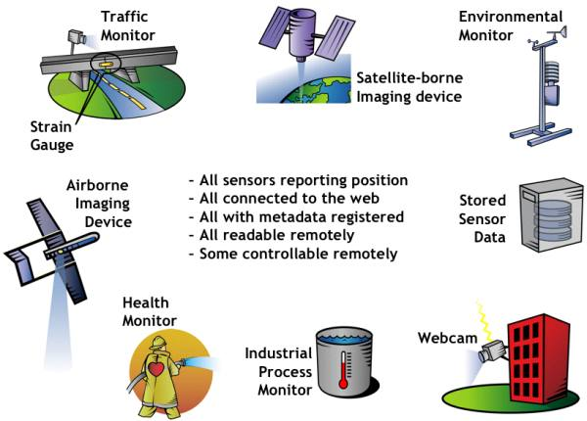
Relevant Domains (on beyond Sensors)
No data loss in comparison to Excel:
https://www.theguardian.com/politics/2020/oct/05/how-excel-may-have-caused-loss-of-16000-covid-tests-in-england
Environmental:
  Air quality, Meteorology
  Water quality and quantity
  Biodiversity occurrence data
  Soil and Geological data
Demography
BMS
Industry 4.0
Smart Cities
Covid Case Data
…
©OGC: http://www.opengeospatial.org/ogc/markets-technologies/swe

Slide 4
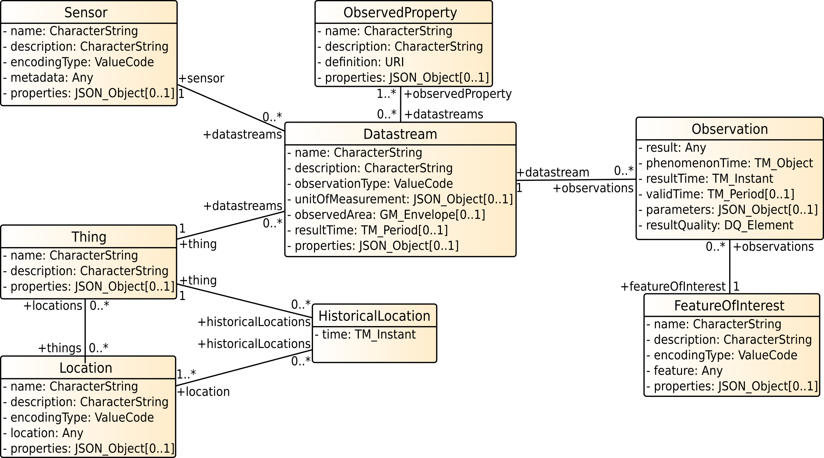
OGC SensorThings API
ObservedProperty
ObservedProperty
Temperature
Sensor
Sensor
Thermometer
DataStream
DataStream
Temp in Room26
Observation
Observation
21°
Thing
Thing
Room26
FeatureOfInterest
HistoricalLocation
FeatureOfInterest
[18.22998, 49.73265]
HistoricalLocation
Location
Location
[18.23, 49.73]

Slide 5
OGC SensorThings API - French Water Depth API
ObservedProperty
Water Depth
Sensor
Electronic probe
DataStream
Water Depth Loire
Observation
1.2 m
Thing
La Loire à Orléans – Quai du Roi
HistoricalLocation
FeatureOfInterest
[1.904788014, 47.897324928]
Location
[1.904788014, 47.897324928]

Slide 6
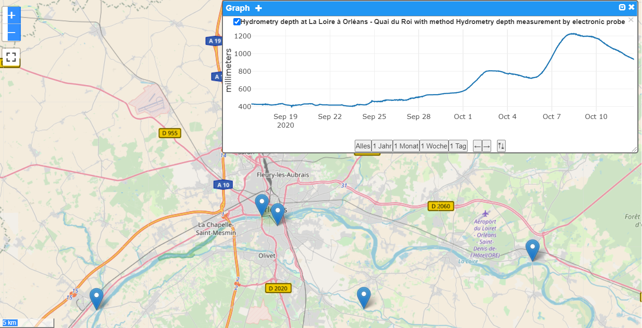
OGC SensorThings API - French Water Depth API
https://iddata.eaufrance.fr/api/stapiHydrometry/Datastreams(4239)?$top=1000&
$select=id,name,unitOfMeasurement,properties,phenomenonTime&
$orderby=name&$expand=ObservedProperty,Sensor,Thing,Thing/Locations

Slide 7
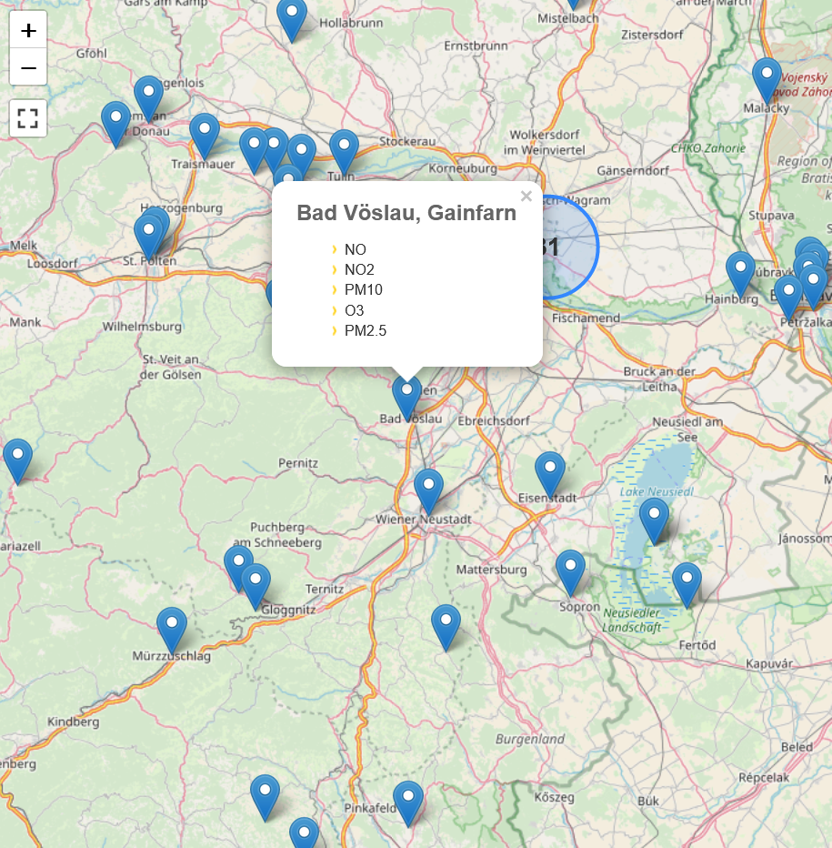
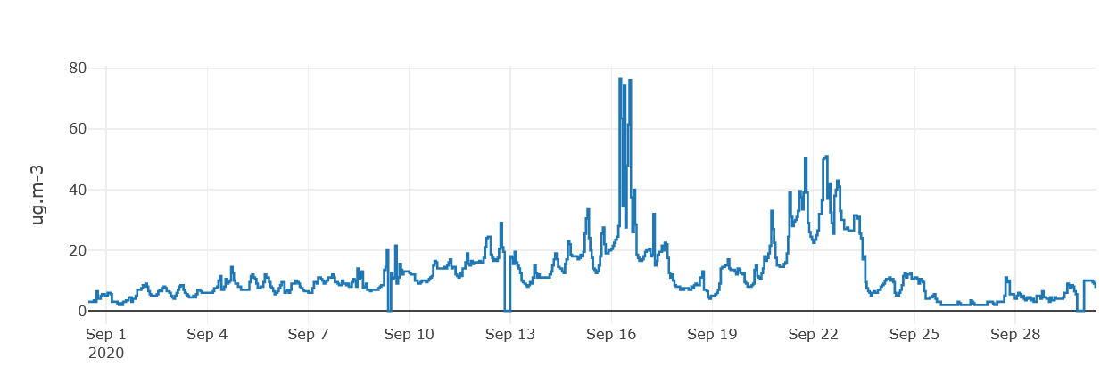
Realtime Air Quality
https://airquality-frost.k8s.ilt-dmz.iosb.fraunhofer.de/v1.1/Datastreams(75)?$top=1000&
$select=id,name,unitOfMeasurement,properties,phenomenonTime&
$orderby=name&$expand=ObservedProperty,Sensor,Thing,%20Thing/Locations

Slide 8
Some Demos
Demos
https://datacoveeu.github.io/API4INSPIRE/maps/Demography.html
https://datacoveeu.github.io/API4INSPIRE/maps/AirQuality.html
https://datacoveeu.github.io/API4INSPIRE/maps/RiversInBw.html

Slide 9
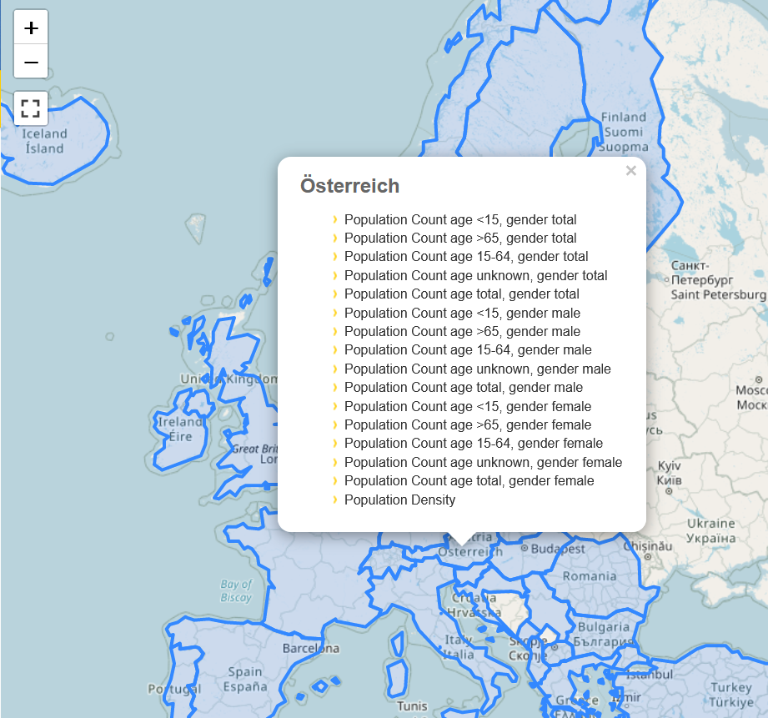
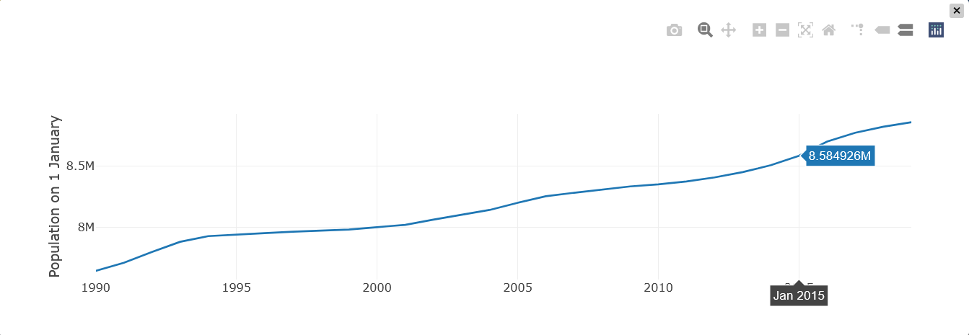
European Demography

Slide 10
Some Queries - Population European Countries
http://service.datacove.eu/DemographyThings/v1.1/Things
?$top=10
&$filter=length(name) eq 2
&$select=name
&$expand=Locations($select=location),
Datastreams(
$filter=ObservedProperty/name eq 'demo_r_pjanaggr3';
$select=name;
$expand=ObservedProperty($select=name, definition),
Sensor($select=metadata),
Observations(
$select=result,phenomenonTime;
$orderby=phenomenonTime desc;
$top=1
)
)
&$resultFormat=geojson

Slide 11
Some Queries - All stations at a river that flows into the Rhine
https://lubw.k8s.ilt-dmz.iosb.fraunhofer.de/v1.1/Things
?$filter=properties/type eq 'station'
and
properties/gewaesser.Location/properties/sink.Location/name
eq 'Rhein'
&$resultFormat=geojson

Slide 12
SensorThings API Endpoints
Water:
  Ground Water (FR): https://sensorthings.brgm-rec.fr/SensorThingsGroundWater/v1.0
  Surface Water Quantity (FR): https://iddata.eaufrance.fr/api/stapiHydrometry/v1.1
  Surface Water Quality (FR): https://sensorthings-wq.brgm-rec.fr/FROST-Server/v1.0
  Water (DE): https://lubw.k8s.ilt-dmz.iosb.fraunhofer.de/v1.1
Air Quality - Near-real-time air quality across Europe, data from both national sources (harvested from AT SOS and WFS) and Europe (EEA):
https://airquality-frost.k8s.ilt-dmz.iosb.fraunhofer.de/v1.1
  Reuse by Windy: https://www.windy.com/fr/-NO2-no2?camsEu,no2,47.905,1.908,5
Smart Cities - Urban Data Platform Hamburg: https://iot.hamburg.de/v1.1
Demography - Based on European NUTS regions, data from Eurostat: https://demography.k8s.ilt-dmz.iosb.fraunhofer.de/v1.1
Covid Case Data, harvested from various sources including Johns Hopkins and RKI: http://covidsta.hft-stuttgart.de/server/v1.1
  Dashboard: http://www.covid19dashboard.org/
User base expanding, example France:
BRGM (French Geological Institute)
French Office for Biodiversity
INRAe: Soil
IFREMER: marine
Highly interested: MNHN and IGN France (mapping agency)

Slide 13

Conclusions
SensorThings API is being increasingly deployed
Far easier to deploy and use than SOS
Data model isomorph to O&M, thus compatible to INSPIRE data specifications
  "Extending INSPIRE to the Internet of Things through SensorThings API" doi:10.3390/geosciences8060221
Map based visualization still in development
  STAM provides simple mapping support
  https://github.com/DataCoveEU/STAM
  Grafana support:
  https://grafana.com/grafana/plugins/linksmart-sensorthings-datasource
More examples and demos at:
  https://datacoveeu.github.io/API4INSPIRE/
This on-going API4INSPIRE study is funded in the frame of the European Location Interoperability Solutions for e-Government action ELISE, part of the ISA Programme.

Slide 14


Thanks for your Attention!
Kathi Schleidt
Kathi@DataCove.eu
Hylke van den Schaaf
hylke.vanderschaaf@iosb.fraunhofer.de

