Slide 1

Using the INSPIRE Validator in the 2019 Monitoring process: experience & lessons learnt
Marco Minghini, Robert Tomas, Lukasz Ziemba, Davide Artasensi, Fabio Vinci, Daniele Francioli, Emanuela Epure, Michael Lutz
61st MIG-T meeting – March 5, 2020

Slide 2
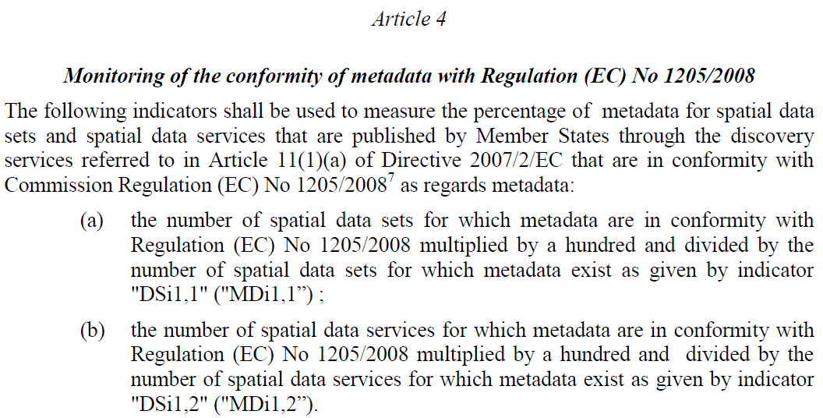
Calculation of Monitoring indicators
Indicators MDi1,1 & MDi1,2 are calculated using the INSPIRE Validator:
https://eur-lex.europa.eu/legal-content/EN/TXT/PDF/?uri=CELEX:32019D1372&from=EN
Notes:
Implementing Decision from August 2019 regarding monitoring and reporting

Slide 3
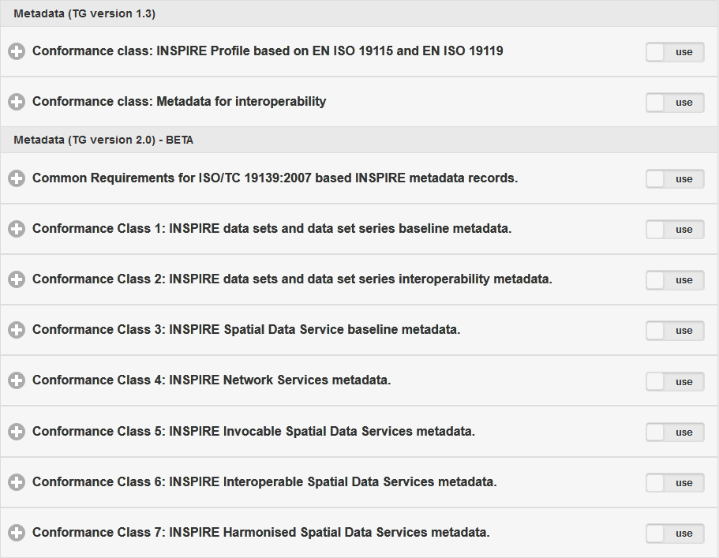
Calculation of Monitoring indicators
MD TG 1.3
Indicator MDi1,1:
  percentage of metadata for spatial data sets conformant with Commission Regulation (EC) No 1205/2008 as regards metadata
MD TG 2.0
http://inspire.ec.europa.eu/validator

Slide 4
Calculation of Monitoring indicators
MD TG 1.3
Indicator MDi1,2:
  percentage of metadata for spatial data services conformant with Commission Regulation (EC) No 1205/2008 as regards metadata
MD TG 2.0
http://inspire.ec.europa.eu/validator

Slide 5
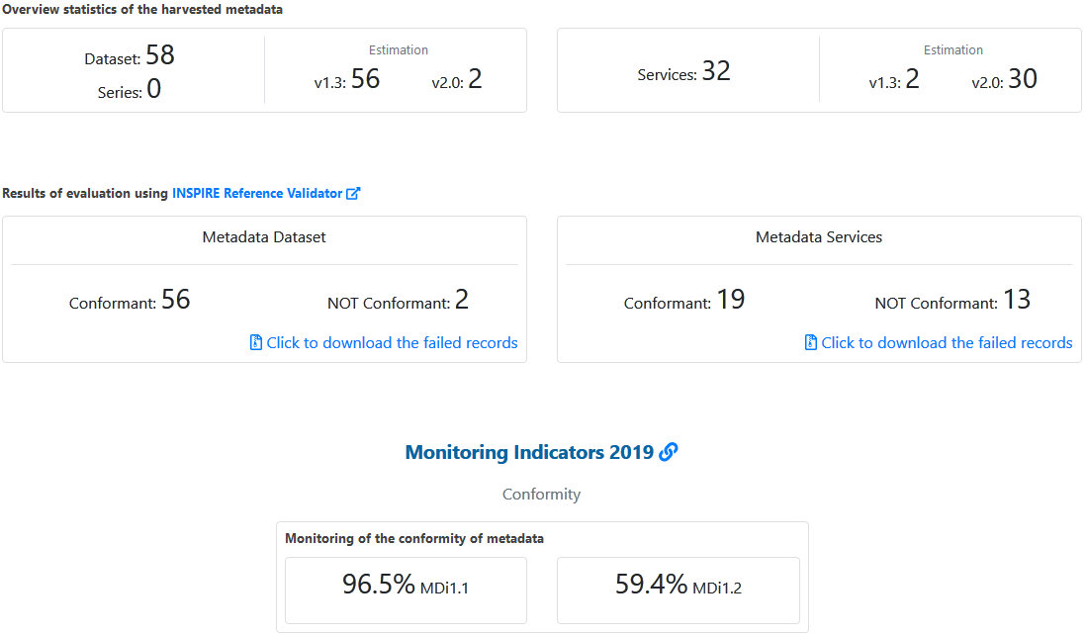
Calculation of Monitoring indicators
Results:
number of MD for datasets/series
TG version (estimated)
number of MD for spatial data services
TG version (estimated)
number of conformant MD for datasets/series
number of conformant MD for spatial data services
indicator values
https://inspire-geoportal.ec.europa.eu/mr2019.html
Notes:
This is the dashboard for a single endpoint

Slide 6
Workflow for MD validation
Initial approach:
  classification (1.3 vs. 2.0) based on a filter
  validation against the corresponding Conformance Class(es)
classification of MD TG version
validation outcome (passed/failed)
MD record
validation
Notes:
We validate each single metadata using this workflow.

Slide 7
Filter for classification of MD TG version
classification of MD TG version
validation outcome (passed/failed)
MD record
validation
The filter is based on the only element that is different in the XML encoding between TG 1.3 and 2.0, i.e. <gmd:useLimitation> (required for the MD element “Conditions applying to access and use”):
  if <gmd:useLimitation> is found, the MD record is classified and validated against the Conformance Class of TG 1.3
  if <gmd:useLimitation> is NOT found, the MD record is classified and validated against the Conformance Classes of TG 2.0
Notes:
The element <useLimitation> is used to for the element “Conditions applying to access and use” (in MD TG 1.3).

Slide 8
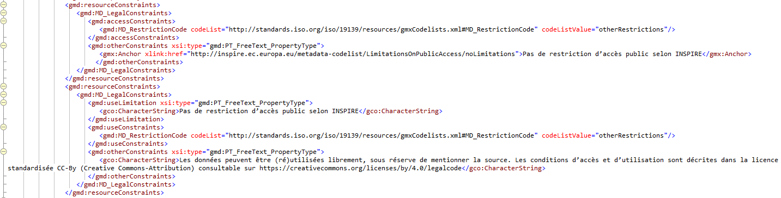
Filter for classification of MD TG version
But the reality was more complex than expected….
  <gmd:useLimitation> is ALSO found in MD compiled according to TG 2.0!
limitations on public access
conditions applying to access and use
Notes:
C.17 (limitations): there must be <accessConstraints>
C.18 (conditions): there can be either <accessConstraints> or <useConstraints>

Slide 9
Filter for classification of MD TG version
But the reality was more complex than expected….
  <gmd:useLimitation> is ALSO found in MD compiled according to TG 2.0!
limitations on public access
conditions applying to access and use

Slide 10
Workflow for MD validation
Final approach:
  classification (1.3 vs. 2.0) based on the same <gmd:useLimitation> filter
  validation against the corresponding Conformance Class(es)
  if the test is passed, the MD record is classified as initially determined
  if the test is NOT passed, the test against the Conformance Class(es) of the other TG is run
  if this second test is passed, the MD record is classified as compiled according to the TG tested later
  if this second test is NOT passed, the MD record is classified back as initially determined by the filter
Notes:
We validate each single metadata using this workflow.

Slide 11
Workflow for MD validation
Final approach:
classification of MD TG version
validation (for the estimated TG version)
classification (first TG version estimated)
MD record
test passed?
YES
NO
classification (second TG version estimated)
validation (for the other TG version)
test passed?
YES
NO
classification (first TG version estimated)
Notes:
We validate each single metadata using this workflow.
Add that we also tested manually a portion of the metadata to check that the workflow was working properly, especially for countries which according to the procedure had all metadata failing tests.

Slide 12
Workflow for MD validation
Final approach:
  we cannot be 100% sure that the final classification (1.3 or 2.0) corresponds to the actual ‘intention’ of the metadata creator
    it is only an estimation!
  BUT this does NOT impact on the value of the indicators:
    if a MD record is conformant against 1.3 OR 2.0, this is detected!
Notes:
The main message is that ...

Slide 13
Common validation errors
Schema validation errors
  especially caused by missing xsi:schemaLocation attribute
Unstable services
Multiple occurrences of the same thesaurus
Missing/wrong declaration of conformity of the described resource:
  “One of the citation elements shall contain title and date of the [Regulation 1089/2010].”
Incorrect date and/or date type of the vocabularies and specifications
Notes:
Unstable service: For example, a requirement tests that a resource locator linking to the described Spatial Data Service is given if online access is available. If not, tests that is provided an URL pointing to an online resource providing additional information of the service, if available.
Conformity: either missing, or errors in the date, regulation, or the passed value is not there, etc.

Slide 14
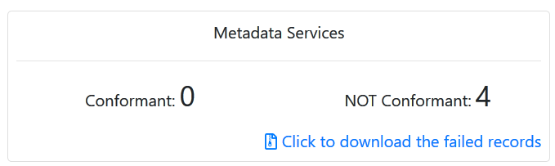
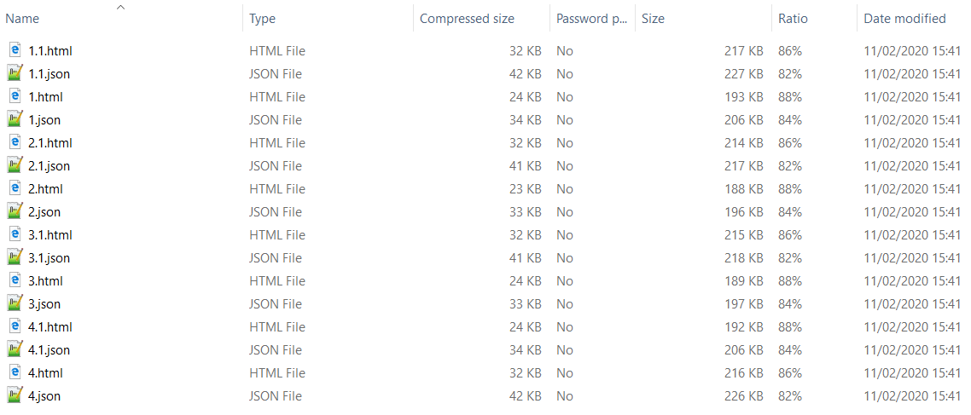
Understanding errors & fixing metadata
Download the test reports for the failed MD records:
  the zipped folder includes reports in html and json:
Notes:
x.*: report related to the validation against the TG version identified by the filter (with some exceptions – new procedure)
x.1.*: report related to the validation against the other TG version

Slide 15
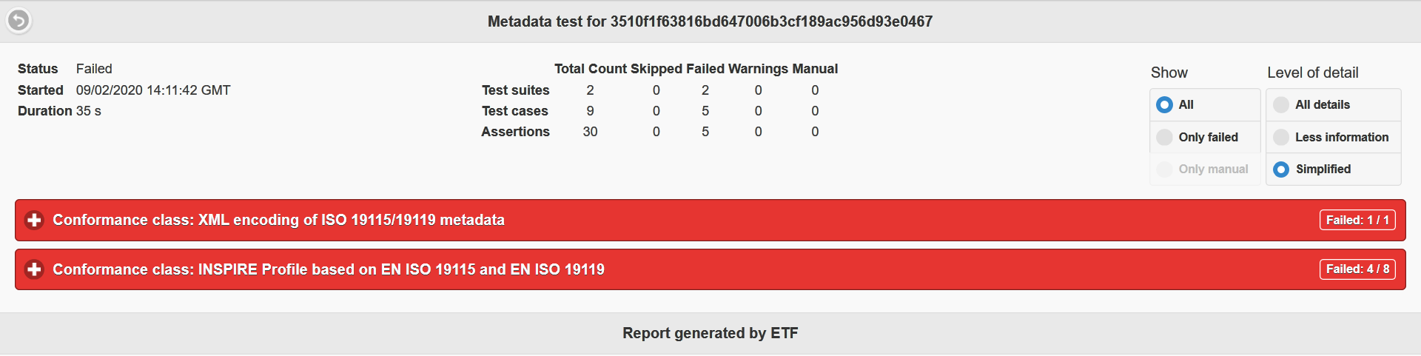
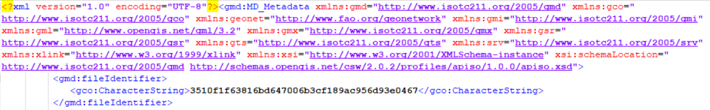
Understanding errors & fixing metadata
Open the test report (e.g. in the html version) and analyse the errors.
Find the corresponding MD record (look at the value of </gmd:fileIdentifier>).
Fix the MD record.

Slide 16
Lessons learnt from the JRC Team
This was our first-ever look at all MD records from MS.
Many data providers did not check the conformity of their MD using the INSPIRE Reference Validator before the Monitoring deadline in Dec 2019.
There is still a high percentage of MD TG 1.3 although the deadline expired in Dec 2019.
We noticed that some of the validated MD were not ‘seen’ by the Geoportal due to specific MD errors that corrupted the Geoportal internal processor and its workflow during the harvest:
  we are working to improve the Geoportal to manage this invalid content,
  so that any MD being validated is also visible in the Geoportal
Due to the Monitoring exercise many improvements were made to the INSPIRE Reference Validator, mainly regarding stability & performance.
Notes:
- This exercise was very useful for us. This was the first time that we had the chance to physically look at all the MD records published by MS, and see how different MS (and different organisations inside MS) are encoding specific information in the metadata.
- There are countries with valies of indicators equal or close to 0%, which made us think that those countries did not actually use the Validator as the reference tool to check and finetune their MD before the Monitoring deadline.

Slide 17
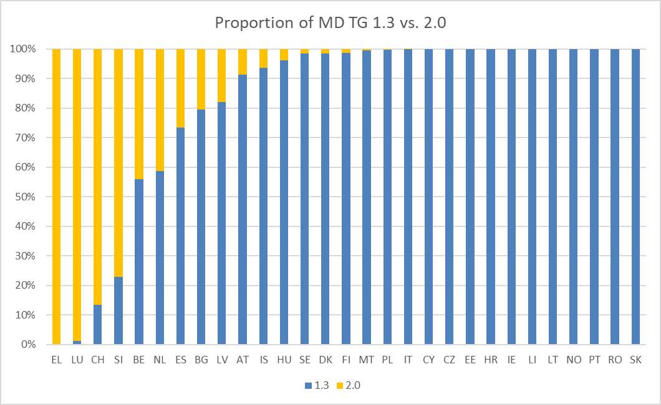
Lessons learnt from the JRC Team

Slide 18
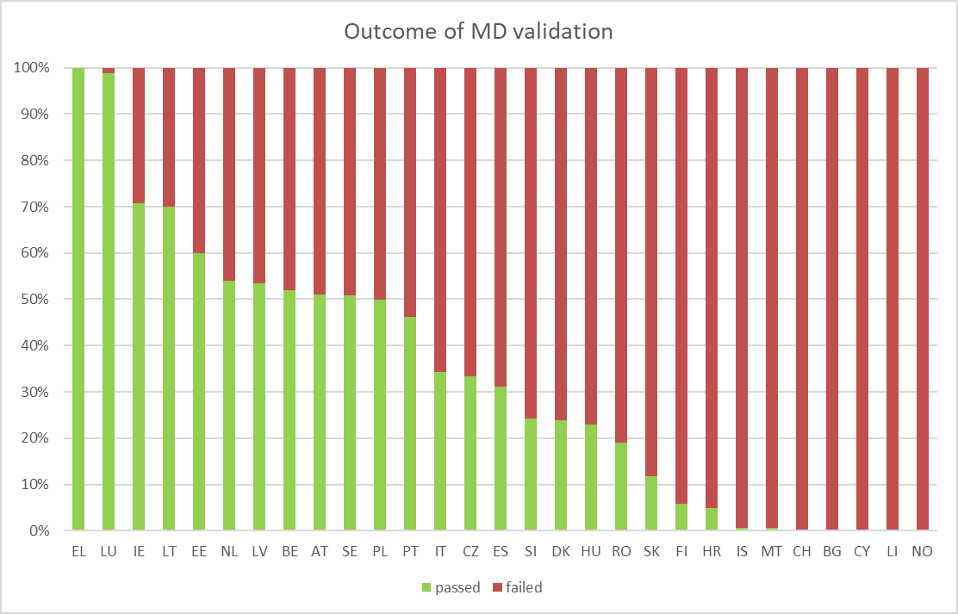
Lessons learnt from the JRC Team

Slide 19
Recommendations for the MS
Please switch to MD TG 2.0:
  support for MD TG 1.3 in the Geoportal ended in Dec 2019!
Please use the INSPIRE Reference Validator to test your resources:
  report bugs in the issue tracker at https://github.com/inspire-eu-validation/community/issues
Please setup your own instance of the Validator:
  we will share the script for automated batch tests
  documentation for deployment of the INSPIRE Reference Validator will be improved
  we will run a dedicated hands-on workshop at the INSPIRE Conference 2020 on how to deploy the INSPIRE Reference Validator (on May 13)

Slide 20

Thank you!
marco.minghini@ec.europa.eu
© European Union 2020
Unless otherwise noted the reuse of this presentation is authorised under the CC BY 4.0 license. For any use or reproduction of elements that are not owned by the EU, permission may need to be sought directly from the respective right holders.

Slide 21





Keep in touch
EU Science Hub: ec.europa.eu/jrc
@EU_ScienceHub
EU Science Hub – Joint Research Centre
EU Science, Research and Innovation
Eu Science Hub
Notes:
Delete/update as appropriate

