Slide 1

MIWP Action 2020.1
INSPIRE Download Services based on the OGC API – Features standard
61st MIG-T meeting – March 5, 2020

Slide 2
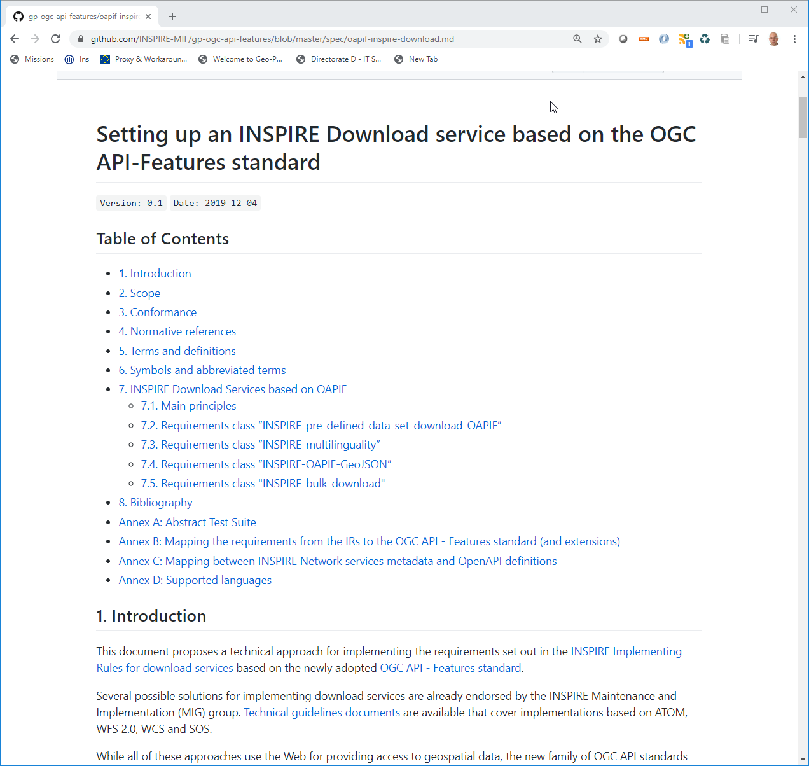
Community approach to specification development
https://github.com/INSPIRE-MIF/gp-ogc-api-features
Specification drafted entirely on GitHub
First round of comments completed
  Early adopters
  Solution providers and open source projects
  Representatives of standardization bodies
Special thanks to
  Heidi Vanparys (Danish Agency for Data Supply and Efficiency) & Jari Reini (NLS Finland) for the outstanding work on the specification
  Contributors on GitHub
  All who will deploy and test the solution!

Slide 3
What next?
New MIWP Action (2020.1)
  Short term action (proposed Date of Completion: November 2020)
  For endorsement during the 11th MIG meeting
Objective
  Prepare and submit for approval by the MIG an INSPIRE good practice dedicated to the use of the OGC API Features as an INSPIRE Download service
Out of scope
  Data encoding of the data
  ETS covered separately

Slide 4
Tasks
Review the existing guideline
Test the proposed approach through deployment of OGC API – Features instances with volunteer MS data providers.
  Different open source and proprietary implementations of the OGC API – Features should ideally be covered.
Summarise the lessons learnt on GitHub, and propose revisions of the draft guideline.
Organise a webinar/meeting for discussing the lessons learnt and potential issues or improvement proposal.
Draft and submit for endorsement an INSPIRE good practice fiche.
Identify and document issues for (i) a possible update of the INSPIRE NS Regulation, and (ii) the technological evolution of INSPIRE in general.

Slide 5





Keep in touch
EU Science Hub: ec.europa.eu/jrc
@EU_ScienceHub
EU Science Hub – Joint Research Centre
EU Science, Research and Innovation
Eu Science Hub
Notes:
Delete/update as appropriate

