Slide 1

MIWP Action 2.3.1: Governance of INSPIRE artefacts
JRC INSPIRE Team
76th MIG-T meeting - Part 2 – December 06, 2023

Slide 2
Status update
Clarifications on change proposal #108

Slide 3
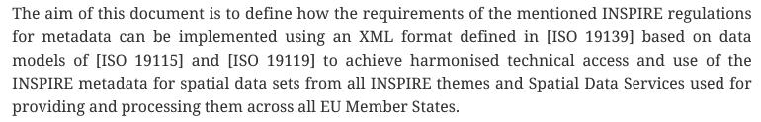
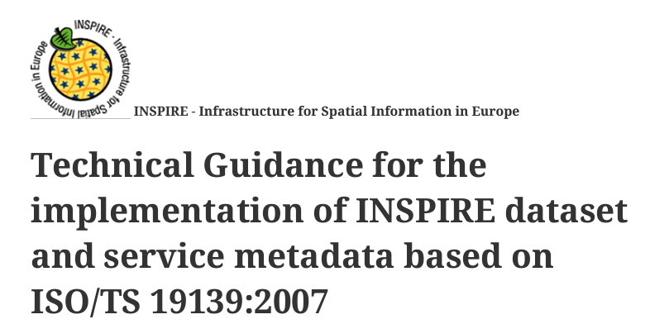
Change proposal #108 - Clarification
TG Metadata - Data-service linking simplification for ISO/TS 19139:2007 metadata

Slide 4
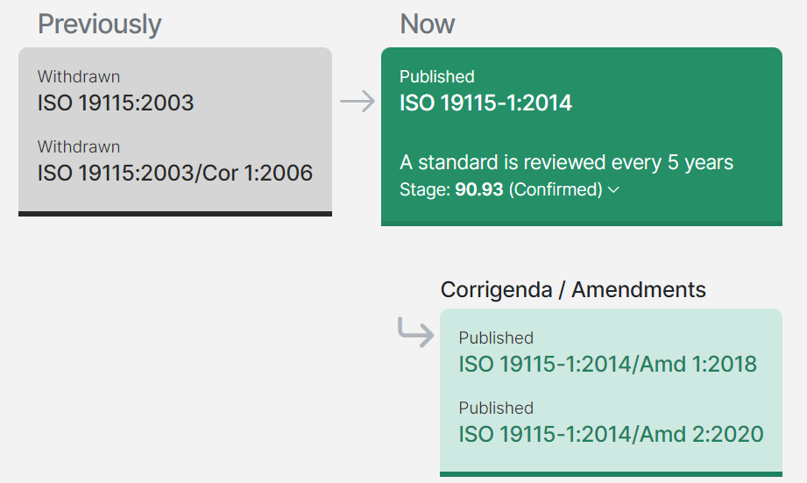
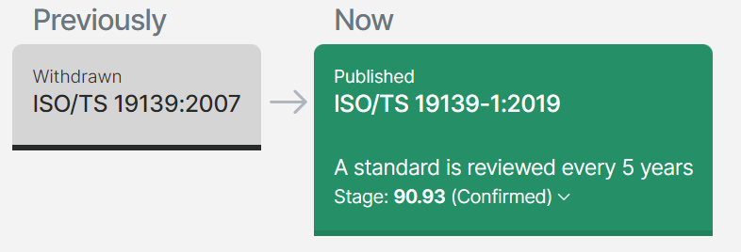
Change proposal #108 - Clarification
Notes:
While ISO 19139:2007 has been withdrawn and revised by 19139-1:2019, this latter also introduces a widening of the scope. The 2007 version was the XML implementation of the 19115, while in the 2019 version is mentioned that “The standardization target of this document is XML implementations of metadata”, so it defines general rules.

Slide 5
Change proposal #108 - Clarification
Conclusion:
The ISO 19139:2007 has been withdrawn and revised by 19139-1:2019, but this latter also introduces a widening of the scope. The 2007 version was the XML implementation of the 19115, while the new one defines more general rules:
                … this document provides a definitive set of rules for encoding ISO metadata standards in Extensible Markup Language (XML).
                …. These rules were first used in creating ISO/TS 19115-3 as an XML encoding of ISO 19115-1…
In the current MD TG, it is mentioned that: “It was decided in the MIWP-8 sub-group that new versions of the ISO 19115 standard were out of scope for this version of this specification. The future versions of this Technical Guidelines may be revised taking into account the new ISO 19115 family standards”.
Base standard | XML implementation | INSPIRE MD TG
ISO 19115:2003 | ISO 19139:2007 | TG 2.0
ISO 19115-1:2014 (and related amendments) | ISO 19115-3:2023, in turn conforming to 19139-1:2019 | New version?
Notes:
While ISO 19139:2007 has been withdrawn and revised by 19139-1:2019, this latter also introduces a widening of the scope. The 2007 version was the XML implementation of the 19115, while in the 2019 version is mentioned that “The standardization target of this document is XML implementations of metadata”, so it defines general rules.

Slide 6
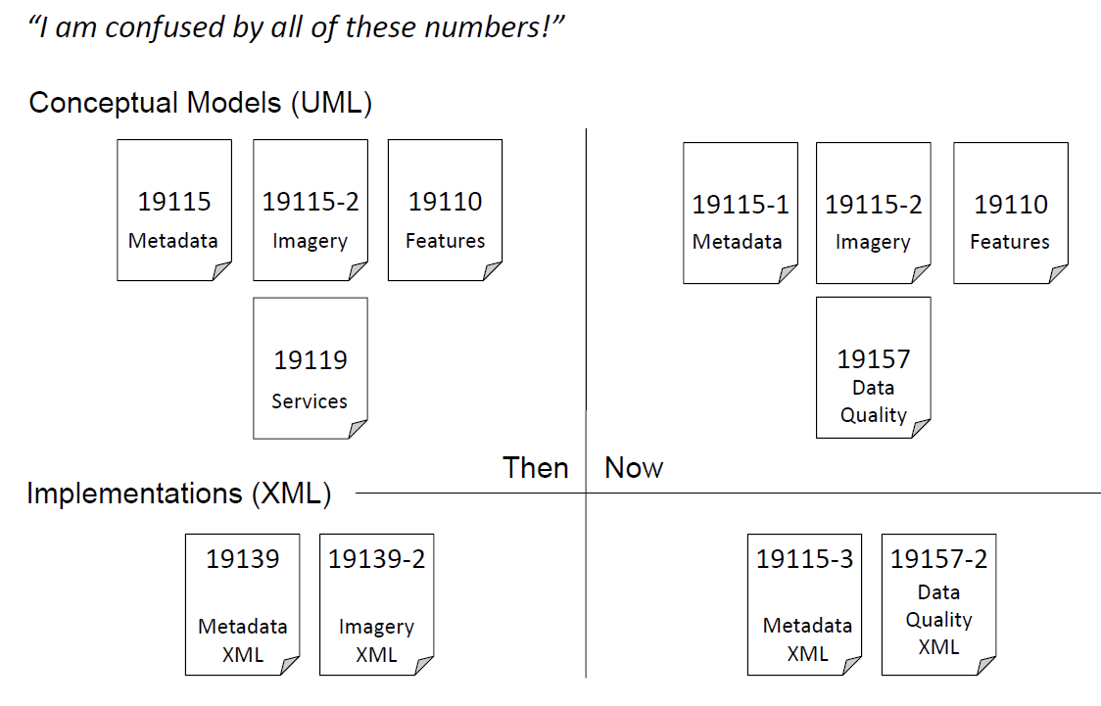
Base standards of the current MD TG
Service metadata has moved from ISO 19119 to ISO 19115-1.
Data Quality metadata has moved from ISO 19115 to ISO 19157.
Base standards of future revision of MD TG
Before
Source: https://external.ogc.org/twiki_public/pub/ILAFpublic/DiaInteroperabilidadOGCBarcelona15/08_19115-1_El_nuevo_est%E1ndar_de_metadatos._Vinculaci%F3n_con_OGC%2C_Ted_Habermann%2C_The_HDF_Group.pdf

Slide 7
Thank you!
© European Union 2023
Unless otherwise noted the reuse of this presentation is authorised under the CC BY 4.0 license. For any use or reproduction of elements that are not owned by the EU, permission may need to be sought directly from the respective right holders.

