Slide 1

Validation and conformity through the INSPIRE reference validator (MIWP Action 2017.4)
Marco Minghini, Fabio Vinci, Michael Lutz
61st MIG-T meeting – March 5, 2020

Slide 2
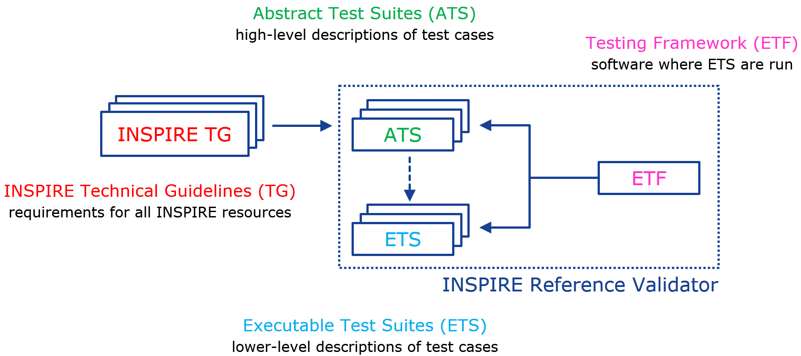
INSPIRE Reference Validator

Slide 3
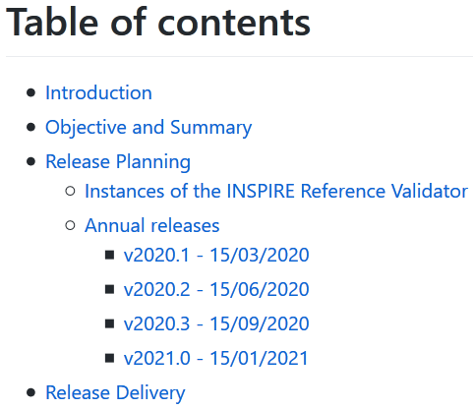
Release planning strategy
A document describing the annual plan for future releases of the INSPIRE Reference Validator:
  designed to help data providers prepare themselves for the annual Monitoring deadline in December
  it describes:
    the number of scheduled releases
    the content of each release
    the management of releases
https://github.com/inspire-eu-validation/community/tree/master/release%20strategy

Slide 4
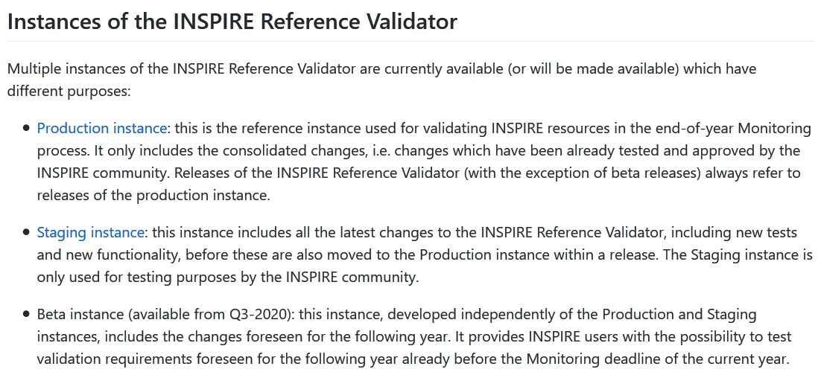
Release planning strategy
https://github.com/inspire-eu-validation/community/tree/master/release%20strategy

Slide 5
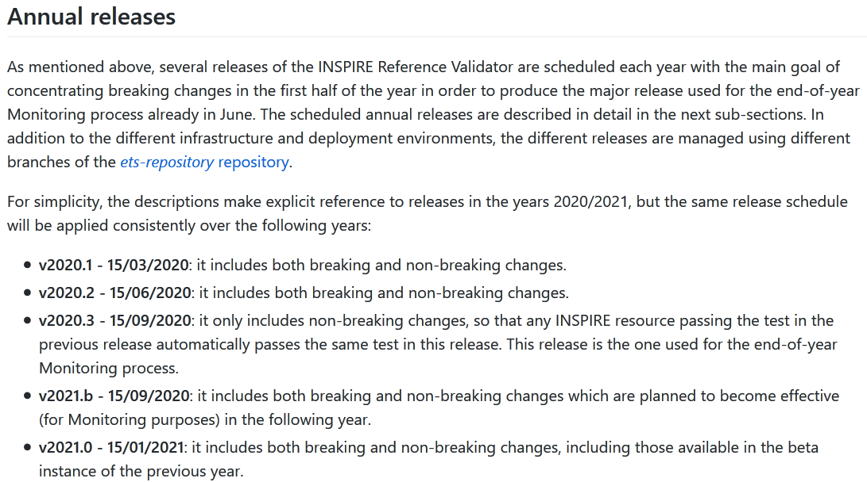
Release planning strategy
https://github.com/inspire-eu-validation/community/tree/master/release%20strategy

Slide 6
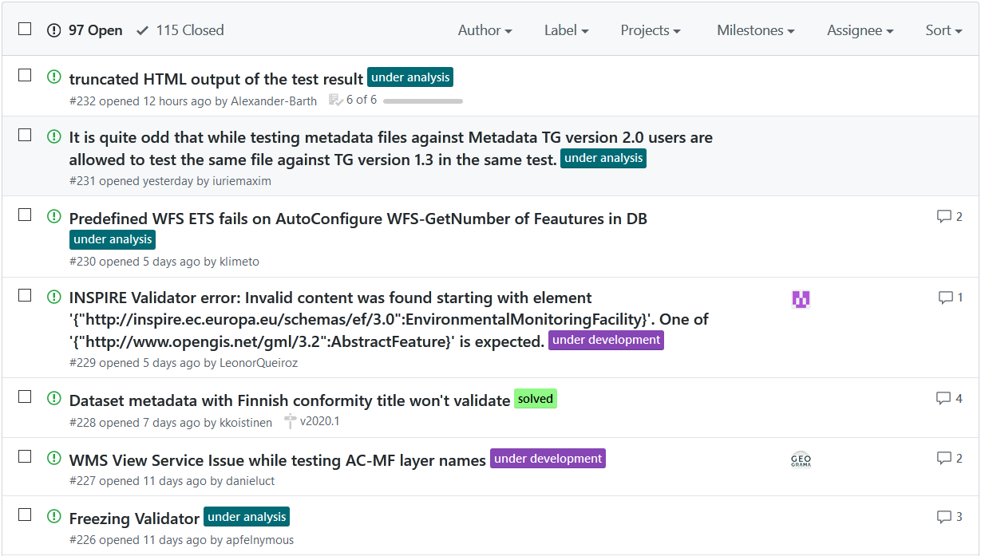
Validator issue tracker
Use of labels to categorize the current stage of solution implementation:
https://github.com/inspire-eu-validation/community/issues

Slide 7
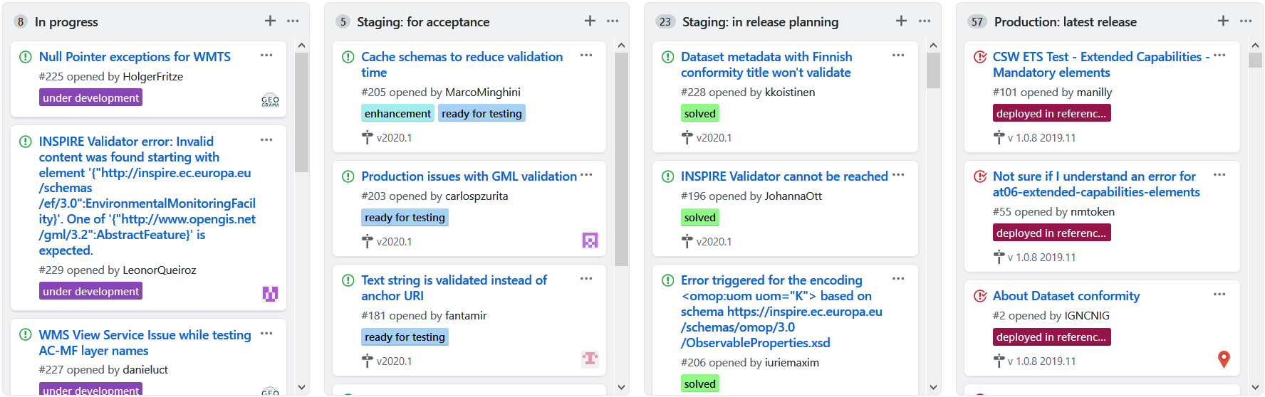
Validator issues – Project board
Comprehensive view of the current implementation stage of all issues:
https://github.com/inspire-eu-validation/community/projects/1

Slide 8
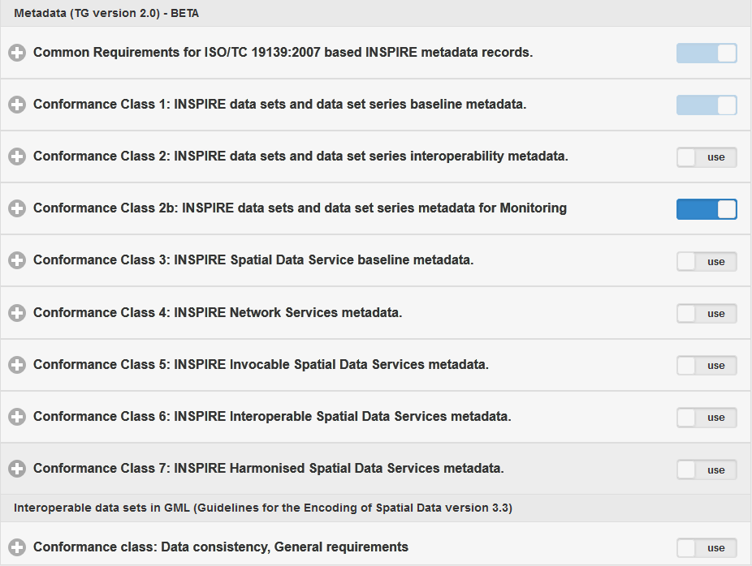

New tests coming soon
New ATS / ETS for:
  Spatial scope code lists
  Priority Data Sets
Soon available in the Staging instance for testing

Slide 9
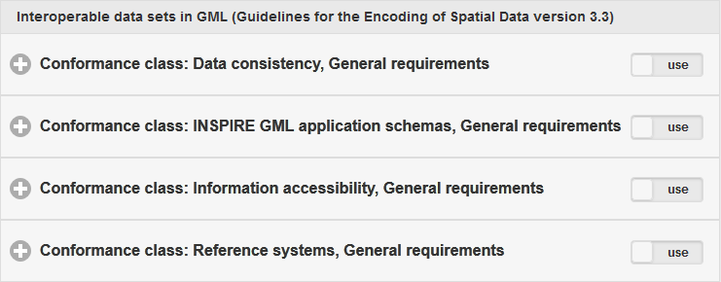
New tests coming (less) soon
New ATS / ETS for:
  Annex II / III Data Specifications
    they will be added incrementally
    data sets from Annex II / III can already be tested against cross-cutting requirements
  Download Services based on OGC API - Features
    based on the requirements to setup an INSPIRE Download Service based on the OGC API - Features standard: https://github.com/INSPIRE-MIF/gp-ogc-api-features/blob/master/spec/oapif-inspire-download.md

Slide 10
deegree geometry issue
Issue on the geometry orientation for datasets having a N-E CRS, see e.g.
    https://github.com/inspire-eu-validation/ets-repository/issues/60
    https://github.com/inspire-eu-validation/ets-repository/issues/137
    https://github.com/etf-validator/etf-gmlgeox/issues/20
    https://github.com/inspire-eu-validation/ets-repository/issues/147
This is due to a known bug in the deegree library:
  a fix is currently under development by the JRC
    https://github.com/deegree/deegree3/issues/886

Slide 11
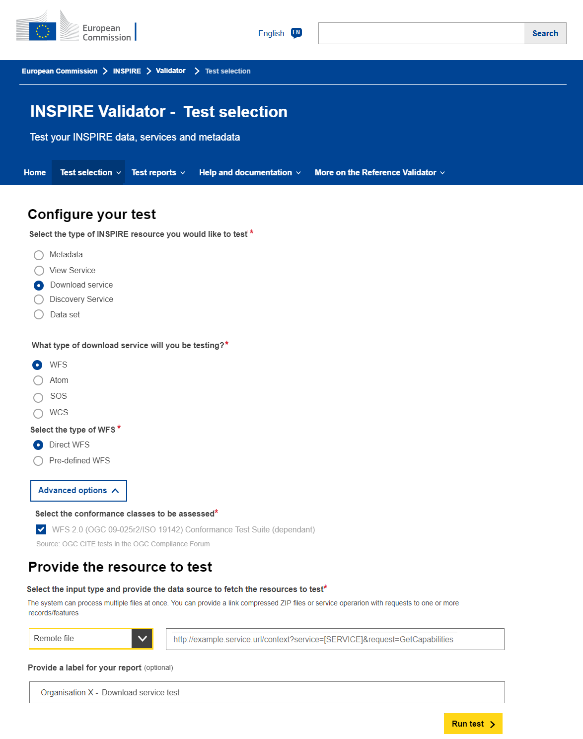
New INSPIRE UI for the Reference Validator
Aimed at:
  simplifying the selection of the resource to be tested
  being in line with the visual identity of the European Commission
Mockups currently under finalization, development starting soon
Prototype ready for the INSPIRE Conference 2020

Slide 12
Closure of Action 2017.4
Open since the beginning of 2018, now we feel it’s time to close it:
  few members active, limited feedback received, few meetings
Request to the MIG to formally close the Action – under preparation
Proposal to substitute the Sub-group with a network of Validation Contact Points (e.g. admins of national validators) who should:
  be informed / inform on the implementation of the Validator in their country
  monitor issues in the INSPIRE Validator helpdesk and provide expert feedback

Slide 13




Thank you!
marco.minghini@ec.europa.eu
© European Union 2020
Unless otherwise noted the reuse of this presentation is authorised under the CC BY 4.0 license. For any use or reproduction of elements that are not owned by the EU, permission may need to be sought directly from the respective right holders.

Slide 14





Keep in touch
EU Science Hub: ec.europa.eu/jrc
@EU_ScienceHub
EU Science Hub – Joint Research Centre
EU Science, Research and Innovation
Eu Science Hub
Notes:
Delete/update as appropriate

