Slide 1


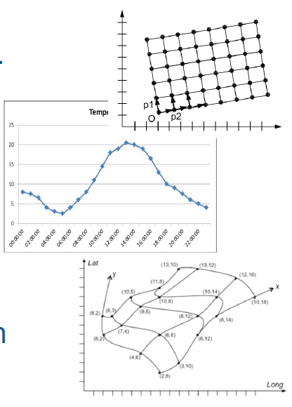


Good practice for providing INSPIRE Coverage data and services
INSPIRE Community Forum
Elevation, Orthoimagery, Reference systems and Geographical grids
Observations & Measurements
Software & Tools
Jordi Escriu & Peter Baumann & Kathi Schleidt

Slide 2
INSPIRE Coverages
Summary
Coverage – What is it?
Identification of issues (October 2014 - today)
  Inconsistencies: INSPIRE conceptual model vs. Implementation standard (CIS 1.0).
    Lack of clarity of the standards for implementing coverages existing at that point of time (GML 3.2.1, GML 3.3, CIS 1.0).
    Possible misinterpretation (not ample experience on them).
    Immaturity and inconsistencies of the standards in place.
  INSPIRE added additional properties and model constructs not expected in an OGC-compliant implementation (i.e. not appropriately mapped).
Scope
  INSPIRE Thematic Clusters (October 2014 - May 2019).
  INSPIRE Community Forum (From June 2019).
Team involved
  Jordi Escriu (IDEC – ICGC, Catalunya).
  Peter Baumann (Jacobs University + rasdaman, Germany).
  Kathi Schleidt (DataCove.eu, Austria).

Slide 3
Implementation of INSPIRE Coverages
Main activities run till today
“Implementation of INSPIRE Coverages” – Webinar
6th November 2017
  https://inspire.ec.europa.eu/forum/pages/view/159283/webinar-implementation-of-inspire-coverages
“Practicing INSPIRE coverages - Enhancing your data cube implementation assets!” – Workshop
INSPIRE Conference 2018 Antwerp:
  https://inspire.ec.europa.eu/events/conferences/inspire_2018/submissions/248.doc
“Feel the power of INSPIRE WCS/WCPS in your hands!” – Workshop
INSPIRE Helsinki 2019:
  https://inspire.ec.europa.eu/forum/pages/view/262985/workshop-%E2%80%9Cfeel-the-power-of-inspire-wcs-wcps-in-your-hands%E2%80%9D
  “INSPIRE Coverages demystified” (Description) - Dedicated session:
  Online INSPIRE Conference 2020 (10th June 2020) – Presentations + Video:
  https://inspire.ec.europa.eu/conference2020/webinars/inspire-coverages-demystified

Slide 4
INSPIRE Coverages
Modelled at conceptual level
INSPIRE Data models
(Conceptual level)
Implementation standards
(Implementation level)
D2.10.2 v1.0
INSPIRE Data specifications –
Base Models –
Coverage types
OGC 09-146r1
GML Coverage application schema
?
OGC 09-146r2
CIS 1.0
GML Application Schema for Coverages
<<featureType>>
<Theme-specific coverage class 1>
…
<<featureType>>
<Theme-specific coverage class N>
INSPIRE Themes

Slide 5
INSPIRE Coverages
Common seed model for all INSPIRE themes
D2.10.2 v1.0
INSPIRE Data specifications –
Base Models –
Coverage types
abstract
<<featureType>>
CoverageByDomainAndRange
domainSet (any type)
rangeSet (any type)
rangeType (RecordType type)
metadata (any type)
Domain constrained to CV_Grid (*)
Regular domain
Irregular domain
<<featureType>>
RectifiedGridCoverage
Domain constrained to
CV_RectifiedGrid (*)
<<featureType>>
ReferenceableGridCoverage
Domain constrained to CV_ReferenceableGrid (*)
Regular grids
Irregular grids

Slide 6













Use of coverages in INSPIRE
13 Data themes
WCS view: Coverages as Features
SOS view: Coverages as Observation Results
EL
LC
SD
GE
INSPIRE
Coverages
ER
OI
OF
SO
MF
LU
AC
NZ
EF

Slide 7




WCS view: Coverages as Features
INSPIRE FeatureTypes based on Coverage Classes
Regular grids:
  Elevation (EL)
  Land cover (LC)
  Orthoimagery (OI)
  Soil (SO)
  Energy resources (ER).
  Species distribution (SD) - Application schema deprecated.
Regular or Irregular grids:
  Natural risk zones (NZ)
  Geology (GE).
EL
LC
SD
GE
INSPIRE
Coverages
ER
OI
OF
SO
MF
LU
AC
NZ
EF

Slide 8
SOS view: Coverages as Observation Results
Coverage based models in the observational context
Regular or irregular grids
  Environmental monitoring facilities (EF)
  Atmospheric conditions (AC)
  Meteorological geographic features (MF)
  Oceanographic geographic features (OF)
  Geology (GE)
Provided as discrete observation coverages, i.e. gridded data specialized observation types applying the ISO 19156:2011 (O&M), following INSPIRE D2.9 v3.0
EL
LC
SD
GE
INSPIRE
Coverages
ER
OI
OF
SO
MF
LU
AC
NZ
EF

Slide 9
SOS view: Coverages as Observation Results
Coverage based models in the observational context
D2.9 v3.0
INSPIRE Guidelines for the use of
Observations & Measurements and Sensor Web Enablement-related standards
in INSPIRE Annex II and III data specification development
Based on ISO 19156:2011 Observations and Measurements standard (O&M in OGC)
Use of Gridded Data specialized observation types.
EF
AC
MF
OF

Slide 10

Implementation of INSPIRE Coverage
What is exactly the issue? INSPIRE Extensions
OGC CIS1.0
Implementation model
INSPIRE
Conceptual
model
INSPIRE
Implementation model
(PROPOSAL)
INSPIRE
range type
metadata
range type
metadata
Extensions
range type
INSPIRE Cov
Metadata
2
7
3
2
7
3
2
7
3
4
1
9
4
1
9
4
1
9
0
2
8
0
2
8
0
2
8

Slide 11
Good Practice for providing
INSPIRE Coverage data and services
An interoperable solution
The proposed solution
  Getting feedback from the community on this functional good practice to align INSPIRE coverages to OGC standards.
  Promote our interoperable schemas for their widespread use by the thematic communities dealing with coverage data for INSPIRE purposes:
    Directly adopt OGC CIS 1.0 schema as default implementation model.
    Replace the existing INSPIRE coverage schemas by our INSPIRE coverage metadata schemas (i.e. consider INSPIRE extensions as coverage metadata).
  Please do USE these schemas!!

Slide 12
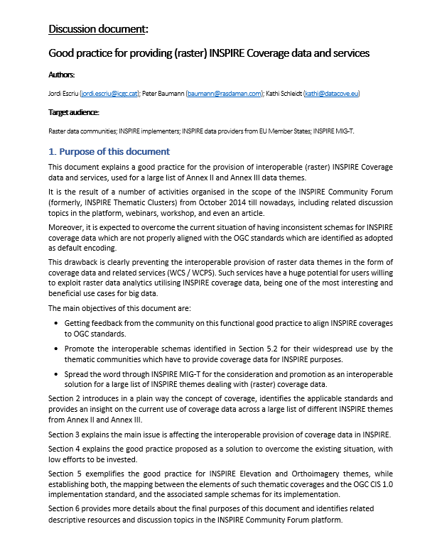
Good Practice for providing
INSPIRE Coverage data and services
Documentation + Discussion
Documentation & Discussion
  Discussion document:
  https://inspire.ec.europa.eu/forum/file/view/266799/discussion-document-good-practice-for-providing-raster-inspire-coverage-data-and-services
  Dedicated page:
  https://inspire.ec.europa.eu/forum/pages/view/265454/an-effective-good-practice-to-boost-interoperable-provision-of-raster-inspire-coverage-data-and-services
  Discussion topic (for providing feedback):
  https://inspire.ec.europa.eu/forum/discussion/view/265095/inspire-coverages-demo-service

Slide 13


INSPIRE Coverages Demystified
Website and Demonstrator
https://inspire.rasdaman.org/

Slide 14

Implementation of INSPIRE Coverages
More details about this work
“INSPIRE coverages: an analysis and some suggestions” - Article with first suggestions:
  https://link.springer.com/article/10.1186%2Fs40965-019-0059-x
Documentation of past activities (See Slide 3)
Results & Demos from the “INSPIRE Coverages demystified” session (Online INSPIRE Conference 2020), focused on OI, EL, LC:
https://inspire.ec.europa.eu/conference2020/webinars/inspire-coverages-demystified
  INSPIRE coverage (metadata) schemas.
  Examples of WCS/WCPS services.
  Examples of INSPIRE coverage metadata.

Slide 15
Good Practice for providing
INSPIRE Coverage data and services
Discussion
Objectives
  Getting feedback from the community on this functional good practice to align INSPIRE coverages to OGC standards.
  Spread the word through INSPIRE MIG-T for its consideration and promotion.
  Promote the use of the amended, interoperable schemas proposed in this good practice.
  Engage specific data providers in adopting this good practice.
Potential next steps
  Looking forward to got it endorsed.
  Get a critical mass of use.
  Document it using the INSPIRE good practice template.
  Revise the necessary items of INSPIRE framework (schemas, TGs, etc.).
Discussion

Slide 16





Thanks for your attention!
Jordi Escriu
jordi.escriu@icgc.cat
Peter Baumann
baumann@rasdaman.com
Kathi Schleidt
kathi@DataCove.eu

