Slide 1
2 July 2020
62th INSPIRE MIG-T meeting
Status report
MIG subgroup 2016.5
Priority list of datasets for e-Reporting
Stefan Jensen, EEA
Joeri Robbrecht, EC DG ENV
Darja Lihteneger, EEA
Vlado Cetl, JRC
Marco Minghini, JRC

Slide 2
The 4 task areas
BACKGROUND
work programme 2017 - 2018
1. Manage and update the priority list of eReporting datasets
  UPDATED priority dataset version 2.1
  https://ies-svn.jrc.ec.europa.eu/projects/2016-5/wiki/
2. Make data available as is
  MS to publish from 15.5.2018 onwards in the INSPIRE Geoportal
3. Common and interoperable European data models
Stepwise by per reporting obligation/data … based on demand and reporting deadlines
4. Monitoring the availability of pan-European datasets
Through the EU Geoportal https://inspire-geoportal.ec.europa.eu/pdv_home.html

Slide 3
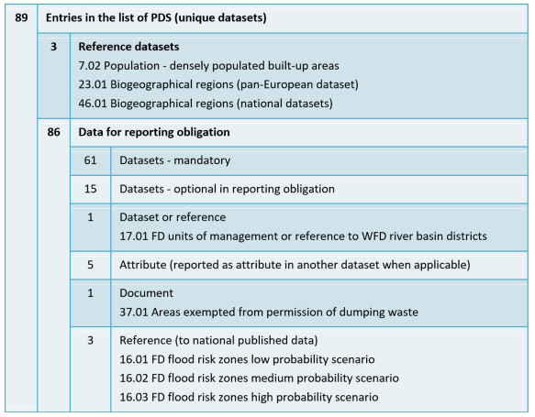
Task 1: Restructuring the PDS list
Pan European Datasets
Categorisation of datasets (reference data, reported data)
Responsibility
Expected reporting form
References to datasets in other legislation
Reference to Reporting obligation (as in Reportnet ROD)
Mapping to INSPIRE themes
  different types of certainty: from implemented (high) to initial mapping (simple evaluation, less certain))
Keyword proposals from the code list
Next steps:
Update after feedback
Validation in the 2016.5 group
Information for MIG

Slide 4
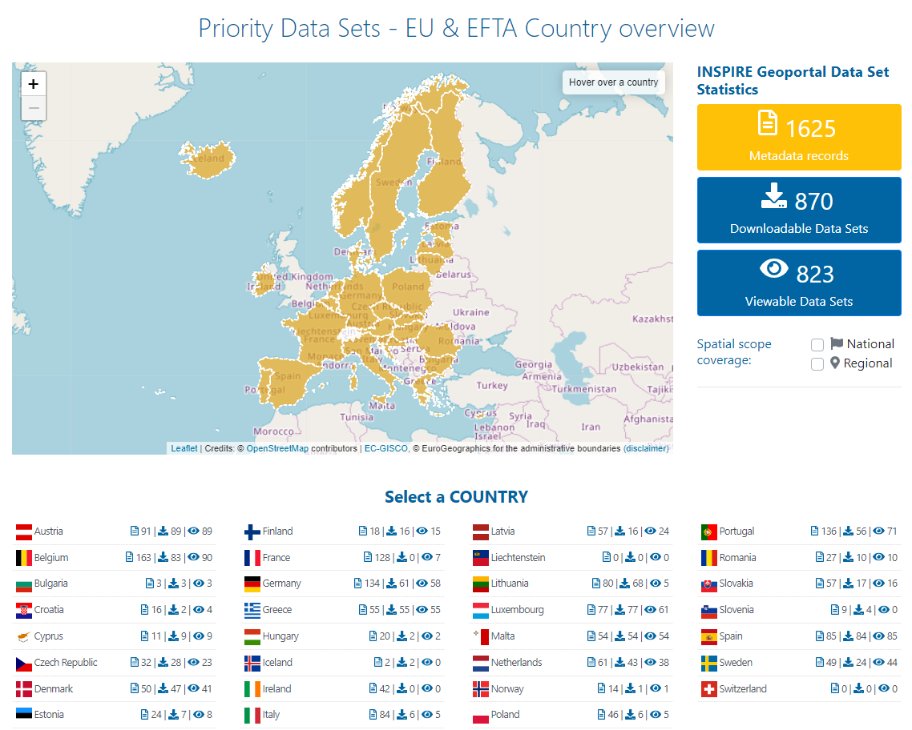
Task 2/4:
Change in download services since 16.3.2020
BG 84 > 3
FR 9 > 0
ES 0 > 84
SE 55 > 24
* status 26.06.2020

Slide 5
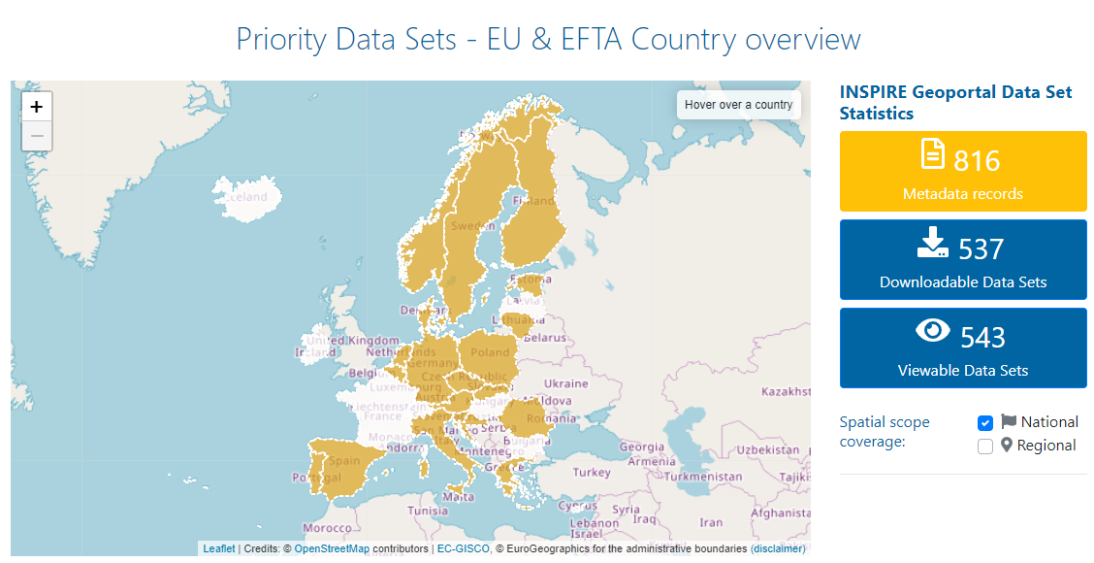
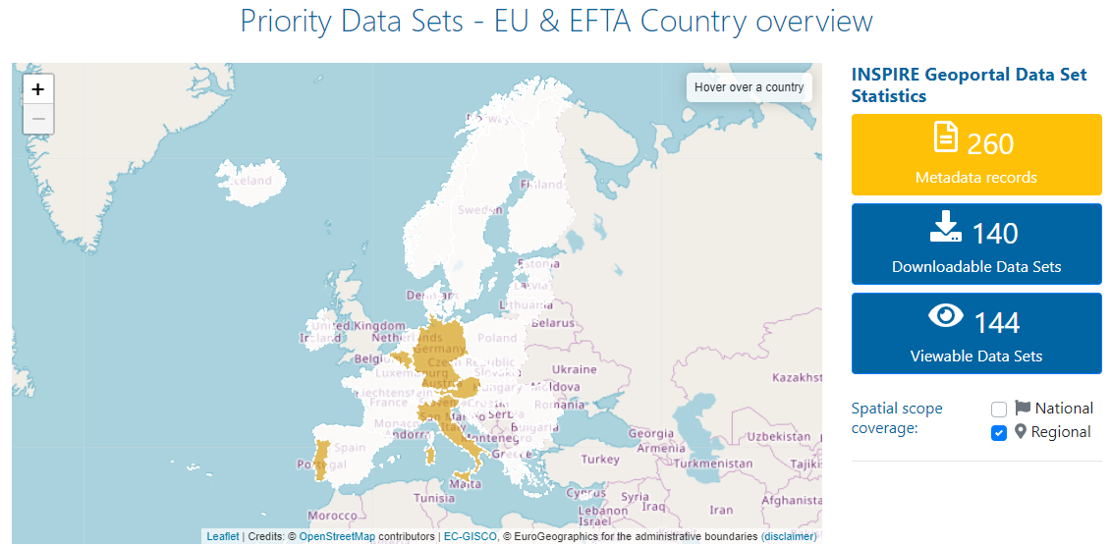
Task 2 - Observations
National spatial scope
Regional spatial scope
Since 27.05.2019: increase in number of metadata (1049 > 1625) and download services (392 > 824)
Changing number of download services, still present issues that download servics are not visible in IG
Missing references between services and data sets should by now have been fixed
Diversity in available datasets per legislation (Landfill of waste – low / WFD – high)
Around half of metadata declare national spatial scope
A few countries apply regional spatial scope

Slide 6
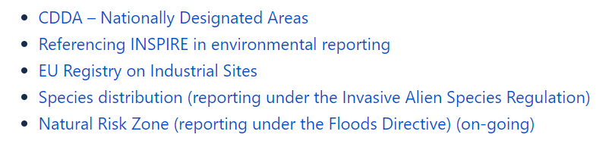

Task 3: Common and interoperable European data models
Information on new harmonised European data models is regularly pulished on the 2016.5 wiki
Environmental Noise Directive and INSPIRE:
  Conceptual data model and documentation in July 2020 (will be shared with 2016.5 group)
  Encoding testing with GML and geoPackage, including simplification rules on-going
  Support to the revised IR on Interoperability (INSPIRE Human Health data model)
EC: in preparation reporting mechanisem for the recast of the Drinkinig Water Directive
Latest calls for reporting obligations – reporting data flows
https://www.eionet.europa.eu/

Slide 7

Task 4: INSPIRE Geoportal – PDS usability and visibility
https://inspire-geoportal.ec.europa.eu/pdv_home.html
Stable functionalities in the INSPIRE Geoportal
JRC contact points:
  Vlado Cetl: participation in the INSPIRE MIWP 2016.5 action
  Marco Minghini: INSPIRE Geoportal

