Slide 1
INSPIRE download service
based on OGC API - Features

Slide 2
Main principle
INSPIRE-specific extensions

Slide 3
Main principles for the data set contents
A Web API provides data from one data set.
A data set is structured into one or several feature collections.
A feature collection contains features of only one feature type.
The exact composition of a data set is determined by the data publisher.

Slide 4
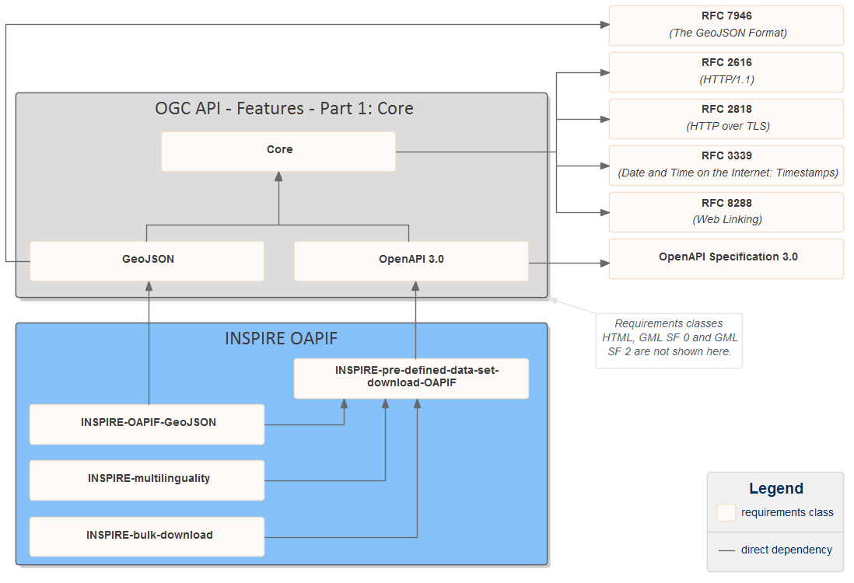
See also https://github.com/INSPIRE-MIF/gp-ogc-api-features/blob/master/spec/oapif-inspire-download.md

Slide 5
Roadmap for OGC API - Features
Part 1: Core
  Released, many implementations, CITE tests
  Landing Page, Conformance Declaration à starting point for Common (Core)
  Collections, Collection à starting point for Common (Collections)
  Features, Feature à simple filtering using query params: bbox, datetime plus collection-specific
Part 2: Coordinate Reference Systems by Reference
  In public review, several implementations
  Features, Feature à add crs query parameter (also used on Map)
Part 3: Simple Transactions
  Early draft, several implementations
  Features, Feature à support POST, PUT, DELETE, PATCH based on the IETF RFCs (PATCH same as on Styles, Style)
Part 4: Common Query Language (CQL)
  Early draft, several implementations
  Queryables (new resource) à properties that can be used in a filter expression
  Features à add filter, filter-lang, filter-crs query parameters (also used on Records and in Vector Tiles Pilot 2 on Tile)
See also http://www.ogcapi.org/apiroadmap.html

