Slide 1

MIWP Action 2.3.1: Governance of INSPIRE artefacts
JRC INSPIRE Team
75th MIG-T meeting – July 07, 2023

Slide 2
Status update
Conversion of TGs to AsciiDoc
Open action on the TG change proposal
Request for additional feedback
Overview of next releases

Slide 3
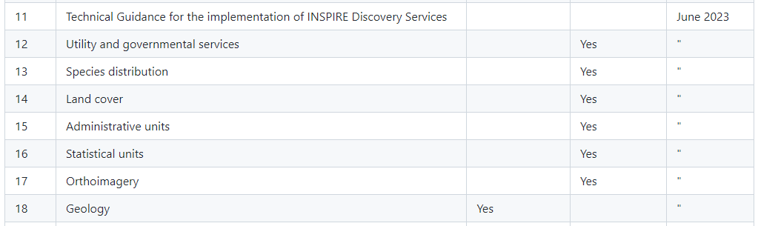
Conversion of INSPIRE TGs in AsciiDoc
All TGs scheduled by June are available in the 2023.2 branch. Comments and/or pull requests are more than welcome.
These TGs will be included in the v.2023.2 release (due by July 31st) and will contain the related change proposals endorsed by the MIG by 31/07/2023.

Slide 4
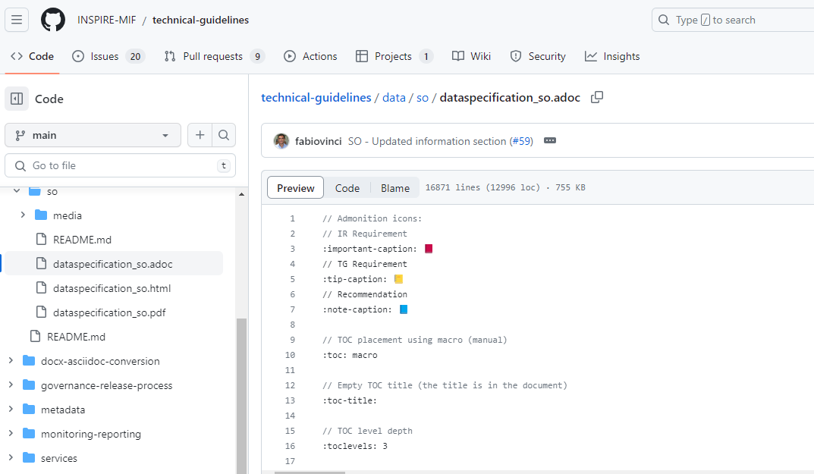
Issue for AsciiDoc preview in GitHub
It seems GitHub is no longer able to preview the large AsciiDoc files (files greater than 200-300 KB, but it also depends on complexity).
An issue in the GitHub community space was opened and we are waiting for feedback.

Slide 5
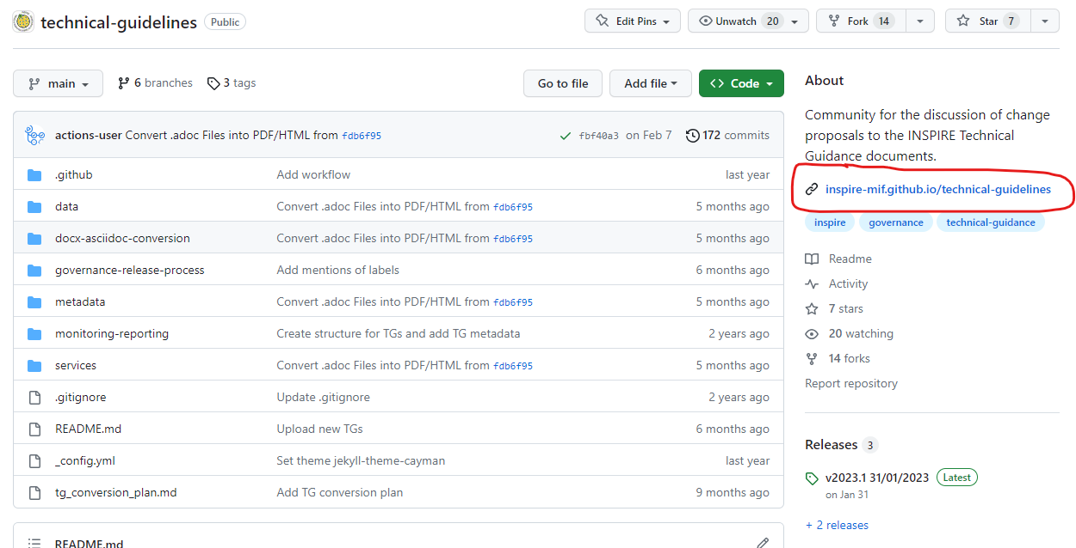
Issue for AsciiDoc preview in GitHub
In the meantime, we recommend the use of pdf and html versions published by GitHub pages: https://inspire-mif.github.io/technical-guidelines

Slide 6
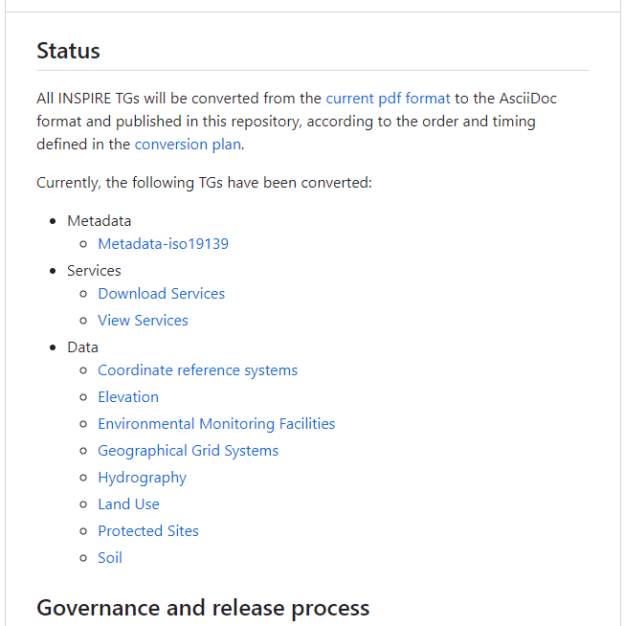
Issue for AsciiDoc preview in GitHub
We will add in the next release quick links to pdf and html versions.
(pdf, html)

Slide 7
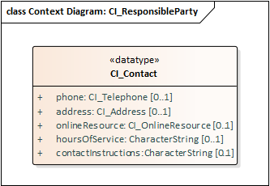
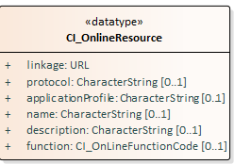
Open action on TG change proposal #72
#72: Metadata contactInfo: onlineResource as alternative to electronicMailAddress
  to investigate whether a more specific alternative to the onlineResource element exists.
<gmd:contact>
<gmd:CI_ResponsibleParty>
<gmd:organisationName>
<gco:CharacterString>MyOrganisation</gco:CharacterString>
</gmd:organisationName>
<gmd:contactInfo>
<gmd:CI_Contact>
<gmd:address>
<gmd:CI_Address>
<gmd:electronicMailAddress>
<gco:CharacterString>info@my-organisation.eu</gco:CharacterString>
</gmd:electronicMailAddress>
</gmd:CI_Address>
</gmd:address>
</gmd:CI_Contact>
</gmd:contactInfo>
<gmd:role>
<gmd:CI_RoleCode codeList="http://standards.iso.org/iso/19139/resources/gmxCodelists.xml#CI_RoleCode" codeListValue="pointOfContact"/>
</gmd:role>
</gmd:CI_ResponsibleParty>
</gmd:contact>
Definition: Online information that can be used to contact the individual or organisation

Slide 8
Open action on TG change proposal #72
An alternative element to the proposed onlineResource element.
Definition: Supplemental instructions on how or when to contact the individual or organisation.
Please provide feedback on GitHub issue #72

Slide 9
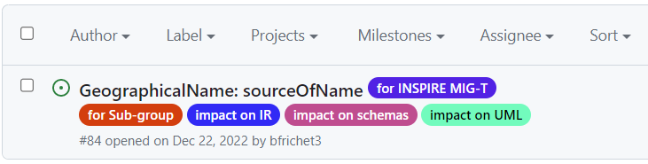
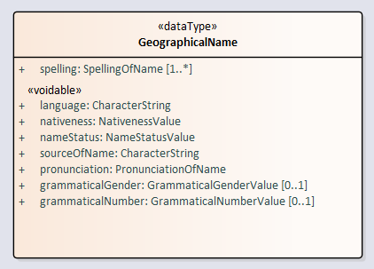
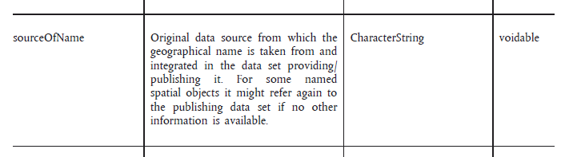
Change proposals to TGs – Additional feedback request
#84 - GeographicalName: sourceOfName
  The sub-group decided to bring this change proposal directly to the attention of the MIG-T to ask for feedback.

Slide 10
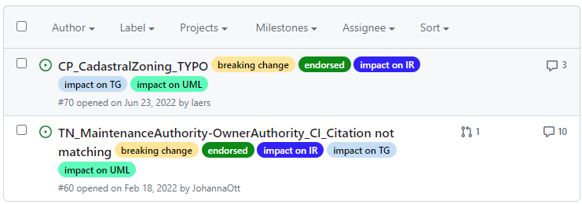
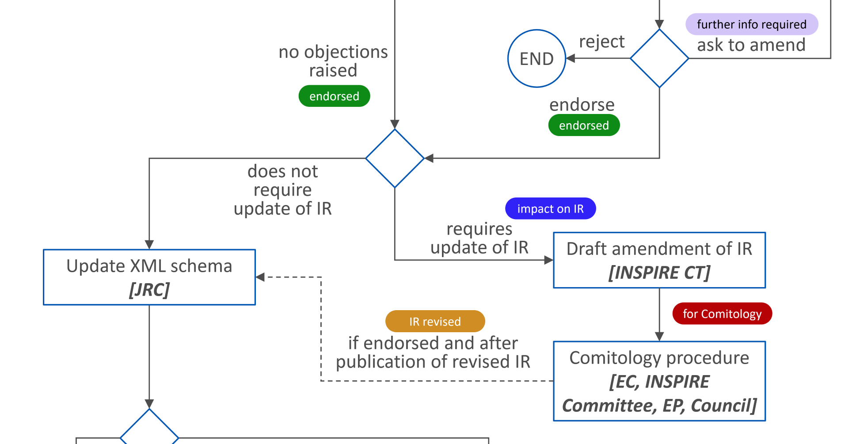
No release of INSPIRE schemas – v.2023.2
All endorsed change proposals have an impact on IR.
Notes:
hydrogeology schema

Slide 11
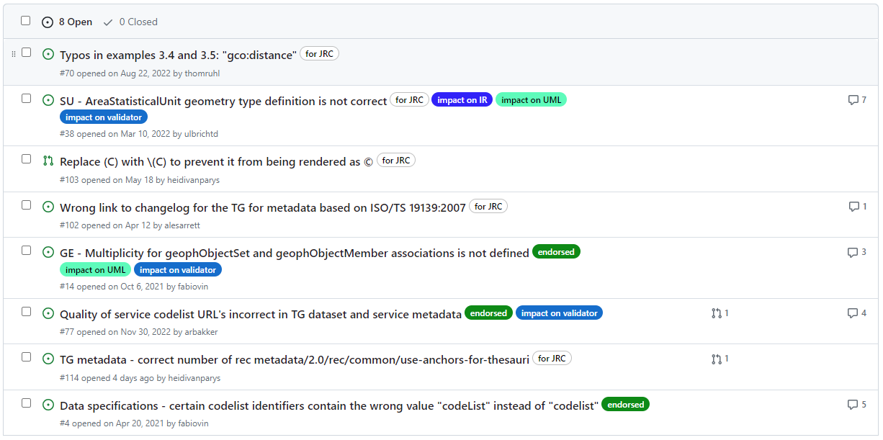
Next release of TGs – v.2023.2
Inclusion of the change proposals endorsed by the MIG by 31/07/2023
https://github.com/INSPIRE-MIF/technical-guidelines/milestone/4
Notes:
hydrogeology schema

Slide 12
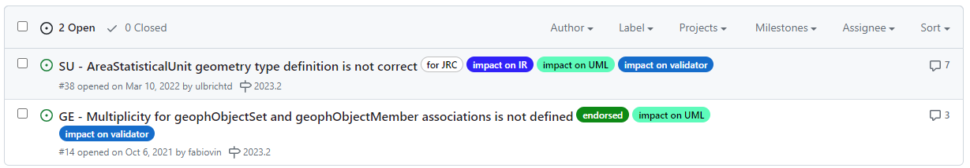
Next release of UML models – v.2023.2
Inclusion of the endorsed change proposals related to TGs and schema which have an impact on UML
https://github.com/INSPIRE-MIF/technical-guidelines/issues?q=is%3Aopen+is%3Aissue+label%3A%22impact+on+UML%22+milestone%3A%222023.2%22
Notes:
hydrogeology schema

Slide 13
Thank you!
© European Union 2023
Unless otherwise noted the reuse of this presentation is authorised under the CC BY 4.0 license. For any use or reproduction of elements that are not owned by the EU, permission may need to be sought directly from the respective right holders.

