Slide 1

INSPIRE Registry & Re3gistry software
JRC INSPIRE Team
73rd MIG-T meeting – February 17th, 2023

Slide 2
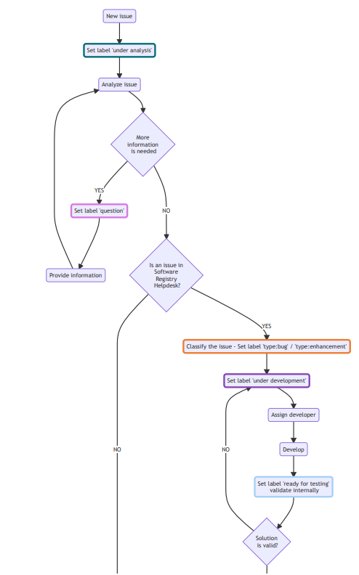
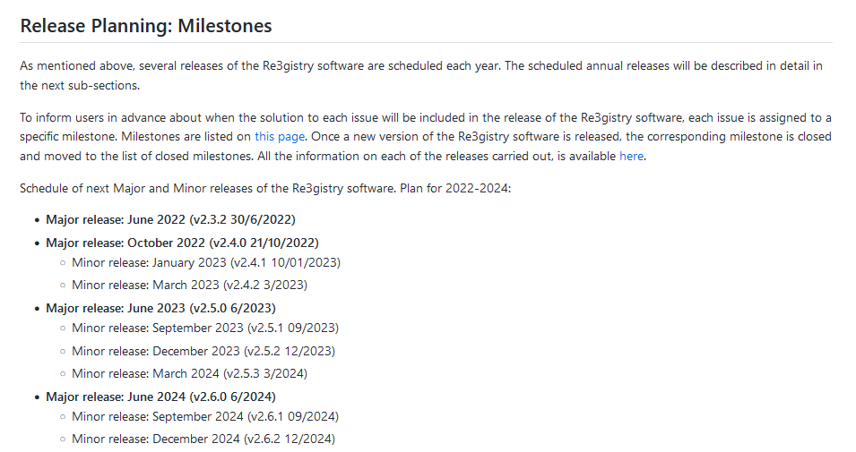
Re3gistry software
Strategy
Helpdesk management workflow
https://github.com/ec-jrc/re3gistry/tree/master/helpdesk-management
  Labels & Issue management
Release plan
https://github.com/ec-jrc/re3gistry/tree/master/release-strategy
  Milestones

Slide 3
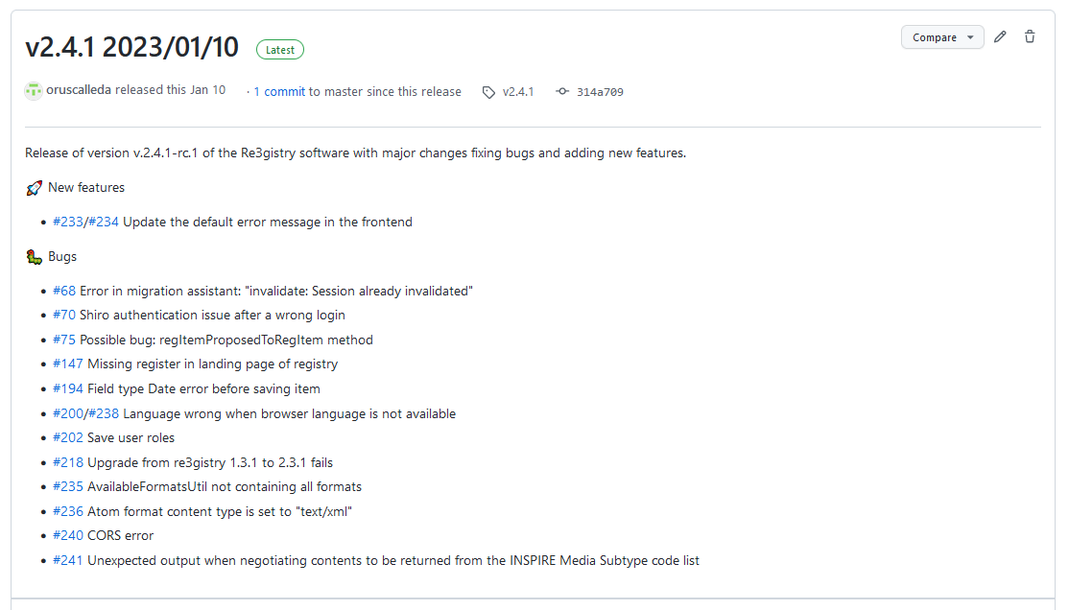
Re3gistry software
https://github.com/ec-jrc/re3gistry/releases
Latest releases
Minor release v2.4.1 (10 Jan. 2023)
Major release v2.4.0 (21 Oct. 2022)
Next release
Minor release v2.4.2 (end Mar. 2023)
Register of Registers
Integration with the Re3gistry postponed to June 2023 Major release.

Slide 4
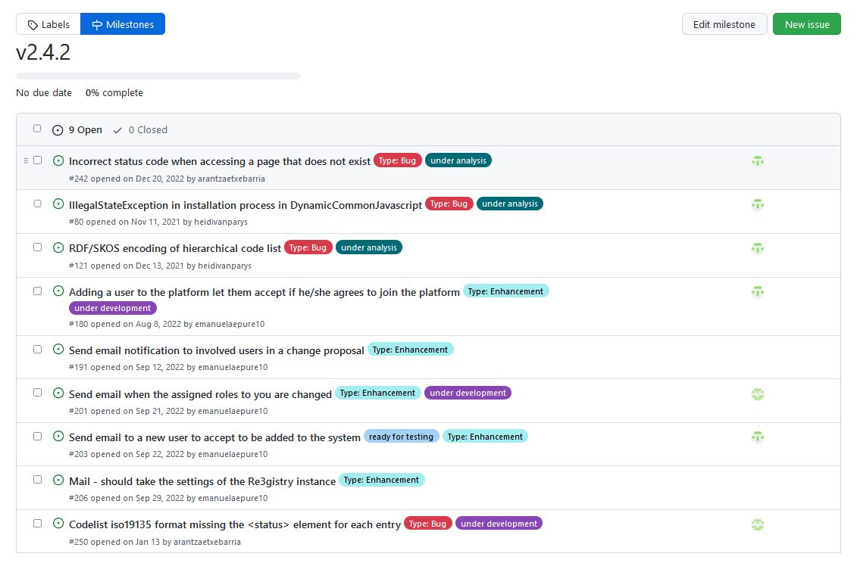
Re3gistry software
Next release
milestone
Available on GitHub
Issues for v2.4.2
https://github.com/ec-jrc/re3gistry/milestone/4

Slide 5


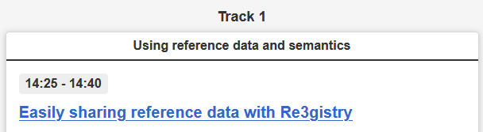

Re3gistry
Community building
Next planned activities
New Re3gistry video - Available soon
European Data Conference on
Reference Data and Semantics
https://op.europa.eu/en/web/endorse
https://op.europa.eu/en/web/endorse-2023/programme
  Demonstration (15/03, 12:15-13:15)
  Presentation (16/03, 14:25-14:40)
Google Summer of Code 2023
  Proposal submitted:
  https://wiki.osgeo.org/wiki/Google_Summer_of_Code_2023_Ideas
  https://github.com/ec-jrc/re3gistry/wiki/Google-Summer-of-Code-2023

Slide 6
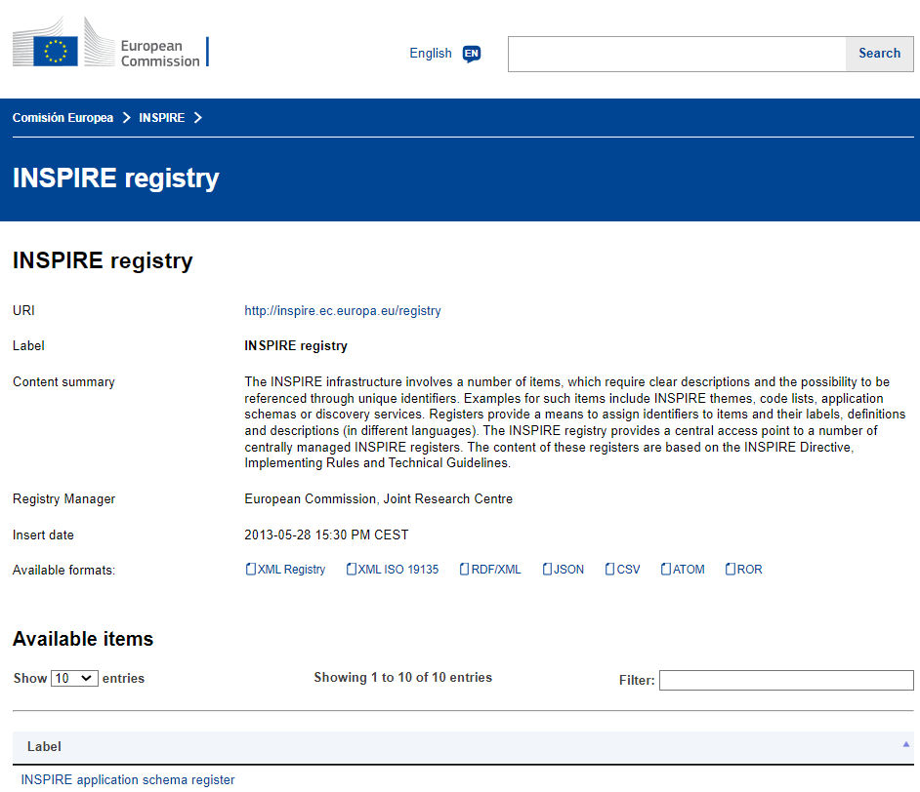
INSPIRE Registry
Software update
INSPIRE Registry v2 (Based on Re3gistry v2.3.1)
  Launch completed - 6 October 2022.
Evaluation
        The tool demonstrated good performance during the
        M&R 2022.
Maintenance and evolution
          Management workflow
          https://github.com/INSPIRE-MIF/helpdesk-registry/tree/main/helpdesk-management
          Issues
          https://github.com/INSPIRE-MIF/helpdesk-registry/issues
News item in INSPIRE Knowledge Base:
https://inspire.ec.europa.eu/news/update-inspire-registry-re3gistry-software-v2

Slide 7
INSPIRE Registry
Content management – Objectives 2023
Update the governance process, streamlining and simplifying it as much as possible to achieve an agile operation.
Processing the accumulated backlog of changes proposals to the INSPIRE Registry content, taking advantage of its administration interface (v2).
Proposals 73 MIG-T
Reactivate the operation according an updated governance process and release strategy, including periodic milestones.
Elect new members for the Control Body and reactivate its operation.
Update appointed Submitting organisations (SOs) and associated representatives.
Organise training sessions for SOs in the use of the INSPIRE Registry v2 administration Interface.
→ Specific proposals to be validated by the MIG-T today

Slide 8
INSPIRE Registry
Governance process proposal (73 MIG-T)
‘INSPIRE registry – Terms of Reference for the control body and submitting organisations’
Validate the current governance process:
  https://github.com/INSPIRE-MIF/helpdesk-registry/blob/main/registry-control-body-and-submitting-organisations.md (to be updated)
  With proposed minor updates:
    4. The control body shall regularly inform the MIG, particularly through its technical MIG-T sub-group, about its progress and can request guidance from the MIG when needed, particularly for issues, that may have far-reaching consequences for INSPIRE implementation in the Member States.
    5. Secretarial services shall be provided by the Joint Research Centre, who may delegate part of these tasks to the contractors operating the INSPIRE Registry.
    [ADD]: INSPIRE National Contact Points shall regularly (e.g. once a year) update the list of representatives for their Submitting organization.
Control body
Submitting organisations

Slide 9
INSPIRE Registry
Release strategy proposal (73 MIG-T)
3 releases over the year (1 month before each INSPIRE Reference Validator release)
  First annual release 202x.01 (15 February).
  Second annual release 202x.02 (15 May).
  Last annual release 202x.03 (15 August).
No release at the end of the year, to avoid interferences with the M&R.
Changed proposals included in each release – Milestones, until 1 month before the actual release:
  Milestone 202x.01 (16 July - 15 January)
  Milestone 202x.02 (16 January -15 April)
  Milestone 202x.03 (16 April - 15 July)
Proposed release plan:
https://github.com/INSPIRE-MIF/helpdesk-registry/tree/main/release%20strategy

Slide 10
INSPIRE Registry
Control body
Current composition
  5 organisations (4 National: AT, IT, DE / 1 EU level: EC-JRC) / 5 representatives – Status: outdated
  https://github.com/INSPIRE-MIF/helpdesk-registry/blob/main/control-body-list.md
Proposal (73 MIG-T)
  Election of 5 new members (3 National / 2 EU Level: 1 Chair from the EC).
  Suggested: Mixed composition, with sound Technical and/or Thematic expertise.
  If no candidates express their interest → Direct appointment (by EC-JRC).
Steps and Timing
  20–24 Feb….……..….. Expression of interest…….. Email to: jordi.escriu@ec.europa.eu
  27 Feb–3 Mar…..…..... Online poll (candidates)...... INSPIRE Registry helpdesk (launched 27 Feb)
  6 Mar….……………..... Official nomination………… INSPIRE Registry helpdesk + MIG-T mailing list

Slide 11
INSPIRE Registry
Submitting organisations (SO)
Current composition
  26 organisations (3 EU level) / 23 countries / 29 representatives – Status: outdated
  https://github.com/INSPIRE-MIF/helpdesk-registry/blob/main/submitting-organisations-list.md
Proposal (73 MIG-T)
  Update list of organisations and representatives, assuring representativeness:
    National: Each country shall have 1 SO / 1-2 representatives maximum.
    EU Level: SOs: DG-ENV, DG-JRC, DG-AGRI, EEA, EUROSTAT / 1 representative per DG/agency
  If no SO for a country / EU-level organisation → Contact country NCP - Inform the MIG, if no answer.
Steps and Timing
  20–24 Feb….……..….. Outreach & Promotion……. Email to: NCPs + Current representatives
  20 Feb–3 Mar…..…..... Propose representatives..... Email to: jordi.escriu@ec.europa.eu
  6 Mar….……………..... Official nomination………… INSPIRE Registry helpdesk + MIG-T mailing list

Slide 12



Re3gistry & INSPIRE Registry
Community feedback
New surveys will be available soon in EU-Survey
Promotion:
  Re3gistry software / INSPIRE Registry
  GitHub helpdesks:
    https://github.com/ec-jrc/re3gistry
    https://github.com/INSPIRE-MIF/helpdesk-registry
  INSPIRE Communication channels

Slide 13


Thank you!
© European Union 2023
Unless otherwise noted the reuse of this presentation is authorised under the CC BY 4.0 license. For any use or reproduction of elements that are not owned by the EU, permission may need to be sought directly from the respective right holders.
jordi.escriu@ec.europa.eu
Notes:
Update/add/delete parts of the copy right notice where appropriate.
More information: https://myintracomm.ec.europa.eu/corp/intellectual-property/Documents/2019_Reuse-guidelines%28CC-BY%29.pdf

Slide 14





Keep in touch
EU Science Hub: ec.europa.eu/jrc
@EU_ScienceHub
EU Science Hub – Joint Research Centre
EU Science, Research and Innovation
Eu Science Hub
Notes:
Delete/update as appropriate

